Slide 1
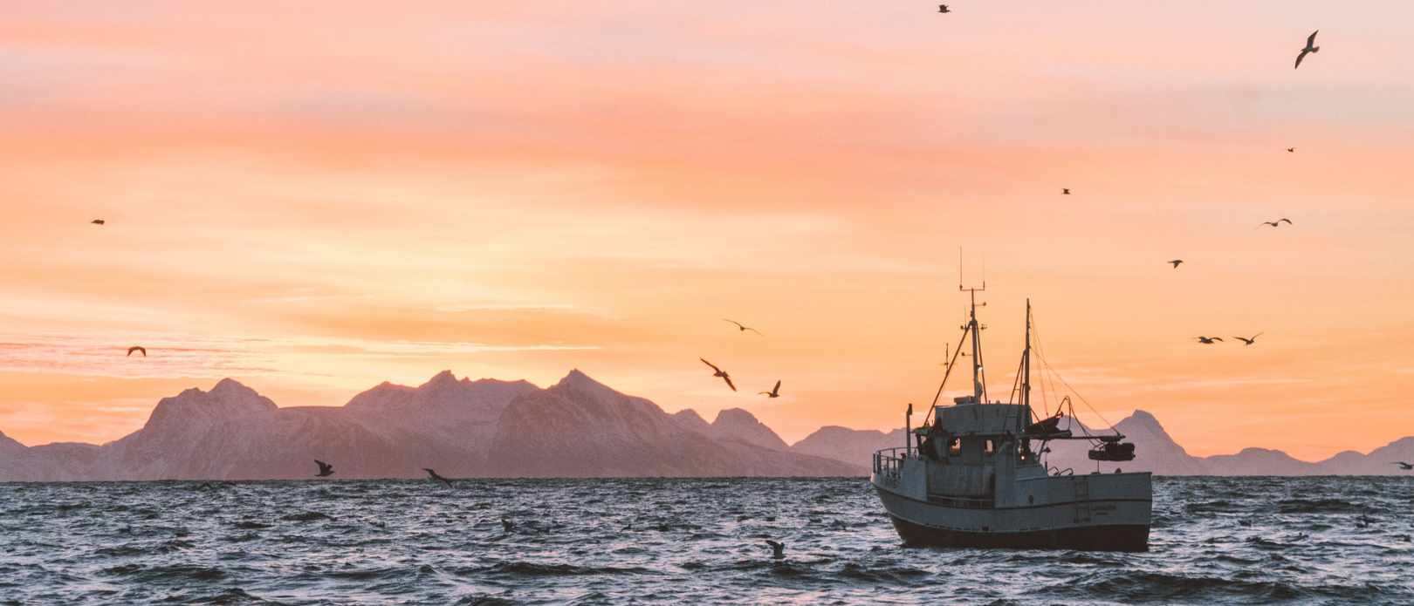
Business and Human Rights in the Fishing Industry
GBSN-UniGE, with inputs from the ILO
GBSN-HR supply chain research cluster
Based on the technical workshop on 30th Nov. – 2nd Dec. 2022

Slide 2
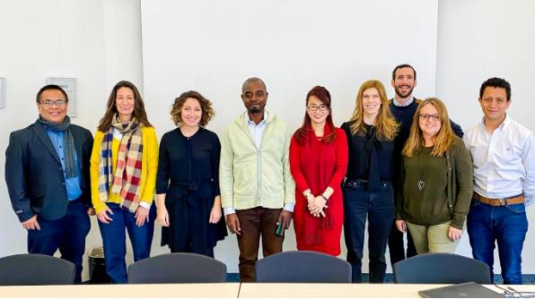
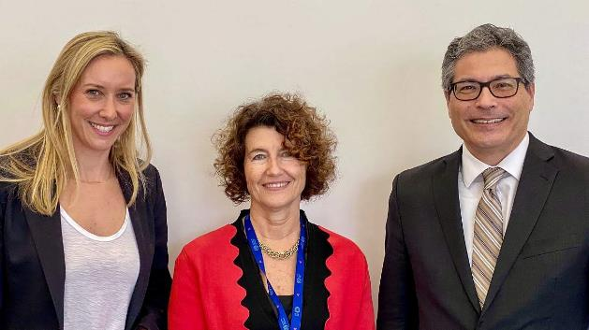
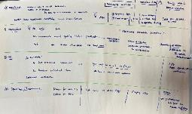
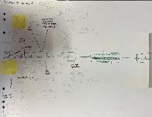
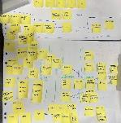
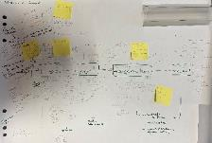
ILO-GBSN-UniGE Launch of MoU & Technical Workshop on Fishing

Slide 3
Learning objectives
1. Understand the importance and characteristics of global fish production (Unit 1)
2. Examine how the operations of fishing companies can lead to labor rights violations and, in some cases, to forced labor (Unit 2)
3. Map the different risks for businesses related to labor rights violations, including forced labor, in fishing and discover promising solutions to address them (Unit 3)

Slide 4
Agenda
Unit 0 – Setting the stage
Unit 1 – The fishing industry
Unit 2 – Human rights risks in the fishing industry
Unit 3 – Decent work in fishing

Slide 5
Agenda
Unit 0 – Setting the stage
Unit 1 – The fishing industry
Unit 2 – Human rights risks in the fishing industry
Unit 3 – Decent work in fishing

Slide 6

What does this picture have to do with today’s topic?
Mathias Erhart from Nenzing, Austria, CC BY-SA 2.0 <https://creativecommons.org/licenses/by-sa/2.0>, via Wikimedia Commons (https://commons.wikimedia.org/wiki/File:Red_Kitten_01.jpg,)

Slide 7
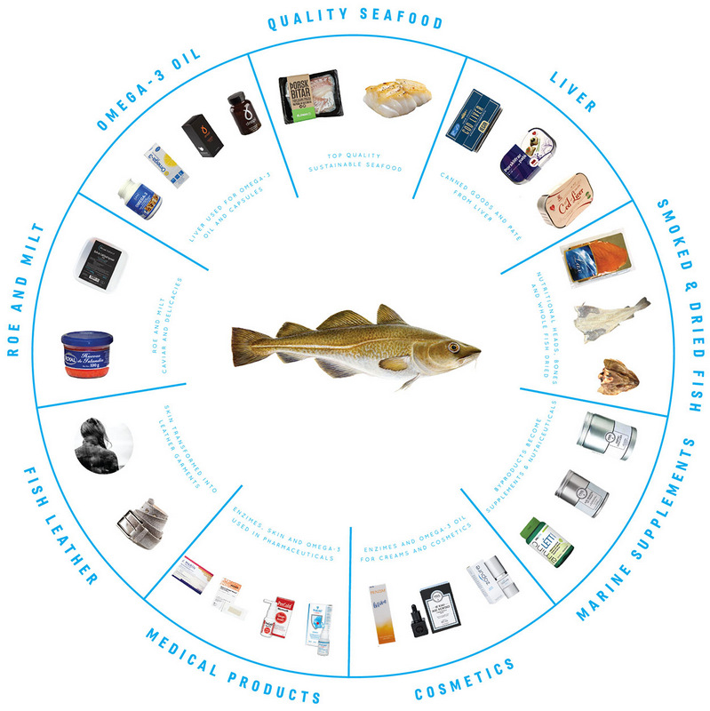
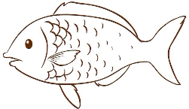
Which products contain fish?
Whole fish, dried fish, fish meal, head, bones, skin, liver, milt, roe, enzymes, omega 3 oil, …
https://www.sjavarklasinn.is/en/100-fish/; https://de.freepik.com/fotos-vektoren-kostenlos/fish-outline

Slide 8
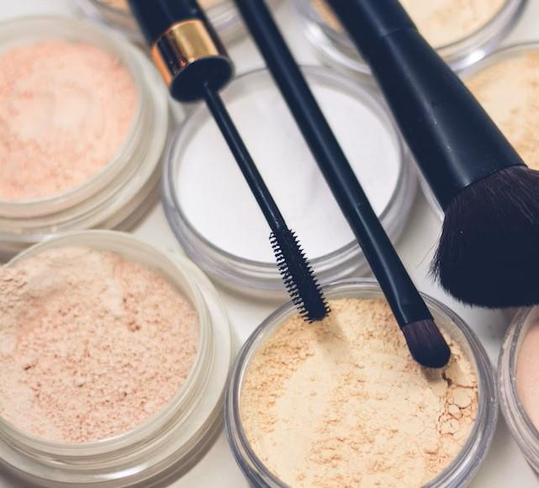
Which products contain fish?
Squalene (from Sharks): lip balms, tanning oils, creams and moisturizers
Guanine (from shimmering scales of fish): nail varnishes, lipsticks, eyeshadows, highlighters, bronzers and some mascaras
Collagen (from fish or other animals – e.g., from skin or bones): beauty products for elasticity and anti-wrinkles
https://unsplash.com/photos/DEuob2v77wI; https://www.greenqueen.com.hk/animal-ingredients-beauty-products/

Slide 9
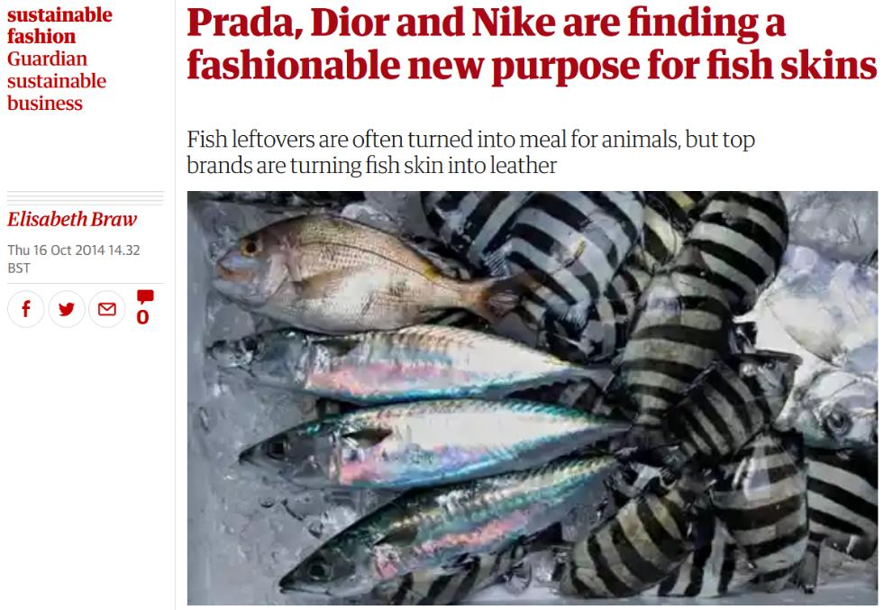
Sustainability of fish products?
Using all parts of the fish can increase the sustainability of fish use.
This sustainability discussion in fishing is focused on environmental aspects. People are concerned with the fish and fishers are often forgotten.
https://www.theguardian.com/sustainable-business/sustainable-fashion-blog/2014/oct/16/fish-skins-fashion-leather-prada-nike-dior

Slide 10

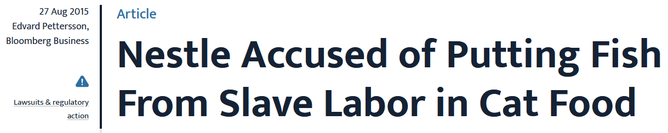
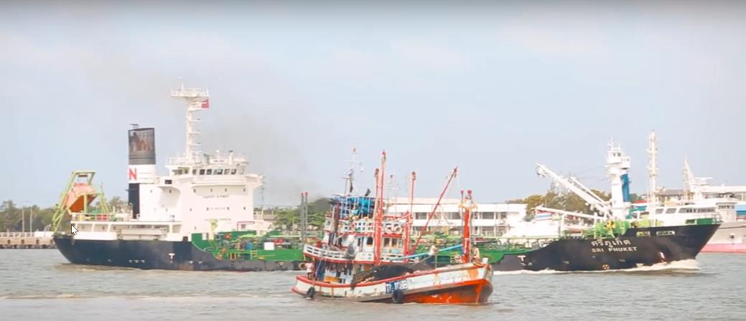
Why is this a BHR issue?
https://www.business-humanrights.org/en/latest-news/nestle-accused-of-putting-fish-from-slave-labor-in-cat-food/; https://www.youtube.com/watch?v=qTZUDHPts10

Slide 11
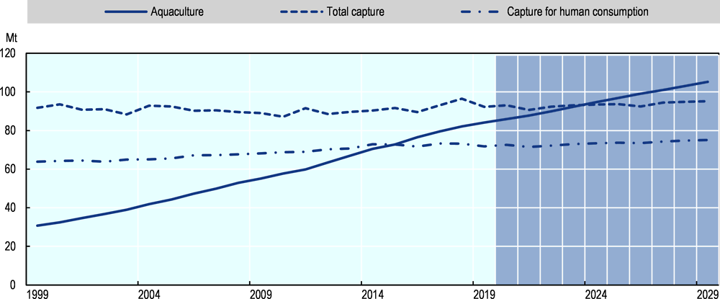
Increasing relevance of seafood
Projected 14% increase in global fish production
https://www.oecd-ilibrary.org/sites/4dd9b3d0-en/index.html?itemId=/content/component/4dd9b3d0-en

Slide 12
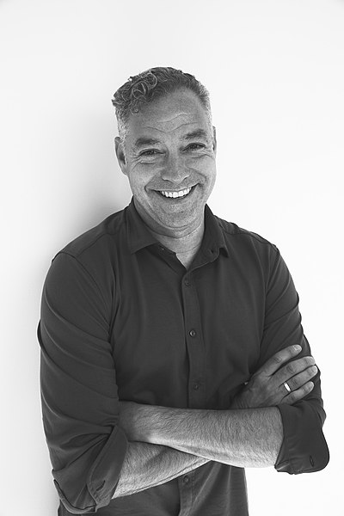
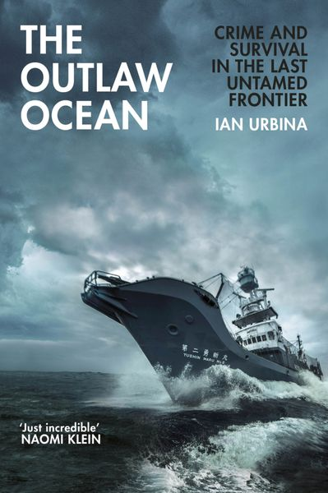
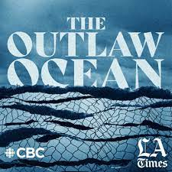
Documenting forced labor on fishing vessels
Ian Urbina, investigative journalist, author, and founder of the NGO “The Outlaw Ocean Project”
https://commons.wikimedia.org/wiki/File:Ian_Urbina.jpg; https://www.orellfuessli.ch/shop/home/artikeldetails/A1053059498; https://www.theoutlawocean.com/

Slide 13
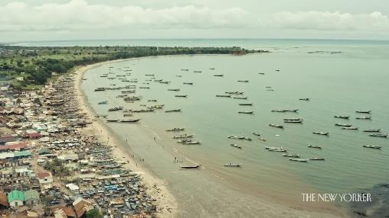
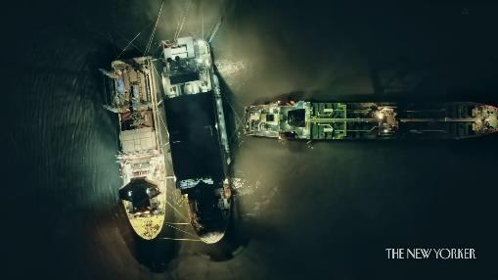
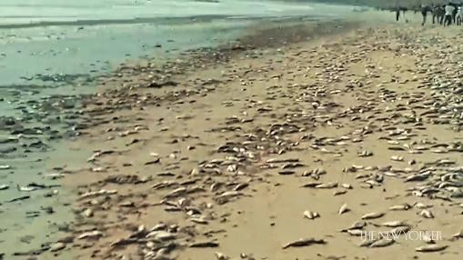
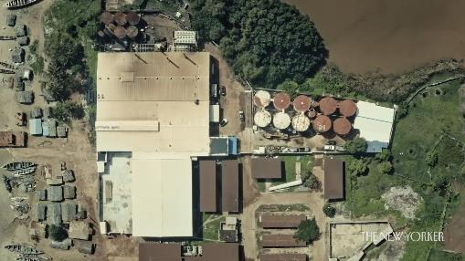
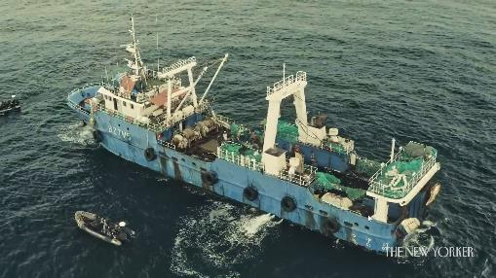
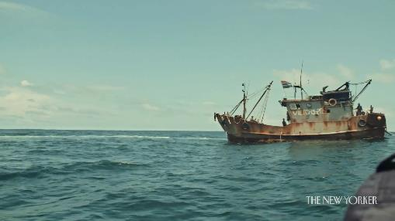
Urbina 2021: How fish-meal production is destroying Gambia’s waters
https://www.newyorker.com/video/watch/how-fish-meal-production-is-destroying-gambias-waters

Slide 14
Agenda
Unit 0 – Setting the stage
Unit 1 – The fishing industry
Unit 2 – Human rights risks in the fishing industry
Unit 3 – Decent work in fishing

Slide 15
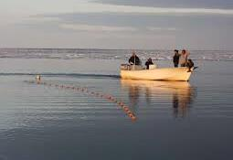
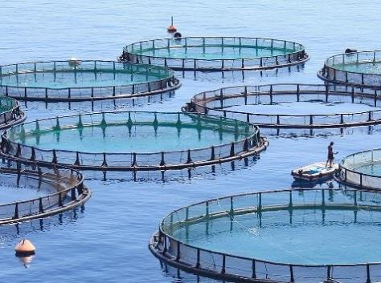
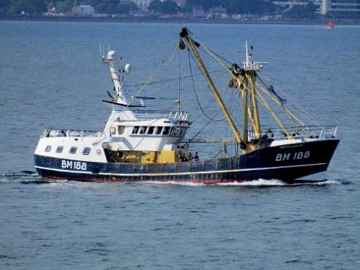
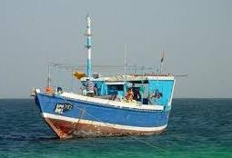
Subsistence fishing
Fishing for a living
Industrial fishing
Artisanal/ small-scale fishing
Aquaculture
Capture fishery
https://www.nps.gov/articles/aps-v12-i2-c10.htm; https://www.researchgate.net/figure/The-two-most-commonly-used-Artisanal-Fisheries-boats_fig3_301213420; https://commons.wikimedia.org/wiki/File:BM188_off_Berry_Head.jpg/; https://commons.wikimedia.org/wiki/File:Fish-farm-hero.jpg
Notes:
While artisanal and small-scale fishing also faces many decent work deficits, particularly with regards to a lack of social protection as it is almost entirely informal, this presentation will focus on capture fisheries and the specific issues of isolation, working hours, length of time at sea, etc.

Slide 16
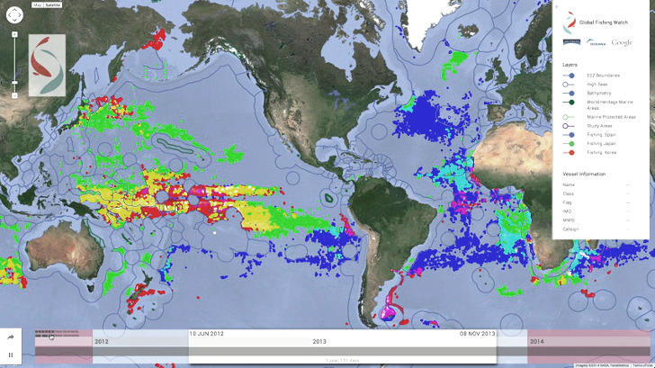
Global fishing industry
~ 38 million people work in the global fishing industry, 80% in Asia, 20% women.
+ ~ 20 million workers are employed in aquaculture.
In comparison: the forestry sector employs approx. 33 million people (approx. 1% of global employment).
~ 500-600 million livelihoods depend at least partially on fisheries and aquaculture.
~ US$ 141 billion value in sales for capture fisheries.
Illegal, Unregulated and Unreported (IUU) fishing is a global challenge, representing approx. 14-33% of global capture fishery (and up to 37% in West African waters).
Map showing different marine areas and
fishing activity from different countries.
https://inhabitat.com/global-fishing-watch-interactive-map-will-monitor-commercial-fishing/ (2014); https://www.worldbank.org/en/topic/oceans-fisheries-and-coastal-economies; https://www.fao.org/3/cc0461en/online/sofia/2022/transforming-aquatic-based-food.html; http://www.verite.org/wp-content/uploads/2016/12/Fishing-and-Aquaculture-Overview.pdf; http://www.gfintegrity.org/wp-content/uploads/2017/03/Transnational_Crime-final

Slide 17
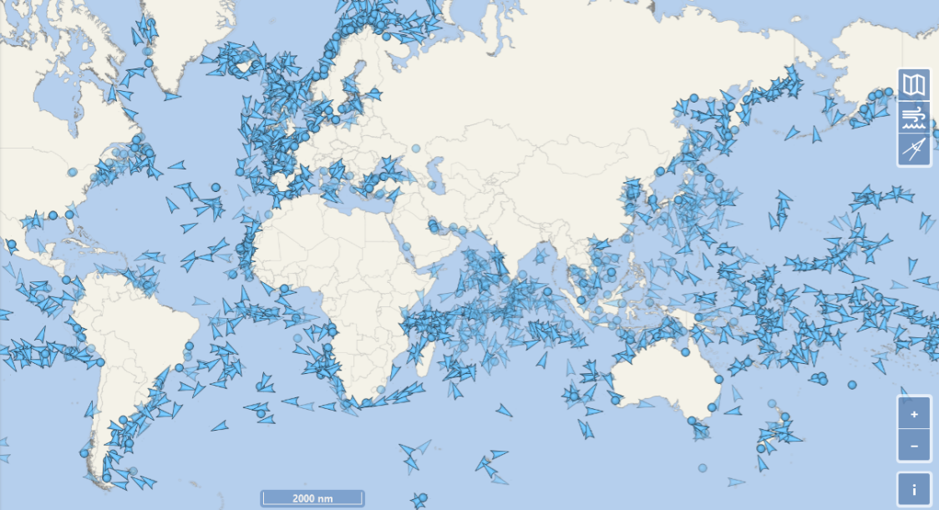
Fishing supply chain
Can you map the key stages of the fishing supply chain?
?
https://www.marinevesseltraffic.com/2013/02/fishing-boat-track.html; https://www.vesselfinder.com/

Slide 18
Fishing supply chain
Pet food
Retailers
Maritime waters
Stages in the Fishing supply chain
On-board vessels
Ports
Processing facilities
Consumers
B2B – B2C
Inland waters
Gastronomy
Cosmetics, Fabrics, …
Aqua-culture
Human rights risks
https://www.marinevesseltraffic.com/2013/02/fishing-boat-track.html; https://www.vesselfinder.com/

Slide 19
What do you know about the fishing industry?
?
Global production of fish is:
Increasing steadily since 1950
Increased from 1950 to 1990 and is now stalling
Increased from 1950 to 1990 and is now decreasing
Global production of fish is:
Predominantly composed of fishing
Evenly composed of fishing and aquaculture
Predominantly composed of aquaculture
The top 7 producers (China, Indonesia, Peru, India, Russia,
USA, and Viet Nam) of fish account for:
25% of world production
50% of world production
75% of world production

Slide 20
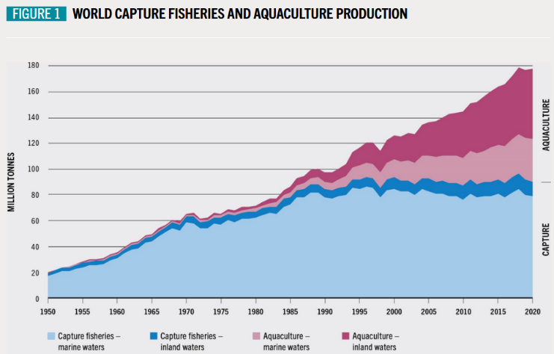
What do you know about the fishing industry?
Global production of fish is:
Increasing steadily since 1950
Increased from 1950 to 1990 and is now stalling
Increased from 1950 to 1990 and is now decreasing
Global production of fish is:
Predominantly composed of capture fishing
Evenly composed of fishing and aquaculture
Predominantly composed of aquaculture
The top 7 producers (China, Indonesia, Peru, India, Russia,
USA, and Viet Nam) of fish account for:
25% of world production
50% of world production
75% of world production

Slide 21
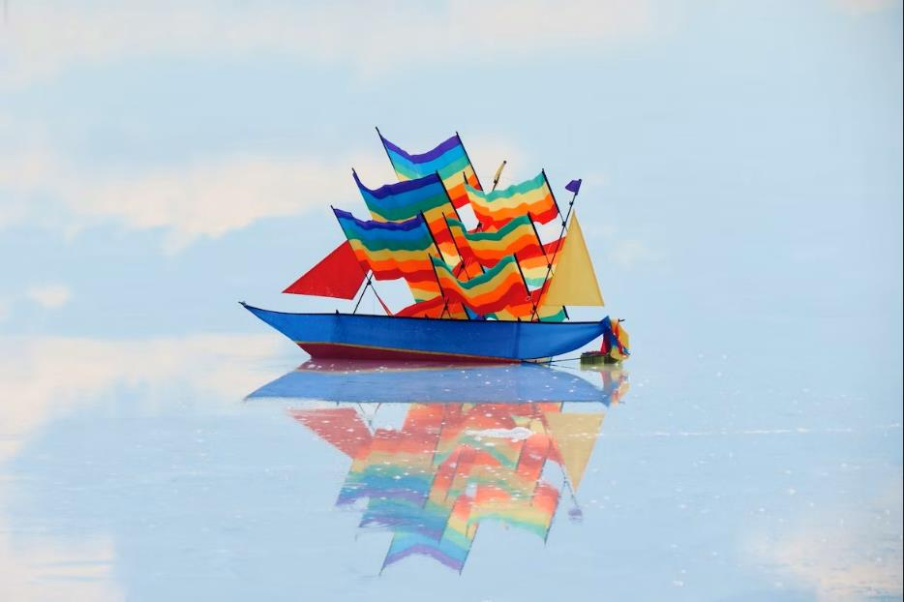
Governance gaps and responsibilities
Flag states: registration of vessels, exercise jurisdiction over vessels and control compliance with int’l conventions, national labor standards, and human rights
High seas: cover 64% of the ocean surface, states must cooperate (e.g., through regional fisheries bodies or international organizations)
Owners’ nationalities
Workers’ nationalities
Port states: legislation of the port’s location, inspection regime to prevent vessels suspected of IUU fishing from using ports and from bringing their produce to the national or int’l market
(see Port State Control, PCS)
Coastal states: sovereign rights for managing fishing activities within their EEZ (Exclusive Economic Zones), up to 200 nautical miles
Trade and Market States: involved in the processing, wholesale, and retail of fish and fish products. The main fish markets are found in the EU, the US, Japan and Australia.
https://unsplash.com/photos/VSxThTFyHGk

Slide 22
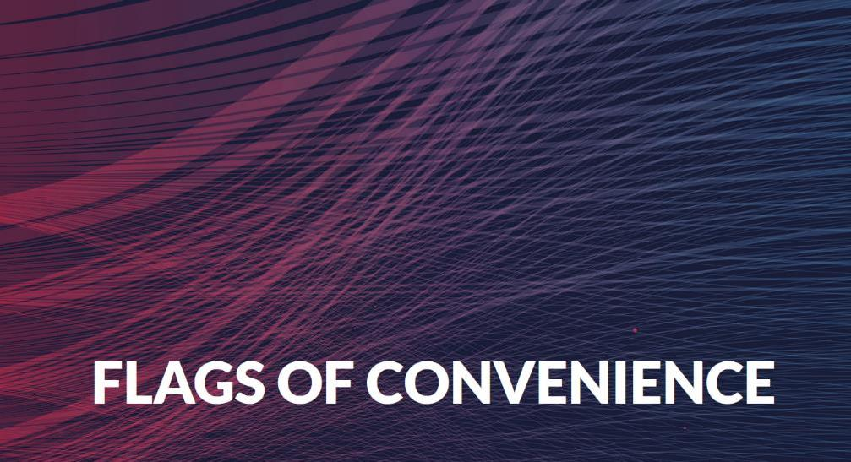
Flags of convenience
A flag of convenience vessel is one that flies the flag of a country other than the country of ownership.
For workers onboard, this can mean:
Very low wages
Poor on-board conditions
Inadequate food and clean drinking water
Long periods of work without proper rest, leading to stress
and fatigue
Associated with illegal, unreported, unregulated fishing (IUU)
Can be used to avoid regulations and controls
SOLAS = International Convention for the Safety of Life at Sea; MARPOL = International Convention for the Prevention of Pollution from Ships, LL66 = The International Convention on Load Lines, MLC2006 = Maritime Labour Convention (ILO), CLC FUND92 = International Convention on the Establishment of an International Fund for Compensation for Oil Pollution Damage
https://www.itfglobal.org/en/sector/seafarers/flags-of-convenience; https://shipbreakingplatform.org/issues-of-interest/focs/

Slide 23
Deep dive
Input from the Charles Autheman:
How does the international community try to regulate labor rights risks in the fishing industry?

Slide 24
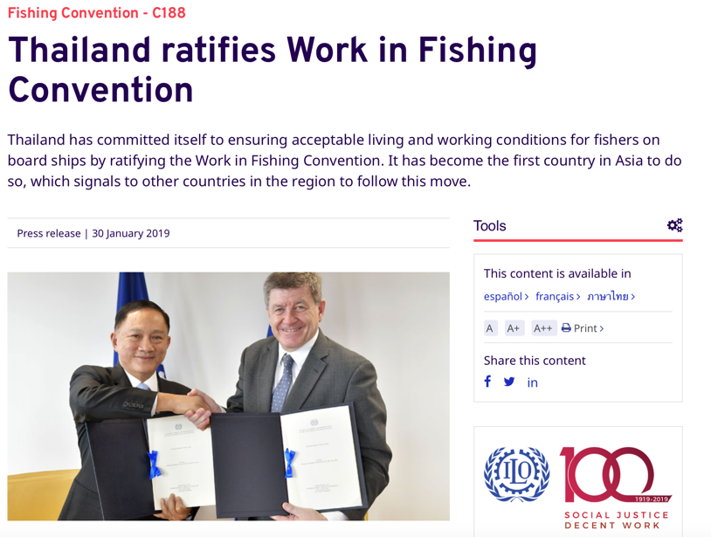
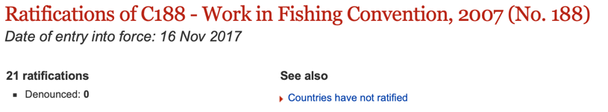
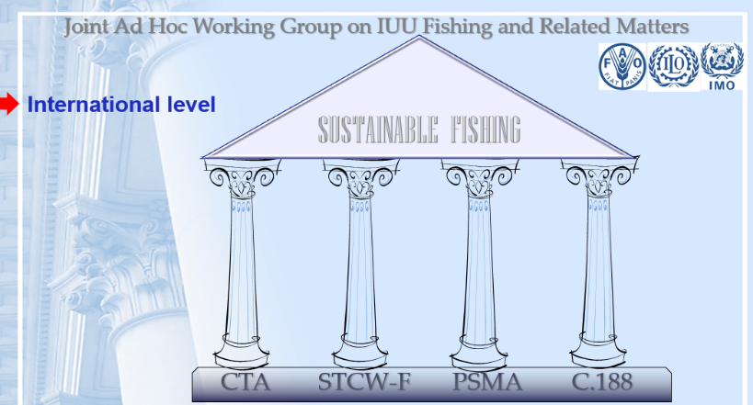
Regulations – International labor standards
https://www.ilo.org/global/about-the-ilo/newsroom/news/WCMS_666581/lang--en/index.htm

Slide 25
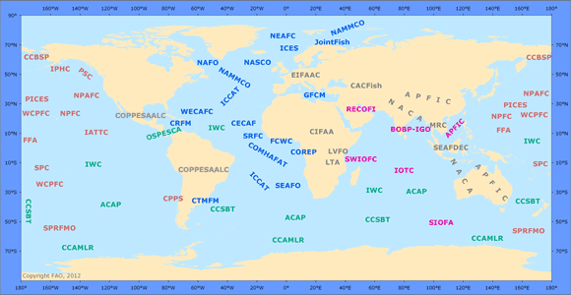
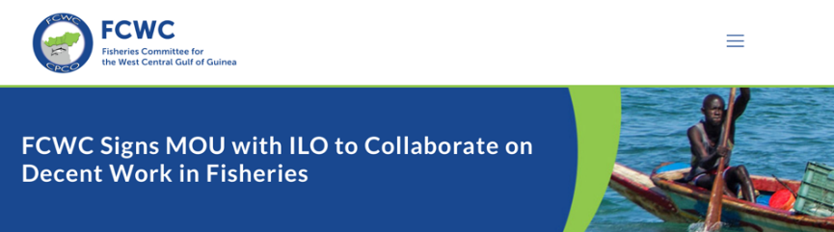
Regulations – Regional fisheries management organizations
https://www.fao.org/fishery/en/rfb; https://fcwc-fish.org/our-news/fcwc-signs-mou-with-ilo-to-collaborate-on-decent-work-in-fisheries

Slide 26
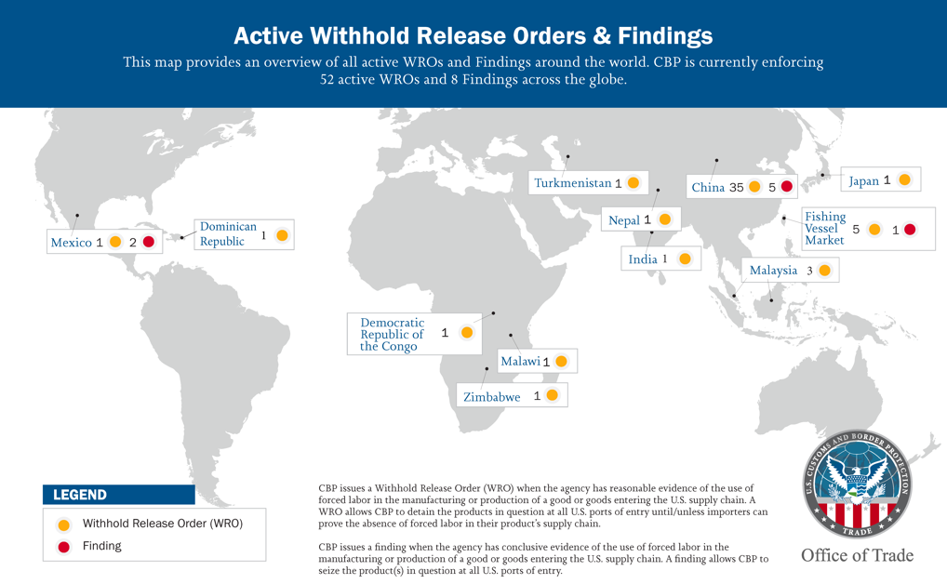
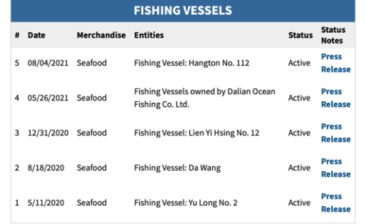
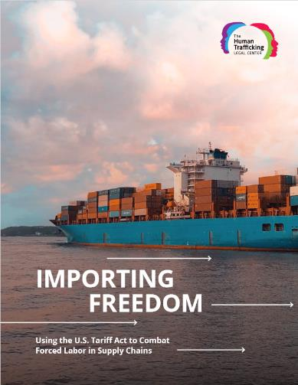
Regulations – Import bans and mHRDD
https://www.cbp.gov/trade/forced-labor/withhold-release-orders-and-findings; https://htlegalcenter.org/wp-content/uploads/Importing-Freedom-Using-the-U.S.-Tariff-Act-to-Combat-Forced-Labor-in-Supply-Chains_FINAL.pdf

Slide 27
Deep dive
Input from the ILO:
Why is it challenging to ensure decent work in the fishing industry?
Who is in charge of implementing labor rights on board fishing vessels?

Slide 28
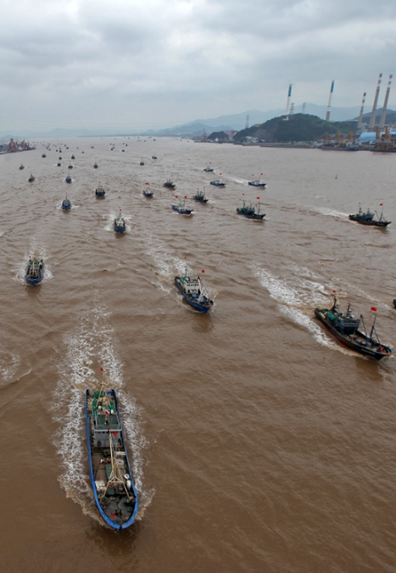
Establishing labor rights in fishing
General challenges
Transnational nature of the industry
Isolation
Declining fish stocks
Challenges for port inspectors
Sheer number of vessels calling into port
Many things to inspect
Limited human resources, labour inspectors not involved

Slide 29
Agenda
Unit 0 – Setting the stage
Unit 1 – The fishing industry
Unit 2 – Human rights risks in the fishing industry
Unit 3 – Decent work in fishing

Slide 30
Human rights risks in the fishing industry
Health and safety
Each year, over 100’000 fishing-related deaths occur, compared to 300 deaths per year in the shipping industry.
Privacy and communication
Workers often live in very tight living quarters and have sporadic cell phone reception.
Hours and wages
Working hours of 16-20 hours a day, seven days a week are common. Workers often experience debt bondage.
Isolation and time at sea
Workers in forced labor spend months or even years at sea without stepping on shore. Fishing, processing the fish, transshipments of the catch and vessel transfers of workers all take place at sea.
Trafficking and forced labor
The Pew Charitable Trusts (pewtrusts.org) ; see also: https://go.fishsafety.org/downloads/White%20Paper%20-%20Triggering%20Death%20-%20November%202022.pdf; https://www.tracit.org/uploads/1/0/2/2/102238034/tracit_forced_labor_and_illicit_trade_nov2021_final.pdf; https://theconversation.com/why-is-it-so-difficult-to-stamp-out-seafood-slavery-there-is-little-justice-even-in-court-152179 ; https://www.theguardian.com/world/2019/sep/21/such-brutality-tricked-into-slavery-in-the-thai-fishing-industry

Slide 31
Deep dive
Input from the ILO:
What is forced labor? How does ILO support governments, employers and workers to address forced labor in the fishing industry?

Slide 32
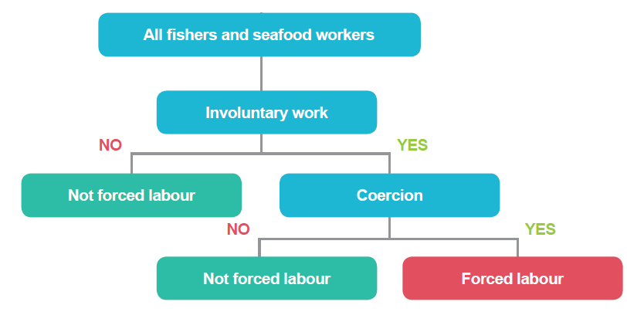
Identifying forced labor in fishing
ILO 2019 Advancing social justice, promoting decent work
Notes:
Forced labor = involuntariness + coercion: Involuntariness is not so hard to find, you’re expected to do something that you didn’t consent to in your contract (such as longer working hours, higher level of responsibility, or lower level of responsibility) – we can all be sold a lie. But you also need coercion, a means through which you find that you cannot leave the job you never signed up for. For example, that can be debt bondage, restriction of movement, a threat to withhold already accumulated wages until you complete the full year at sea.

Slide 33
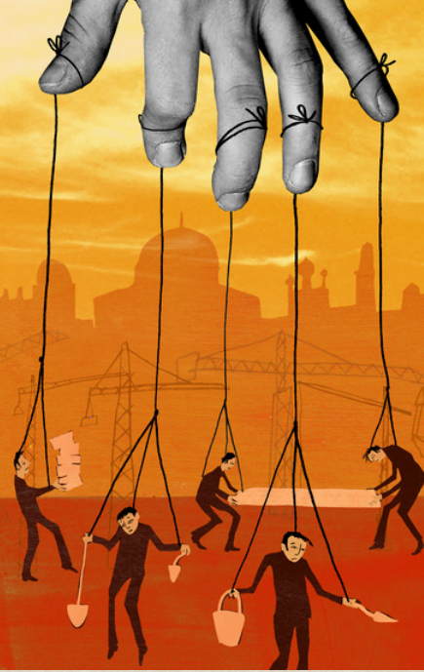
11 indicators / red flags of forced labor
Abuse of vulnerability
Deception
Restriction of movement
Isolation
Physical and sexual violence
Intimidation and threats
Retention of identity documents
Withholding of wages
Debt bondage
Abusive working and living conditions
Excessive overtime
Notes:
The ILO has developed a set of 11 indicators covering the main possible elements of a forced labor situation, which provides the basis to assess whether or not an individual worker is a victim of this crime. The presence of a single indicator in a given situation may in some cases imply the existence of forced labor. However, in other cases you may need to look for several indicators which, taken together, point to a forced labor case.

Slide 34
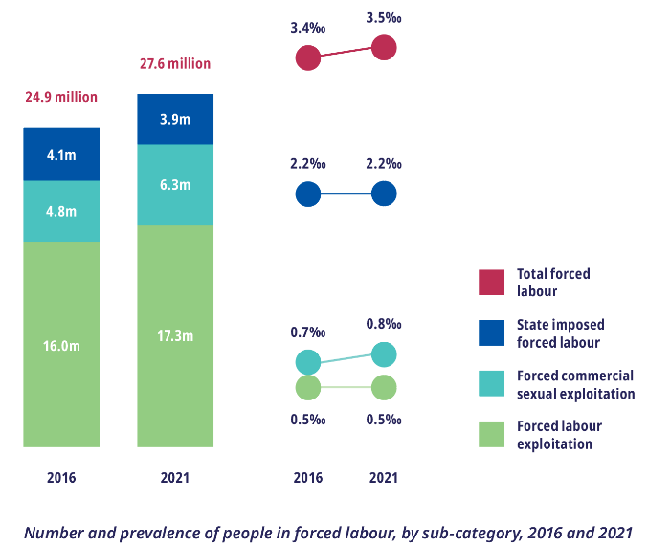
Forced labor trends
The increase in forced labor was driven entirely by forced labor in the private economy
128,000 fishers are trapped in forced labour aboard fishing vessels, often on the high sea, a workplace characterised by extreme isolation, hazardousness, and with gaps in regulatory oversight.
2021 Global Estimates of Modern Slavery: Forced Labour and Forced Marriage
Notes:
The figure 128’000 is considered to be a significant underestimation given the difficulties of conducting prevalence survey with fishers.

Slide 35
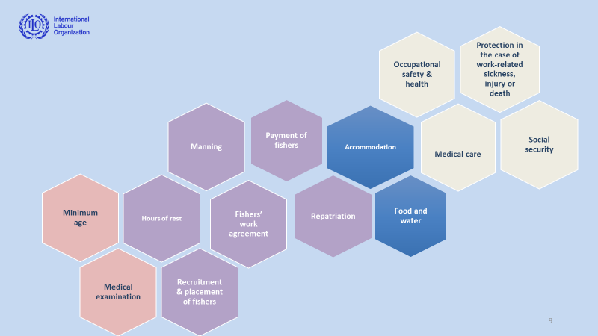
ILO Convention 188 and approaches to decent work
Notes:
The decent work approach to ending forced labor in the fishing industry aims at ensuring compliance with the “Work in Fishing Convention 188” in order to reduce the risk of forced labor, indicator by indicator.

Slide 36

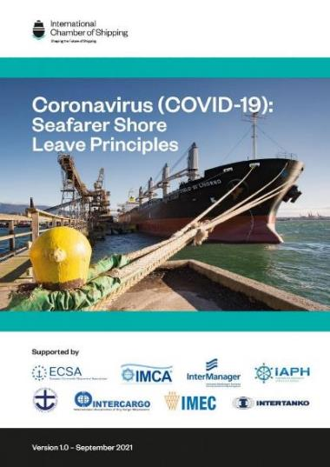
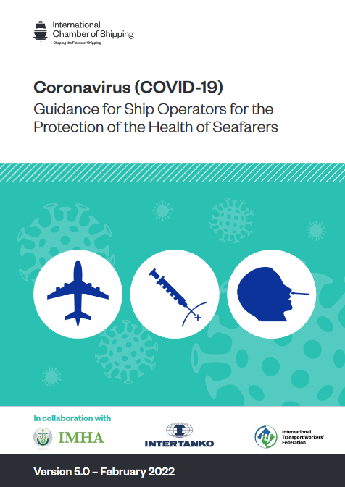
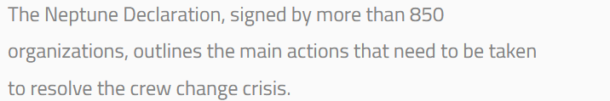
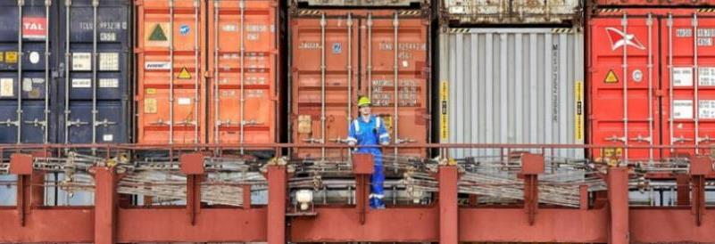
Covid-19 Implications for Seafarers
Earlier versions were withdrawn and replaced
https://www.ics-shipping.org/publication/coronavirus-covid-19-seafarer-shore-leave-principles/; https://www.ics-shipping.org/publication/coronavirus-covid-19-guidance-for-ship-operators-for-the-protection-of-the-health-of-seafarers-fifth-edition/

Slide 37
Agenda
Unit 0 – Setting the stage
Unit 1 – The fishing industry
Unit 2 – Human rights risks in the fishing industry
Unit 3 – Decent work in fishing

Slide 38
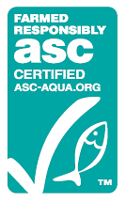





A focus on certifications schemes and their limitations
See also: FAO Regional Fishery Bodies Map Viewer, https://www.fao.org/figis/geoserver/factsheets/rfbs.html

Slide 39
Deep dive
Input from the ILO:
How effective are certifications and conventions for addressing forced labor?
How can technology help monitor labor abuses in the fishing industry?

Slide 40
Solutions: Labor inspection and strategic compliance
Ensure labor inspection of fishing vessels, which is often not performed.
  This can take the form of joint inspections where officials from multiple agencies conduct port-side inspections jointly: e.g., labor, maritime and fisheries inspectors.
  Labor inspection must include face-to-face interviews of skippers and fishers and document reviews with fishers, skippers, vessel owners
  Support strategic compliance and targeted inspections through risk assessment: use officials’ experience and judgment, fishing data and algorithms to measure forced labor risk and focus efforts on the fisheries, ports and vessels where the risk is highest
Focus on improving working conditions in a sustainable manner through support to sectoral trade unions and collective bargaining between workers and employers

Slide 41
Solutions: Monitoring
ILO Strategy and practices for forced labor identification in fishing (cont.):
?
What to look for | Indicator(s) of forced labor risks
What indicators would you look for when inspecting a fishing vessel at sea or in port? What would you observe, what would you ask, what document would you request?

Slide 42
Solutions: Monitoring
ILO Strategy and practices for forced labor identification in fishing (cont.):
What to look for | Indicator(s) of forced labor risks
Manning/crew size ratio | Abusive working conditions, excessive overtime
Days at sea | Restriction of movement, isolation, abusive working and living conditions (rebuttable resumption)
Crew list mismatch | Abuse of vulnerability
Invalid/ incomplete | Invalid/ incomplete licensing, taxes, labor records
Repetitive/ uniform hours records | Abusive working conditions, excessive overtime
Repetitive or mismatched pay records | Wage withholding, deception
Port-switching or trans-shipment | Isolation, deception

Slide 43












Digital technology actors working to address forced labor in fishing
Technologies for use by workers
Technologies for use by source/port/coastal states
Technologies for use by retailers/investors/end-consumers
See the ILO mapping of digital technologies addressing forced labour in the fishing industry , https://www.ilo.org/wcmsp5/groups/public/---ed_norm/---ipec/documents/publication/wcms_856925.pdf

Slide 44

Modern slavery statements: Example Trafigura (2022)
https://www.trafigura.com/media/3716/2022-trafigura-modern-slavery-statement.pdf

Slide 45



Modern slavery statements: Example Mars (2021)
https://www.mars.com/sites/g/files/jydpyr316/files/2022-08/Mars%202021%20Modern%20Slavery%20Act%20Statement.pdf
Notes:
In 2016, Mars launched the Thai Fish Supply Chain Human Rights Action Plan.
Mars is also a member of the ILO Global Business Network on Forced Labour.

Slide 46



Brands reactions to the AP documentary
“
[…] — and thus even businesses carefully tracking the provenance of the shrimp called the AP’s findings a surprise.
“I want to eliminate this,” said Dirk Leuenberger, CEO of Aqua Star. “I think it’s disgusting that it’s even remotely part of my business.”
Some, including Red Lobster, Whole Foods and H-E-B Supermarkets, said they were confident — based on assurances from their Thai supplier — that their particular shrimp was not associated with abusive factories. That Thai supplier admits it hadn’t known where it was getting all its shrimp and sent a note outlining corrective measures to U.S. businesses demanding answers last week.
”
Esther Htusan, Margie Mason, Robin McDowell and Martha Mendoza
https://www.ap.org/explore/seafood-from-slaves/

Slide 47


Brands – Reviewing Nestlé’s reaction and progress
https://www.theguardian.com/global-development/2015/nov/24/nestle-admits-forced-labour-in-seafood-supply-chain

Slide 48

Nestlé 2015: Response to forced labor in seafood supply chains
“Nestlé is committed to eliminating forced labour in our seafood supply chain in Thailand, working alongside other stakeholders to tackle this serious and complex issue.”
– Magdi Batato, Executive Vice President of Operations at Nestlé (2015)
https://www.nestle.com/media/news/nestle-tackles-abuses-seafood-supply-chain

Slide 49

Nestlé 2015: Action Plan (excerpt)
https://www.nestle.com/sites/default/files/asset-library/documents/library/documents/corporate_social_responsibility/nestle-seafood-action-plan-thailand-2015-2016.pdf

Slide 50
Nestlé: Collaborations to improve sourcing of fish
Partnerships and standards:
Stakeholder collaboration: Thai Government, the Seafood Taskforce (industry association), and suppliers
NGOs: Issara Institute (human trafficking and forced labor, grievance mechanisms), Verité (labor abuses in supply chains)
Sustainable Fisheries Partnership (SFP): sharing purchasing information, Target 75% Champion
International Union for Conservation of Nature Red List: to prevent illegal, unreported and unregulated (IUU) fishing
Audits, progress monitoring, accountability:
> 10% of vessels (Thailand) audited against the Seafood Task Force limited scope UL (Underwriters Laboratories) standard
Independent 3rd party vessel audits against the Thai Union Vessel Code of Conduct (VCoC)
Progress reports:
Nestlé responsible sourcing standard
Publication of sourcing regions
Regular progress reports for Nestlé’s seafood sourcing
Focus on Thailand but also working in other countries
https://www.nestle.com/media/news/nestle-tackles-abuses-seafood-supply-chain; https://www.nestle.com/sites/default/files/2019-07/nestle-supply-chain-disclosure-seafood-upstream.pdf
Notes:
Sustainable Fisheries Partnership (SFP): Target 75 aims to ensure that 75% of world production in key sectors is, at a minimum, either sustainable or making regular, verifiable improvements.

Slide 51


Nestlé 2017: Progress after 2-3 years
https://www.nestle-cwa.com/en/csv/raw-materials/fish-seafood; https://www.nestle.com/media/news/inauguration-demo-boat-thai-fishing-industry-Thailand; https://www.youtube.com/watch?v=qTZUDHPts10

Slide 52


Nestlé 2020: Latest update on responsible seafood supply chains
Nestlé’s 2020 progress report includes sections on:
Knowing where our seafood comes from and how it is produced
Collaborating on responsible vessel working conditions
The Business Case for Safe Working and Living Conditions
Worker Voice and Remediation
Multi-stakeholder collaboration
https://www.nestle.com/sites/default/files/2021-03/nestle-responsible-sourcing-seafood-progress-report-2020.pdf; https://www.nestle.com/sites/default/files/asset-library/documents/media/infographics/seafood-supply-chain-infographic.pdf; https://www.nestle.com/sustainability/sustainable-sourcing/fish-seafood

Slide 53



Towards decent work in the fishing industry
Example Ghana: dialogue between government, employers and trade unions
Example from South Africa: detention of foreign flagged vessels for non-compliance with ILO Convention no. 188 on Work in Fishing
Example of Indonesia: strengthening authorities to conduct joint labor inspections

Slide 54
Questions?
Do you have any remaining questions or reactions?
?

