Slide 1
Some thoughts on Research in (Financial) Accounting
Wayne Landsman
KPMG Distinguished Professor of Accounting
University of North Carolina
Copyright 2016
©2014

Slide 2
OUTLINE
Why do we do research?
What are the attributes of good research?
Examples from financial accounting
Concluding Remarks

Slide 3
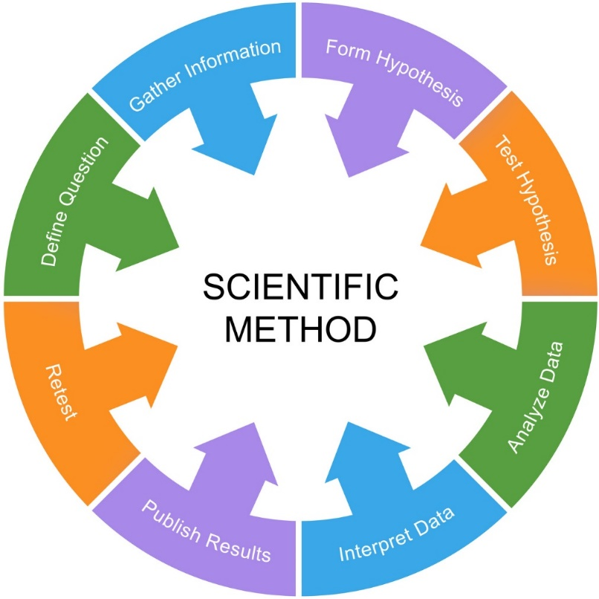
WHY DO WE DO RESEARCH?
Research is a process of discovery
Scientific method involves
Observation
Formulation of (parsimonious) theory
Testing the theory
Subjecting the theory to empirical scrutiny

Slide 4
WHY DO WE DO RESEARCH?
Research is a process of discovery
Revision of theory, or perhaps more observation, and repetition of the cycle

Slide 5
WHY DO WE DO RESEARCH?
Research should not be conducted with the goal of proving a “theory” the researcher believes
Priors can be accommodated when conducting statistical tests, but should be subject to Bayesian revision when evidence is gathered from empirical data.

Slide 6
WHY DO WE DO RESEARCH?
Research should not be conducted with the goal of proving a “theory” the researcher believes
Age-old debate between normative/positive economists will never be resolved—there is room for both normative and positive theory in the scientific method.

Slide 7
WHY DO WE DO RESEARCH?
IN ACCOUNTING?
Examine the role of accounting information in affecting managerial decisions
Focus can be on contracting theory and/or tests of implications of contracting theories
Examine the role of accounting information in affecting decisions of capital suppliers (investors, creditors), informational intermediaries (analysts).

Slide 8
WHY DO WE DO RESEARCH?
IN ACCOUNTING?
To inform standard setters and regulators
How users of financial accounting information make decisions based on such information
Whether accounting amounts, as reflected in security prices (debt and equity), have desired attributes.
Examples—Are ESO expenses valued as expenses? Are financial instruments’fair values valued as assets and liabilities?

Slide 9
WHY DO WE DO RESEARCH?
IN ACCOUNTING?
Examine how auditors make judgments based on accounting information
Includes experimental designs (e.g., how do auditors process information) and empirical (e.g., are their audit pricing decisions reflective of risks as reflected by accounting data)?
List is not meant to be exhaustive

Slide 10
WHY DO WE DO RESEARCH?
IN ACCOUNTING?
Practical considerations
Remaining current in our field makes us better colleagues, more marketable, and better teachers.
For example:
I teach financial reporting (“intermediate” accounting). Many current topics—ESOs, derivatives, asset securitizations—are quickly evolving and won’t be in textbooks for years to come. It would be impossible to teach the course without staying current.

Slide 11
WHY DO WE DO RESEARCH?
IN ACCOUNTING?
Practical considerations
Remaining current in our field makes us better colleagues, more marketable, and better teachers.
For example:
In addition, insights gained from research permit us to provide a broader understanding of how various accounting issues affect real outcomes in the economy, more than just the debits and the credits.
ESOs (SFAS 123)— the “Rally in the (Silicon) Valley”
FASB’s FIN 46R and SPEs.

Slide 12
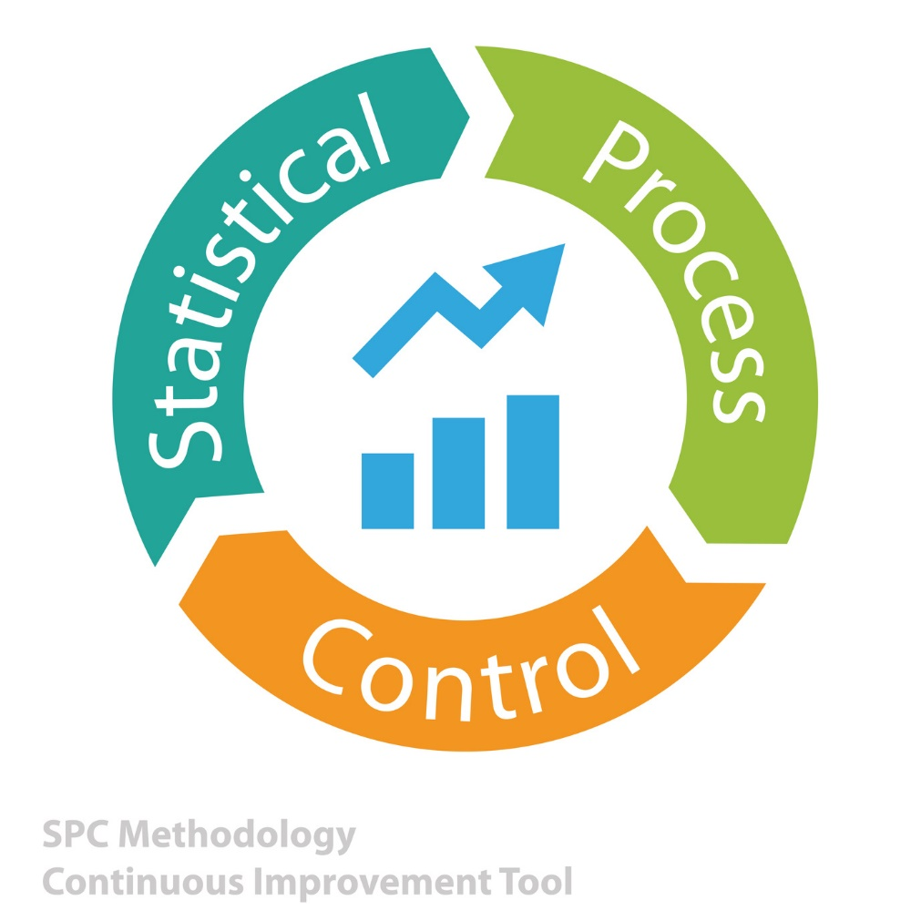
WHAT ARE THE ATTRIBUTES OF RESEARCH?
Returning to the scientific method, good research is grounded in (economic/psychological/sociological) theory and relevant tests should be conducted without investigator bias and with knowledge of the empirical properties of data gathered to test the theory.

Slide 13
WHAT ARE THE ATTRIBUTES OF RESEARCH?
Most (not all) financial accounting studies use archival data
Benefits:
Data often readily available in computer readable form.
Large time series and cross-sectional samples usually available, increasing power of tests
Others can replicate the studies
Aside: Replicability is a desirable attribute, i.e. good research

Slide 14
WHAT ARE THE ATTRIBUTES OF RESEARCH?
Most (not all) financial accounting studies use archival data
Costs:
Investigator cannot conduct a controlled experiment
Representative sampling may be compromised
Other things are not held constant—only variance-covariance matrix of archived data is observable
Limits internal validity, i.e., ability to rule out alternative explanations

Slide 15
WHAT ARE THE ATTRIBUTES OF RESEARCH?
Most (not all) financial accounting studies use archival data
Costs:
Use the same data repeatedly when replicating or extending prior work, limiting ability to draw inferences from the body of work.

Slide 16
WHAT ARE THE ATTRIBUTES OF RESEARCH?
Other financial accounting studies use experimental data
Benefits:
Investigator can conduct a controlled experiment
Example: Experimental markets studies can limit the signals market participants receive
Costs
Labs can be costly to setup
Sample sizes are often small
Others cannot easily replicate prior studies

Slide 17
WHAT ARE THE ATTRIBUTES OF RESEARCH?
Other financial accounting studies use experimental data
Benefits:
Investigator can conduct a controlled experiment
Example: Experimental markets studies can limit the signals market participants receive
Costs
Suffer from external validity—generalizability
What do lab results based on undergraduate students facing different risk/return tradeoffs say about how financial analysts (or auditors) would behave in real settings?

Slide 18
WHAT ARE THE ATTRIBUTES OF RESEARCH?
Role of economic theory (other theories may be appropriate too--I use economic theory as an illustration)
Absent economic theory, developed either in prior work or the current study, empirical work can only be characterized as descriptive.
Theory must make sense, not “unravel”.
General equilibrium arguments (allowing full endogeneity) are almost impossible, but the partial equilibrium models need to make sense

Slide 19
WHAT ARE THE ATTRIBUTES OF RESEARCH?
Role of economic theory (other theories may be appropriate too--I use economic theory as an illustration)
Absent economic theory, developed either in prior work or the current study, empirical work can only be characterized as descriptive.
Theory should have some “tension” in that a sensible competing or alternative explanation is feasible.
Absent such a tension, the empirical result is virtually guaranteed unless the research design is flawed in some way.

Slide 20
WHAT ARE THE ATTRIBUTES OF RESEARCH?
Role of economic theory (other theories may be appropriate too--I use economic theory as an illustration)
Absent economic theory, developed either in prior work or the current study, empirical work can only be characterized as descriptive.
Theory should have some “tension” in that a sensible competing or alternative explanation is feasible.
Remember, our goal is to test a theory that could be wrong, with the goal of learning something.

Slide 21
WHAT ARE THE ATTRIBUTES OF RESEARCH?
Role of economic theory (other theories may be appropriate too--I use economic theory as an illustration)
Absent economic theory, developed either in prior work or the current study, empirical work can only be characterized as descriptive.
Descriptive studies aren’t “bad” in that such studies can be viewed as the observational step in the scientific method

Slide 22
WHAT ARE THE ATTRIBUTES OF RESEARCH?
There is no role for investigator bias.
Affects independence and integrity of the research
This is a real problem, manifested in many ways, as investigator makes decisions regarding:
Sampling
Selection of functional form of estimating equation (should be tied to theory—see Landsman and Magliolo (TAR, 1998).
Inclusion/exclusion of “outliers”
Inclusion/exclusion of experimental variables

Slide 23
WHAT ARE THE ATTRIBUTES OF RESEARCH?
Empirical Tests
Biggest problems researcher faces are:
Models often stated in terms of variables that are unobservable to researcher
Example: Miller and Modigliani (AER, 1966) test a model relating firm value to economic earnings, not accounting earnings.

Slide 24
WHAT ARE THE ATTRIBUTES OF RESEARCH?
Empirical Tests
Biggest problems researcher faces are:
Models often stated in terms of one theoretical unit (firm) at a specific point in time.
Use of Cross-sectional data requires either assuming all firms in cross-section are the “same” in terms of relevant variables included in the study or making adjustments in the research design to address cross-sectional differences in firms’ measured attributes
Example: Tests of the Ohlson model (Barth, Beaver, Hand, and Landsman, RAST, 1999; Dechow, Hutton, and Sloan, JAE, 1999) assume constant discount rate, but BBHL permit coefficients to vary by industry.

Slide 25
WHAT ARE THE ATTRIBUTES OF RESEARCH?
Empirical Tests
Biggest problems researcher faces are:
Models often stated in terms of one theoretical unit (firm) at a specific point in time.
Use of time-series data requires either assuming the distributional properties of the data for a given firm are stable over time (stationarity), or making adjustments to allow for changes in such properties (e.g., use of time-varying coefficients).
DHS and BBHL pool observations across time and assume coefficients are intertemporal constants.

Slide 26
WHAT ARE THE ATTRIBUTES OF RESEARCH?
Empirical Tests
Biggest problems researcher faces are:
Researchers cannot conduct a controlled experiment. As a result, some potentially significant variables, not the focus of the study, are not appropriately controlled for, and, by design, are not directly observable.
Leads to correlated omitted variable bias (internal validity concern)
Potential solutions: include proxies for the variables, limit sample observations for which the omitted variable is likely not varying.

Slide 27
WHAT ARE THE ATTRIBUTES OF RESEARCH?
Empirical Tests
Biggest problems researcher faces are:
Researchers cannot conduct a controlled experiment. As a result, some potentially significant variables, not the focus of the study, are not appropriately controlled for, and, by design, are not directly observable.
Example: ERC studies (event studies relating earnings surprises to stock returns) have a problem in that other information, e.g., dividends, are released at the same time as earnings.
Potential solutions: Include dividends or change in dividends in the regression or study firms for which dividends are not concurrently announced.

Slide 28
WHAT ARE THE ATTRIBUTES OF RESEARCH?
Institutional accounting knowledge
Helps frame research questions
Helps develop the research design by understanding
the economic forces affecting model predictions
properties of accounting data (e.g., measurement error) and how they can affect inferences
Barth (TAR, 1991) study of pension accounting is excellent example
ways to develop (quasi) experimental controls, e.g., by inclusion of conditioning variables.
Barth, Beaver, and Landsman (TAR, 1996) use of conditioning variables

Slide 29
AN EXAMPLE FROM FINANCIAL ACCOUNTING
Miller and Modigliani (AER, 1966)
“Some Estimates of the Cost of Capital to the Electric Utility Industry, 1954-57”
Finance research closely linked to accounting
M&M test their famous equity valuation theoretical model using a sample of electric utilities for three fiscal years in the 1950s.
The model:
V = 1/ρ X + OTHER
Where
V is equity value
is the cost of equity capital
X is economic earnings

Slide 30
AN EXAMPLE FROM FINANCIAL ACCOUNTING
Miller and Modigliani (AER, 1966)
Potential problems
While V is observable, X is not. Not even clear if “economic earnings” is well-defined concept.
Use accounting earnings, E, which can lead to biased estimate of cost of capital, ρ .
Cost of capital is firm-specific, but sample includes cross-section at three points in time.
Heteroscedastic errors are likely because of large size disparity among sample firms.
Loss of efficiency (bias in t-statistics)

Slide 31
AN EXAMPLE FROM FINANCIAL ACCOUNTING
Miller and Modigliani (AER, 1966)
Solutions:
X is not well defined.
But electric utilities are rate-regulated, so earnings and value are more closely linked theoretically.
Using accounting earnings, E, can lead to biased estimate of cost of capital, ρ .
Assume E = X + random error.
Estimate a 2SLS instrument, in which E is regressed on dividends in the first stage, and fitted value of E is included in second stage V regression.

Slide 32
AN EXAMPLE FROM FINANCIAL ACCOUNTING
Miller and Modigliani (AER, 1966)
Solutions:
Cost of capital is firm-specific, but sample includes cross-sectional sample at three points in time.
ρ is likely to vary depending on risk, but electric utilities is similar risk class (rate regulated).
Relation between E and X can vary because of differences in accounting practices, but electric utilities use similar accounting practices
Heteroscedastic errors are likely because of large size disparity among sample firms.
After considering a variety of approaches, settle on deflation by total assets.
Large literature has evolved around scale problem (see Barth and Kallapur, CAR, 1996).

Slide 33
AN EXAMPLE FROM FINANCIAL ACCOUNTING
Miller and Modigliani (AER, 1966)
Why estimate model for three years?
Opportunity to document that cost of equity capital varies with economic environment (one boom year, one average year, and one recession year).
M&M show, that after controlling for measurement error bias in using E instead of X, dividends, D, does not affect value, i.e., they illustrate dividend irrelevancy.
Regression of V on E and D will lead to biased estimate of ρ and lead to the incorrect conclusion that D relates to V.
Regression of V on E* (fitted value of E) and D shows higher estimate of 1/ρ and insignificant coefficient on D.

Slide 34
CONCLUDING REMARKS
Research is a life long process of discovery
Research is governed by the scientific method
Good research involves
Linking tests to economic models
Understanding the properties of data used to test the models’ predictions
Investment in institutional knowledge
Ask interesting questions
Work on topics you finding interesting
Don’t limit research to extending prior research findings
Work with colleagues whose skills and interests complement your own

Slide 35
Thank you.
Wayne Landsman
KPMG Distinguished Professor of Accounting
University of North Carolina
Copyright 2016
©2014

