Slide 1
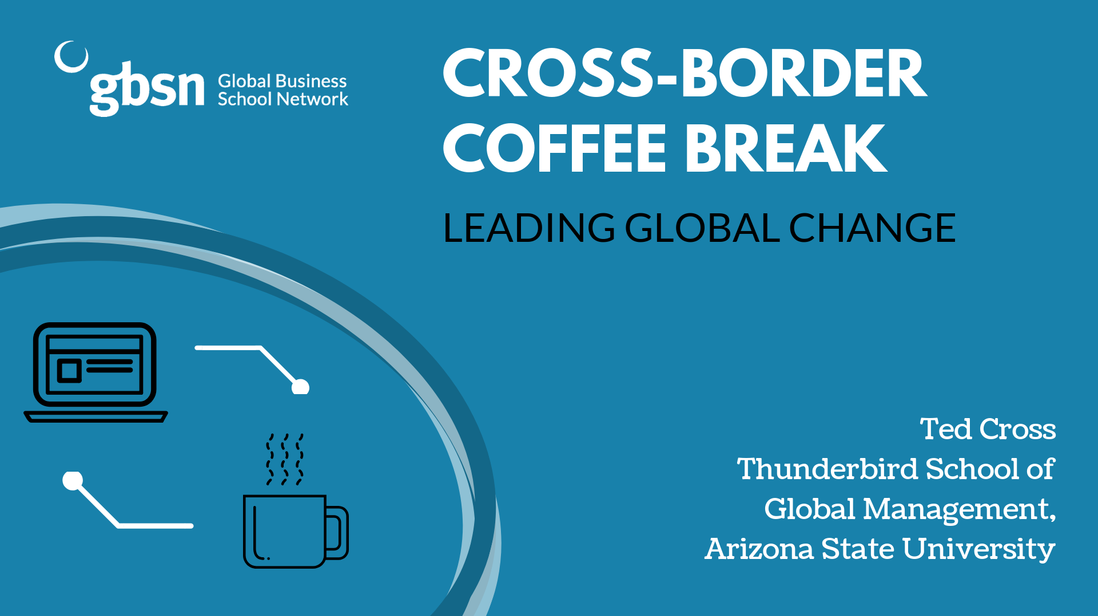

Slide 2

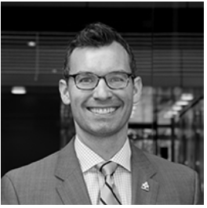

FACILITATOR
PRESENTER
Ted Cross
Clinical Assistant Professor of Leadership and Management
Director of the Master of Applied Leadership and Management Program
Thunderbird School of Global Management, Arizona State University
Fabienne Jolivert
Executive Director
Global Business School Network

Slide 3
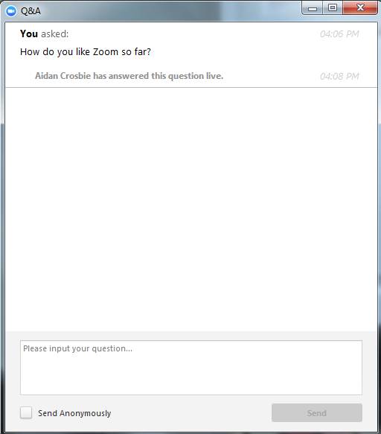

HOW TO SUBMIT A QUESTION ON ZOOM

Slide 4
AGENDA
Overview of the Global Business School Network
Leading Global Change:
  Fear of Globalization
  Change Models
  Barriers to Change & How to Overcome Them
III. Question & Answer

Slide 5
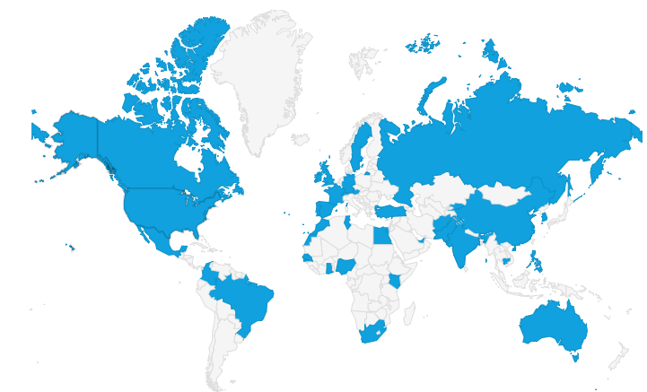
GBSN: 73 Members in 40 Countries
Mission:
Improve access to quality, locally relevant management education for the developing world.
What We Do:
Promotion of Best Practice
Capacity Building Programs
Foster a Network & Partnerships
More info: gbsn.org

Slide 6


Leading Change
Dr. Ted Cross
Notes:
Recently moved- boxes– week out still have a boxes… stuff… lots of stuff we have does it make us happy…. If not what does…

Slide 7

Why asu and thunderbird
The Problem(s)
Globalization
has an image problem
Notes:
I am a naturally pessimsitic person…. Grad school… Pos Psys

Slide 8
People hear the word globalization and think about loosing their jobs identities, and wealth.

Slide 9

Why asu and thunderbird
Headlines
Notes:
I am a naturally pessimsitic person…. Grad school… Pos Psys

Slide 10
No doubt that
Some jobs and industries, in some places, have suffered due to globalization.
Notes:
Moved from happiness to well being

Slide 11
Why asu and thunderbird
Overestimating Bad, Underestimating Good
Only 3% of all phone calls made in the world each year are international (Pankaj Ghemawat, 2017)
Notes:
I am a naturally pessimsitic person…. Grad school… Pos Psys

Slide 12
Why asu and thunderbird
Overestimating Bad, Underestimating Good
Only 10% of all investments in the world each year are made across boarders
Notes:
I am a naturally pessimsitic person…. Grad school… Pos Psys

Slide 13
Why asu and thunderbird
Overestimating Bad, Underestimating Good
Less than 10% of people’s friends on Facebook live in a different country
Notes:
I am a naturally pessimsitic person…. Grad school… Pos Psys

Slide 14
Why asu and thunderbird
Overestimating Bad, Underestimating Good
In 1990 23% of the world’s population was Middle Class. Today 45% are (Homi Kharas)
Notes:
I am a naturally pessimsitic person…. Grad school… Pos Psys

Slide 15
Why asu and thunderbird
Overestimating Bad, Underestimating Good
1 in 5 jobs in Phoenix, AZ is tied to global trade (Morrison, 2018)
Notes:
I am a naturally pessimsitic person…. Grad school… Pos Psys

Slide 16
Why asu and thunderbird
Overestimating Bad, Underestimating Good
Borders frequented by trade seldom need soldiers
Notes:
I am a naturally pessimsitic person…. Grad school… Pos Psys

Slide 17
Why asu and thunderbird
Overestimating Bad, Underestimating Good
“The inability to adapt as fast as technology changes leaves us feeling disoriented and rudderless-- and for good reason. Citizens are left wondering what has happened to their country. Employees are left worrying about their career futures.” (Allen Morrison, 2018)
Notes:
I am a naturally pessimsitic person…. Grad school… Pos Psys

Slide 18
Core problem is that
human beings are resistant to change, and nothing symbolizes change more than globalization.
Notes:
Moved from happiness to well being

Slide 19
Why asu and thunderbird
Leading Change
    Establish Urgency
    Create a guiding coalition
    Communicate the vision
    Remove obstacles to vision
    Empower others to act
    Plan for and create short term wins
    Consolidate wins
    Institutionalize change
John Kotter’s
8 Steps to
Leading Change
Notes:
Leading Change by John P. Kotter
Kotter is perhaps the most widely known guru on organizational change. He proposes 8 steps to leading organizational change.
Establish Urgency
Create a guiding coalition
Create a vision
Communicate the vision
Remove obstacles to vision
Plan for and create short term wins
Consolidate wins
Institutionalize change

Slide 20
Why asu and thunderbird
Leading Change
It Starts With One
Gregersen &
Black (here)
    Failure to SEE
    Failure to MOVE
    Failure to FINISH
Notes:
It Starts with One by Black and Gregersen
In the book “It Starts with One” authors Gregersen and Black argue that large organizational change starts at the individual level. Each individual becoming one domino in a large change process. These authors argue that large organizational change starts at the bottom by convincing each worker that change is necessary, possible, and even desired. They give a poignant example of Motorola's inability to change in the face of cell phone technology moving from analog to digital. Because the company was not able to see the change in the first place they were doomed from the outset and thus the rise of Nokia. In this way, these authors argue that leaders must see the need for change in the early stages in order to head off large problems.
The model: a simplified change model which is based on Kotter’s eight steps, but in a three step phase.
First, is the barrier to see the need to change.
failure to see– "fundamentally, we fail to see because we are blinded by the light of what we already see” (Page 24). In order to break through the barrier of the failure to see the authors suggest creating contrast and confrontation. First, contrast means to show the difference between what we have now and what will happen if we continue on this path. Next, confrontation builds upon the contrast effect by confronting people within the organization of impending realities. The authors argue to create a simple and compelling picture that is not too complex (page 46) .
Second, is the failure to move even after seeing the need to change
failure to move– "even after we have helped people see that that the old right thing is now wrong, and we have painted a picture of the new right thing, that new map must have a clear destination or vision. The map must answer the question, where are we going? Yet this is not enough. Consequently, along with illuminating the new right thing, we must create a belief in people that new maps contain a promising path that will guide them through doing that new right thing poorly to doing it very well” (Page 70–71).
Third, is the failure to finish even though you have moved and seen the need to change
failure to finish–the authors suggest that "proximate factors drive people's behavior significantly more than distant factors” (page 87). One proximate factor that the authors suggest is having champions who model the desired change in results. Further, having visual aid such as charts that demonstrate a measure of progress. Last, making sure champions and data are communicated clearly (page 103–105).

Slide 21
Organizational change starts with
Individual change.

Slide 22
Failure to SEE.
    "fundamentally, we fail to see because we are blinded by the light of what we already see”
Notes:
Moved from happiness to well being

Slide 23
Why asu and thunderbird
Failure to SEE
See need to change
Notes:
It Starts with One by Black and Gregersen
In the book “It Starts with One” authors Gregersen and Black argue that large organizational change starts at the individual level. Each individual becoming one domino in a large change process. These authors argue that large organizational change starts at the bottom by convincing each worker that change is necessary, possible, and even desired. They give a poignant example of Motorola's inability to change in the face of cell phone technology moving from analog to digital. Because the company was not able to see the change in the first place they were doomed from the outset and thus the rise of Nokia. In this way, these authors argue that leaders must see the need for change in the early stages in order to head off large problems.
The model: a simplified change model which is based on Kotter’s eight steps, but in a three step phase.
First, is the barrier to see the need to change.
failure to see– "fundamentally, we fail to see because we are blinded by the light of what we already see” (Page 24). In order to break through the barrier of the failure to see the authors suggest creating contrast and confrontation. First, contrast means to show the difference between what we have now and what will happen if we continue on this path. Next, confrontation builds upon the contrast effect by confronting people within the organization of impending realities. The authors argue to create a simple and compelling picture that is not too complex (page 46) .
Second, is the failure to move even after seeing the need to change
failure to move– "even after we have helped people see that that the old right thing is now wrong, and we have painted a picture of the new right thing, that new map must have a clear destination or vision. The map must answer the question, where are we going? Yet this is not enough. Consequently, along with illuminating the new right thing, we must create a belief in people that new maps contain a promising path that will guide them through doing that new right thing poorly to doing it very well” (Page 70–71).
Third, is the failure to finish even though you have moved and seen the need to change
failure to finish–the authors suggest that "proximate factors drive people's behavior significantly more than distant factors” (page 87). One proximate factor that the authors suggest is having champions who model the desired change in results. Further, having visual aid such as charts that demonstrate a measure of progress. Last, making sure champions and data are communicated clearly (page 103–105).

Slide 24
Why asu and thunderbird
Failure to SEE
Create Contrast
Notes:
It Starts with One by Black and Gregersen
In the book “It Starts with One” authors Gregersen and Black argue that large organizational change starts at the individual level. Each individual becoming one domino in a large change process. These authors argue that large organizational change starts at the bottom by convincing each worker that change is necessary, possible, and even desired. They give a poignant example of Motorola's inability to change in the face of cell phone technology moving from analog to digital. Because the company was not able to see the change in the first place they were doomed from the outset and thus the rise of Nokia. In this way, these authors argue that leaders must see the need for change in the early stages in order to head off large problems.
The model: a simplified change model which is based on Kotter’s eight steps, but in a three step phase.
First, is the barrier to see the need to change.
failure to see– "fundamentally, we fail to see because we are blinded by the light of what we already see” (Page 24). In order to break through the barrier of the failure to see the authors suggest creating contrast and confrontation. First, contrast means to show the difference between what we have now and what will happen if we continue on this path. Next, confrontation builds upon the contrast effect by confronting people within the organization of impending realities. The authors argue to create a simple and compelling picture that is not too complex (page 46) .
Second, is the failure to move even after seeing the need to change
failure to move– "even after we have helped people see that that the old right thing is now wrong, and we have painted a picture of the new right thing, that new map must have a clear destination or vision. The map must answer the question, where are we going? Yet this is not enough. Consequently, along with illuminating the new right thing, we must create a belief in people that new maps contain a promising path that will guide them through doing that new right thing poorly to doing it very well” (Page 70–71).
Third, is the failure to finish even though you have moved and seen the need to change
failure to finish–the authors suggest that "proximate factors drive people's behavior significantly more than distant factors” (page 87). One proximate factor that the authors suggest is having champions who model the desired change in results. Further, having visual aid such as charts that demonstrate a measure of progress. Last, making sure champions and data are communicated clearly (page 103–105).

Slide 25
Why asu and thunderbird
Failure to SEE
See It
Notes:
Shell, G. Richard; Moussa, Mario.,. (2007). The art of woo : Using strategic persuasion to sell your ideas. New York: Portfolio. http://www.ernestocosta.net/uploads/1/2/2/4/12241448/theartofwoosummary.pdf
This book written by negotiations expert and Wharton business school professor Richard shell and consultant Mario Moussa is focused on strategic persuasion. In one section of the book the authors discuss ways to present your information in a novel and persuasive way. The authors point out that presenting a vivid story or representation of your argument is very successful. They cite a study done at Cedars-Sinai Hospital where the lack of handwashing by physicians was causing infections with patients. Researchers found that physicians “believed” they were washing their hands when they were not. After trying several different programs to encourage and incentivize doctors to wash up, the administrator resulted to visually demonstrating the of bacteria that was on the so-called” clean hands” of the physicians. During a meeting physicians were asked to press their hands into a set of lab trays. The trays were later processed to reveal the bacteria that was on the physician’s hands at the moment they had put them into the trays. The hospital then made pictures in full-color of the bacteria that was found on the hands of the physicians. These images were then transformed into screensavers at every computer in the hospital. This conversion of the “unseeable” bacteria to “seeable” images helped correct the handwashing problem. The authors further note that tend to believe what they can picture in their minds or actually see with their eyes.

Slide 26
Failure to MOVE.
    The new right thing is hard and we are not good at it

Slide 27
Why asu and thunderbird
Failure to MOVE
Old Right Thing is New Wrong Thing
Notes:
It Starts with One by Black and Gregersen
In the book “It Starts with One” authors Gregersen and Black argue that large organizational change starts at the individual level. Each individual becoming one domino in a large change process. These authors argue that large organizational change starts at the bottom by convincing each worker that change is necessary, possible, and even desired. They give a poignant example of Motorola's inability to change in the face of cell phone technology moving from analog to digital. Because the company was not able to see the change in the first place they were doomed from the outset and thus the rise of Nokia. In this way, these authors argue that leaders must see the need for change in the early stages in order to head off large problems.
The model: a simplified change model which is based on Kotter’s eight steps, but in a three step phase.
First, is the barrier to see the need to change.
failure to see– "fundamentally, we fail to see because we are blinded by the light of what we already see” (Page 24). In order to break through the barrier of the failure to see the authors suggest creating contrast and confrontation. First, contrast means to show the difference between what we have now and what will happen if we continue on this path. Next, confrontation builds upon the contrast effect by confronting people within the organization of impending realities. The authors argue to create a simple and compelling picture that is not too complex (page 46) .
Second, is the failure to move even after seeing the need to change
failure to move– "even after we have helped people see that that the old right thing is now wrong, and we have painted a picture of the new right thing, that new map must have a clear destination or vision. The map must answer the question, where are we going? Yet this is not enough. Consequently, along with illuminating the new right thing, we must create a belief in people that new maps contain a promising path that will guide them through doing that new right thing poorly to doing it very well” (Page 70–71).
Third, is the failure to finish even though you have moved and seen the need to change
failure to finish–the authors suggest that "proximate factors drive people's behavior significantly more than distant factors” (page 87). One proximate factor that the authors suggest is having champions who model the desired change in results. Further, having visual aid such as charts that demonstrate a measure of progress. Last, making sure champions and data are communicated clearly (page 103–105).

Slide 28
Why asu and thunderbird
Failure to MOVE
Notes:
Old habbits die hard… hard to change … ever moved or changed jobs and found yourself traveling to the old office or house?

Slide 29
Why asu and thunderbird
Failure to MOVE
    Vision to goals
    Goals to actions
    Systems that reward behaviors that lead to new outcomes
Translate to Behaviors
Notes:
It Starts with One by Black and Gregersen
In the book “It Starts with One” authors Gregersen and Black argue that large organizational change starts at the individual level. Each individual becoming one domino in a large change process. These authors argue that large organizational change starts at the bottom by convincing each worker that change is necessary, possible, and even desired. They give a poignant example of Motorola's inability to change in the face of cell phone technology moving from analog to digital. Because the company was not able to see the change in the first place they were doomed from the outset and thus the rise of Nokia. In this way, these authors argue that leaders must see the need for change in the early stages in order to head off large problems.
The model: a simplified change model which is based on Kotter’s eight steps, but in a three step phase.
First, is the barrier to see the need to change.
failure to see– "fundamentally, we fail to see because we are blinded by the light of what we already see” (Page 24). In order to break through the barrier of the failure to see the authors suggest creating contrast and confrontation. First, contrast means to show the difference between what we have now and what will happen if we continue on this path. Next, confrontation builds upon the contrast effect by confronting people within the organization of impending realities. The authors argue to create a simple and compelling picture that is not too complex (page 46) .
Second, is the failure to move even after seeing the need to change
failure to move– "even after we have helped people see that that the old right thing is now wrong, and we have painted a picture of the new right thing, that new map must have a clear destination or vision. The map must answer the question, where are we going? Yet this is not enough. Consequently, along with illuminating the new right thing, we must create a belief in people that new maps contain a promising path that will guide them through doing that new right thing poorly to doing it very well” (Page 70–71).
Third, is the failure to finish even though you have moved and seen the need to change
failure to finish–the authors suggest that "proximate factors drive people's behavior significantly more than distant factors” (page 87). One proximate factor that the authors suggest is having champions who model the desired change in results. Further, having visual aid such as charts that demonstrate a measure of progress. Last, making sure champions and data are communicated clearly (page 103–105).

Slide 30
Failure to FINISH.
    The finish line is too far away
Notes:
Moved from happiness to well being

Slide 31
Why asu and thunderbird
Failure to FINISH
Notes:
When I was a liked my Dad loved to mountain bike. One day he took me with him and his friend. We got lost… after what seemed like a long time… I couldnot go… Dad carried bike… then.. Saw road to our house… and took off… I could see the end… My wife says can do anything if you know where finish line is..

Slide 32
Why asu and thunderbird
Failure to FINISH
    "proximate factors drive people's behavior significantly more than distant factors”
Make Reinforcement
Close
Notes:
It Starts with One by Black and Gregersen
In the book “It Starts with One” authors Gregersen and Black argue that large organizational change starts at the individual level. Each individual becoming one domino in a large change process. These authors argue that large organizational change starts at the bottom by convincing each worker that change is necessary, possible, and even desired. They give a poignant example of Motorola's inability to change in the face of cell phone technology moving from analog to digital. Because the company was not able to see the change in the first place they were doomed from the outset and thus the rise of Nokia. In this way, these authors argue that leaders must see the need for change in the early stages in order to head off large problems.
The model: a simplified change model which is based on Kotter’s eight steps, but in a three step phase.
First, is the barrier to see the need to change.
failure to see– "fundamentally, we fail to see because we are blinded by the light of what we already see” (Page 24). In order to break through the barrier of the failure to see the authors suggest creating contrast and confrontation. First, contrast means to show the difference between what we have now and what will happen if we continue on this path. Next, confrontation builds upon the contrast effect by confronting people within the organization of impending realities. The authors argue to create a simple and compelling picture that is not too complex (page 46) .
Second, is the failure to move even after seeing the need to change
failure to move– "even after we have helped people see that that the old right thing is now wrong, and we have painted a picture of the new right thing, that new map must have a clear destination or vision. The map must answer the question, where are we going? Yet this is not enough. Consequently, along with illuminating the new right thing, we must create a belief in people that new maps contain a promising path that will guide them through doing that new right thing poorly to doing it very well” (Page 70–71).
Third, is the failure to finish even though you have moved and seen the need to change
failure to finish–the authors suggest that "proximate factors drive people's behavior significantly more than distant factors” (page 87). One proximate factor that the authors suggest is having champions who model the desired change in results. Further, having visual aid such as charts that demonstrate a measure of progress. Last, making sure champions and data are communicated clearly (page 103–105).

Slide 33
Why asu and thunderbird
Failure to FINISH
Notes:
It Starts with One by Black and Gregersen
In the book “It Starts with One” authors Gregersen and Black argue that large organizational change starts at the individual level. Each individual becoming one domino in a large change process. These authors argue that large organizational change starts at the bottom by convincing each worker that change is necessary, possible, and even desired. They give a poignant example of Motorola's inability to change in the face of cell phone technology moving from analog to digital. Because the company was not able to see the change in the first place they were doomed from the outset and thus the rise of Nokia. In this way, these authors argue that leaders must see the need for change in the early stages in order to head off large problems.
The model: a simplified change model which is based on Kotter’s eight steps, but in a three step phase.
First, is the barrier to see the need to change.
failure to see– "fundamentally, we fail to see because we are blinded by the light of what we already see” (Page 24). In order to break through the barrier of the failure to see the authors suggest creating contrast and confrontation. First, contrast means to show the difference between what we have now and what will happen if we continue on this path. Next, confrontation builds upon the contrast effect by confronting people within the organization of impending realities. The authors argue to create a simple and compelling picture that is not too complex (page 46) .
Second, is the failure to move even after seeing the need to change
failure to move– "even after we have helped people see that that the old right thing is now wrong, and we have painted a picture of the new right thing, that new map must have a clear destination or vision. The map must answer the question, where are we going? Yet this is not enough. Consequently, along with illuminating the new right thing, we must create a belief in people that new maps contain a promising path that will guide them through doing that new right thing poorly to doing it very well” (Page 70–71).
Third, is the failure to finish even though you have moved and seen the need to change
failure to finish–the authors suggest that "proximate factors drive people's behavior significantly more than distant factors” (page 87). One proximate factor that the authors suggest is having champions who model the desired change in results. Further, having visual aid such as charts that demonstrate a measure of progress. Last, making sure champions and data are communicated clearly (page 103–105).

Slide 34
Why asu and thunderbird
Leading Change
It Starts With One
Gregersen &
Black (here)
    Failure to SEE
    Failure to MOVE
    Failure to FINISH
Notes:
It Starts with One by Black and Gregersen
In the book “It Starts with One” authors Gregersen and Black argue that large organizational change starts at the individual level. Each individual becoming one domino in a large change process. These authors argue that large organizational change starts at the bottom by convincing each worker that change is necessary, possible, and even desired. They give a poignant example of Motorola's inability to change in the face of cell phone technology moving from analog to digital. Because the company was not able to see the change in the first place they were doomed from the outset and thus the rise of Nokia. In this way, these authors argue that leaders must see the need for change in the early stages in order to head off large problems.
The model: a simplified change model which is based on Kotter’s eight steps, but in a three step phase.
First, is the barrier to see the need to change.
failure to see– "fundamentally, we fail to see because we are blinded by the light of what we already see” (Page 24). In order to break through the barrier of the failure to see the authors suggest creating contrast and confrontation. First, contrast means to show the difference between what we have now and what will happen if we continue on this path. Next, confrontation builds upon the contrast effect by confronting people within the organization of impending realities. The authors argue to create a simple and compelling picture that is not too complex (page 46) .
Second, is the failure to move even after seeing the need to change
failure to move– "even after we have helped people see that that the old right thing is now wrong, and we have painted a picture of the new right thing, that new map must have a clear destination or vision. The map must answer the question, where are we going? Yet this is not enough. Consequently, along with illuminating the new right thing, we must create a belief in people that new maps contain a promising path that will guide them through doing that new right thing poorly to doing it very well” (Page 70–71).
Third, is the failure to finish even though you have moved and seen the need to change
failure to finish–the authors suggest that "proximate factors drive people's behavior significantly more than distant factors” (page 87). One proximate factor that the authors suggest is having champions who model the desired change in results. Further, having visual aid such as charts that demonstrate a measure of progress. Last, making sure champions and data are communicated clearly (page 103–105).

Slide 35



Online Master Applied Leadership & Management
Specialized
30 credit
degree program, focused on applied leadership & management
Delivered in
Online format
with optional
in-person experiences
Accessible price point
$30,996
US/Canada
$15,996
^{Emerging Markets}
Master of Applied Leadership & Management

Slide 36

Borderless

Slide 37

QUESTION & ANSWER

