Slide 1
Management Development Institute: The Impact of Partnership and Leadership on the Health Sector
Beacon of Hope
Mdi alumni

Slide 2
Beacon of Hope
Established in September 2002 to respond to the HIV/AIDS pandemic among women in poor communities and started its work in Ongata Rongai in the Southern outskirts of Nairobi
Our vision to be a model of excellence in wholesome community transformation.
Mission to bring hope and catalyze sustainable transformation by uplifting the spiritual, physical, economic and social well-being of vulnerable individuals, families and communities.

Slide 3
Our Core Values: The Beacon Way (Core Values)
We are led by our faith in Jesus Christ: Because all people, being equal in God’s eyes, deserve the love and compassion of Christ.
We are committed: Because all people deserve unwavering support in their most vulnerable moments.
We do it very well: Because all people deserve the highest quality of service.
We do it for good: Because all people deserve protection from the indignity of poverty, injustices & disease.

Slide 4
BOH Strategic areas of focus
Strategic Area 1: Health Services
Strategic Area 2: Education & Training
Strategic Area 3: Youth Empowerment
Strategic Area 4: Social & Economic Empowerment
Strategic Area 5: Beacon Reaching Wide
Strategic Area 6: Institutional Strengthening

Slide 5
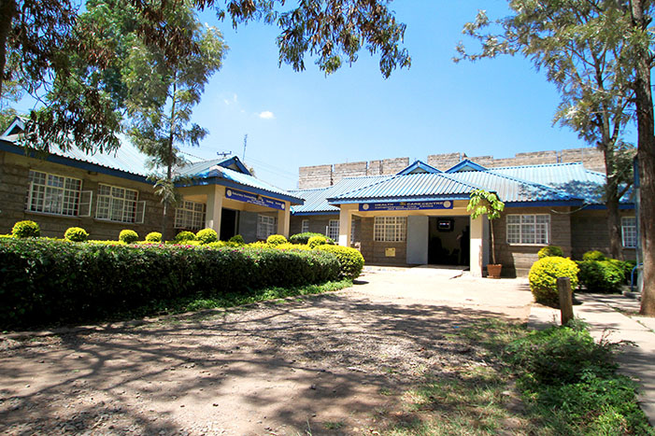
Beacon of Hope Health Centre

Slide 6
High Impact Practices In Health Care workers And Managers
Beacon of Hope HIV clinic caters to women and their families in Kenya, and has seen both the devastating effects of the disease as well as the transformative power of providing women with care.
According to a new report by USAID, new HIV infections have dropped significantly in Kenya and across Sub-Saharan Africa since 2000.
Greater access to treatment, people are living longer, healthier lives. However, as we strive to meet the needs of these patients, we face a shortage of trained health care workers to provide quality services.

Slide 7
High Impact Practices In HIV Care: Strengthen Health Care Workers And Managers
A new report from USAID and FHI 360 identified large gaps between the types of skills needed in clinics and what is taught in traditional health education programs.
HIV treatment is an ongoing process requiring health personnel who are not only committed to patient care, but also have the skills to:
Develop an in-depth understanding of patient needs in collaboration with communities around them
Forecast service demand – Non communicable diseases being cause of death
Appropriate scarce financial resources across competing health programs
Develop outcome-focused approaches for monitoring and evaluation
Collect and analyze patient data
Manage commodities, supplies and equipment

Slide 8
High Impact Practices In HIV Care: Strengthen Health Care Workers And Managers
To scale and address some of these challenges, a few years after the establishment of Beacon of Hope my Executive Director and I participated in an intensive training program the Management Development Institute, a unique partnership between Johnson & Johnson, the UCLA Anderson School of Management, Amref Health Africa and Local ministries of health.

Slide 9
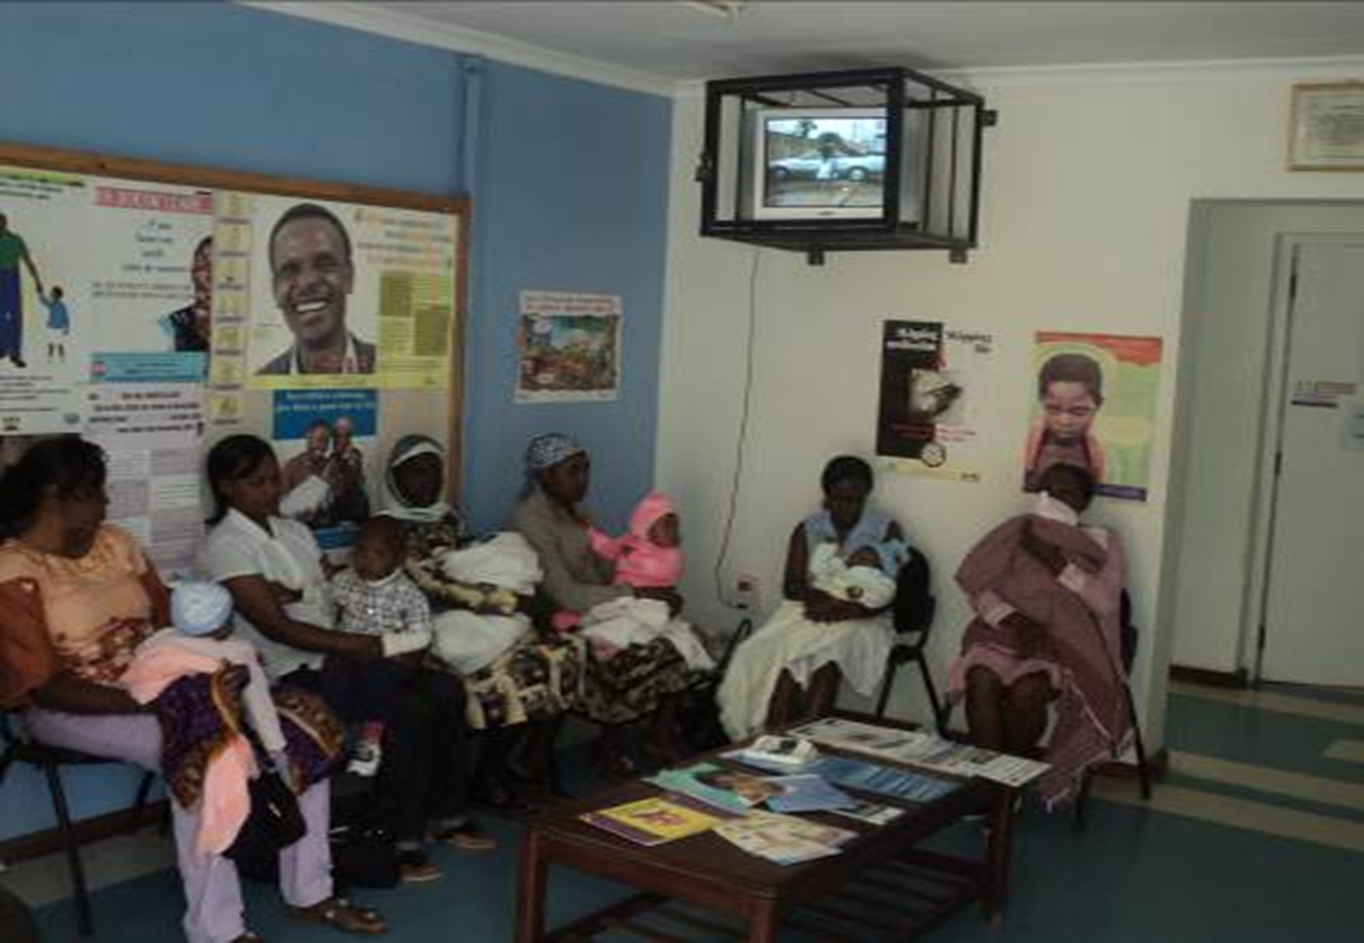
Beacon of Hope Maternal Child Health

Slide 10
High Impact Practices In HIV Care: Strengthen Health Care Workers And Managers
Six years after completing that training, we were able to scale up operations at Beacon of Hope, more than doubling the number of patients we serve and becoming a referral center for HIV treatment in the region.
Better management allowed us reduce patient wait times, increase the flow of information by upgrading to electronic health records (HMIS), and strengthen programs that integrate patient care with the community – Home based care and Medical Outreaches.

Slide 11
High Impact Practices In HIV Care: Strengthen Health Care Workers And Managers
Despite a tight labor market with frequent turnover of health workers, we improved our retention rates by offering continuous professional development programs, mentorship, and feedback loops that involve staff at all levels. Staff that are happy and engaged allowed us to go the extra mile with patients from their first contact with our clinic team.

Slide 12
High Impact Practices In HIV Care: Strengthen Health Care Workers And Managers
In the face of a growing deficit of health care workers in Africa that is estimated to hit 12.9 million by 2035, we need programs like what is offered by the Management Development Institute to change the way health care leaders in Africa resolve pressing issues, facilitate change and share knowledge to improve health systems.

Slide 13
In Numbers…….
BOH Health services are beyond HIV/AIDs care
95% success rate in PMTCT services
Our strength in primary health care services providing health services to over 500,000 clients through on site services and community medical outreach programs.
We practice telemedicine and consult on various medical issues including non-communicable diseases. Smart technology

Slide 14
Community Medical Outreaches: Diabetes, hypertension, cancer screening, Mark International Health Days (WAD)
Quality HIV prevention, care and treatment for all. (90-90-90); Psychosocial support, PMTCT
Research and development
Specialized clinics: Diabetes, hypertension, cancer screening, oral health, eye clinics, TB, Obs.Gynae, Maternity services
Expansion from Health care centre to Hospital
Home and Community based health activities: Quality Improvement teams, CPWP
Quality comprehensive primary health care: reproductive health
BOH Health Services going forward
Provide family friendly, quality, holistic and integrated health services with a touch of excellence

Slide 15
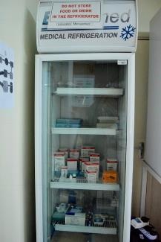
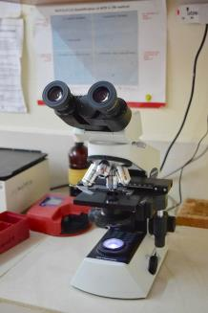
Beacon laboratory unit

Slide 16
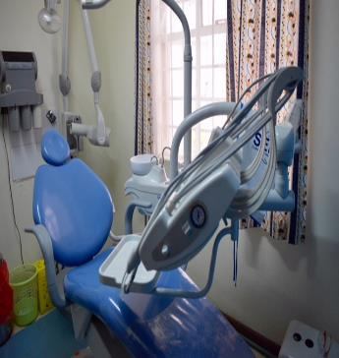
Beacon DENTAL unit

Slide 17
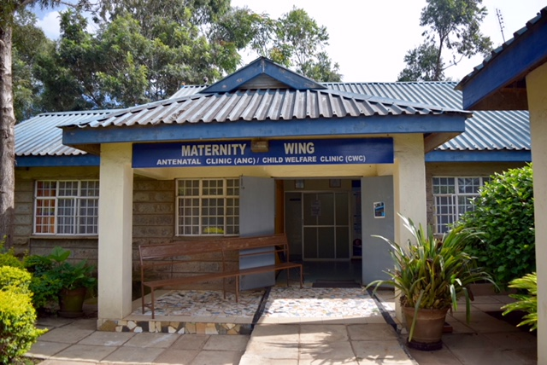
Beacon HEALTH SERVICES Maternity wing

Slide 18
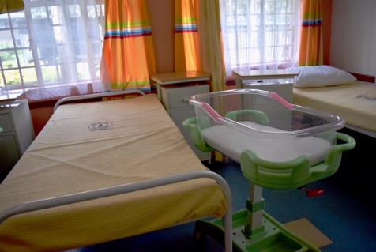
Beacon Maternity unit

