Slide 1
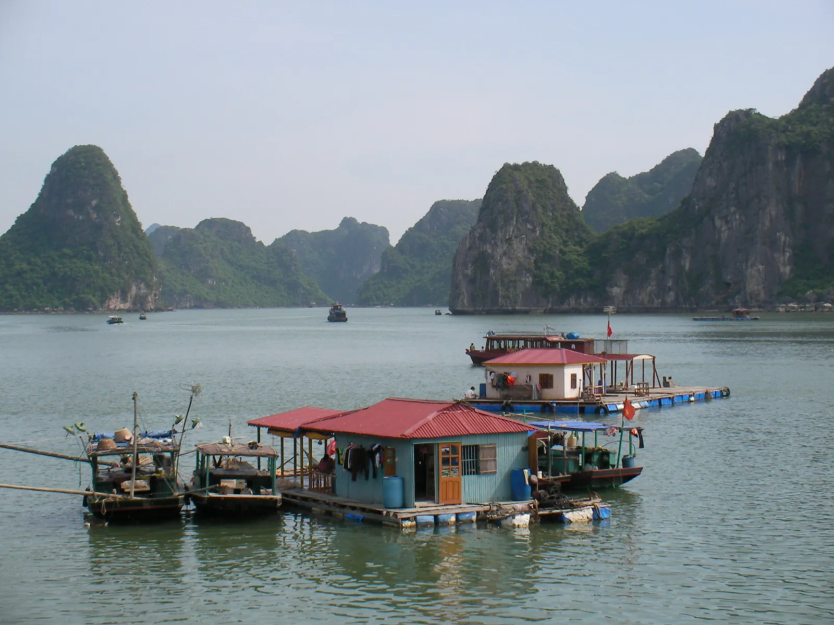
Floating Houses
A Flood Surviving Mechanism
Team members:
1. Duc Toan Nguyen
2. Pauline Mutinta Nalumango
3. Jesse David Mamodu
4. Oluwadamilola Gbuyiro
Masters in Accounting and Financial Management

Slide 2
TABLE OF CONTENTS
01
02
03
Problem Statement
Research outline
Solution Development
04
Implementation
Background of the problem
Proof of research
05
References

Slide 3
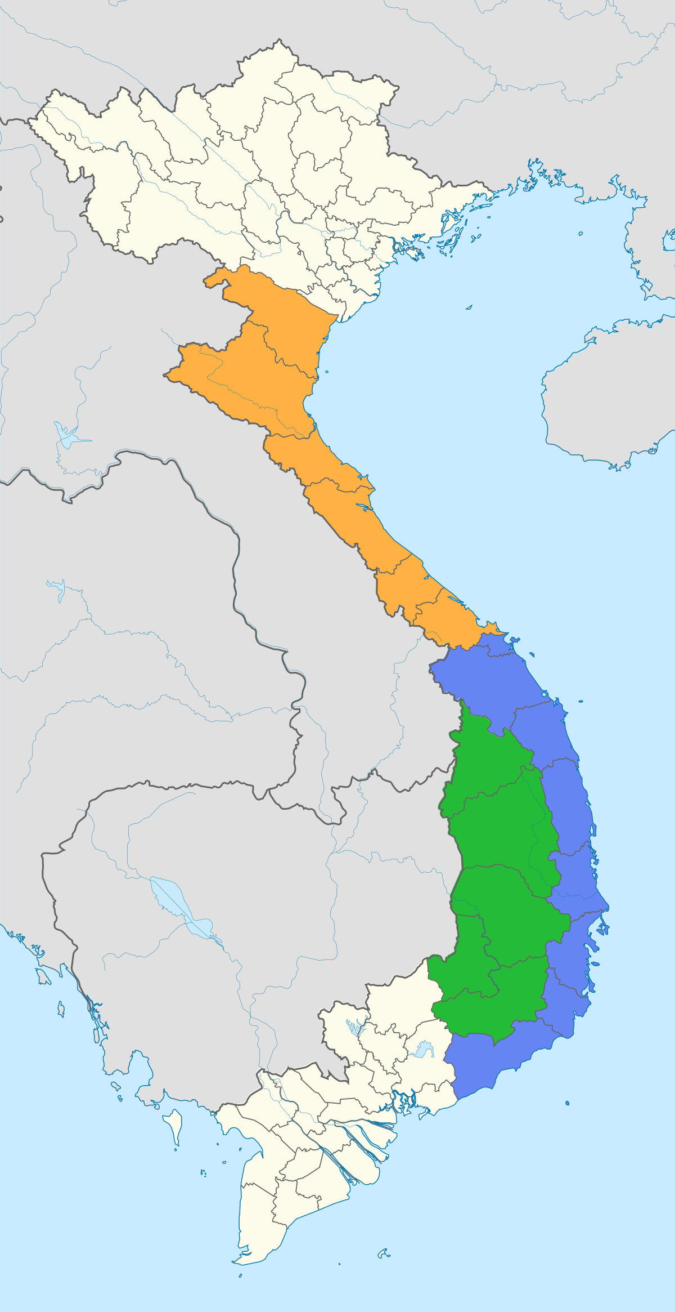
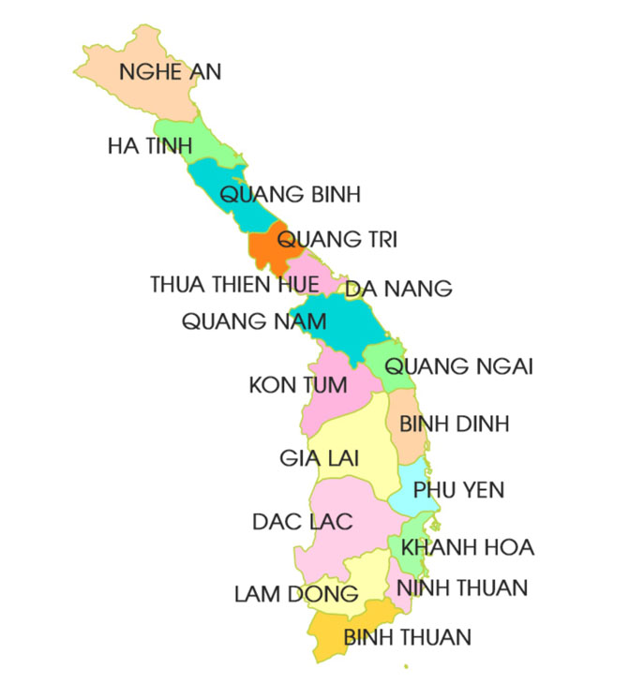
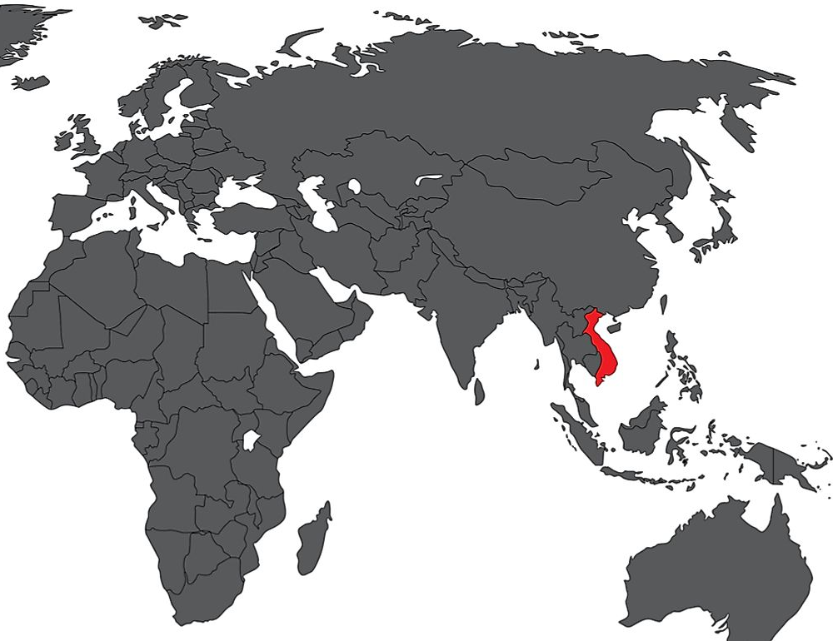
The Central Provinces of Vietnam
18 cities on a long coastline with a highly concentrated population 30.76 million people – 31.62% of the Vietnam population 150,288 km² – 45.38% of the country area
Our
Selected
Region

Slide 4
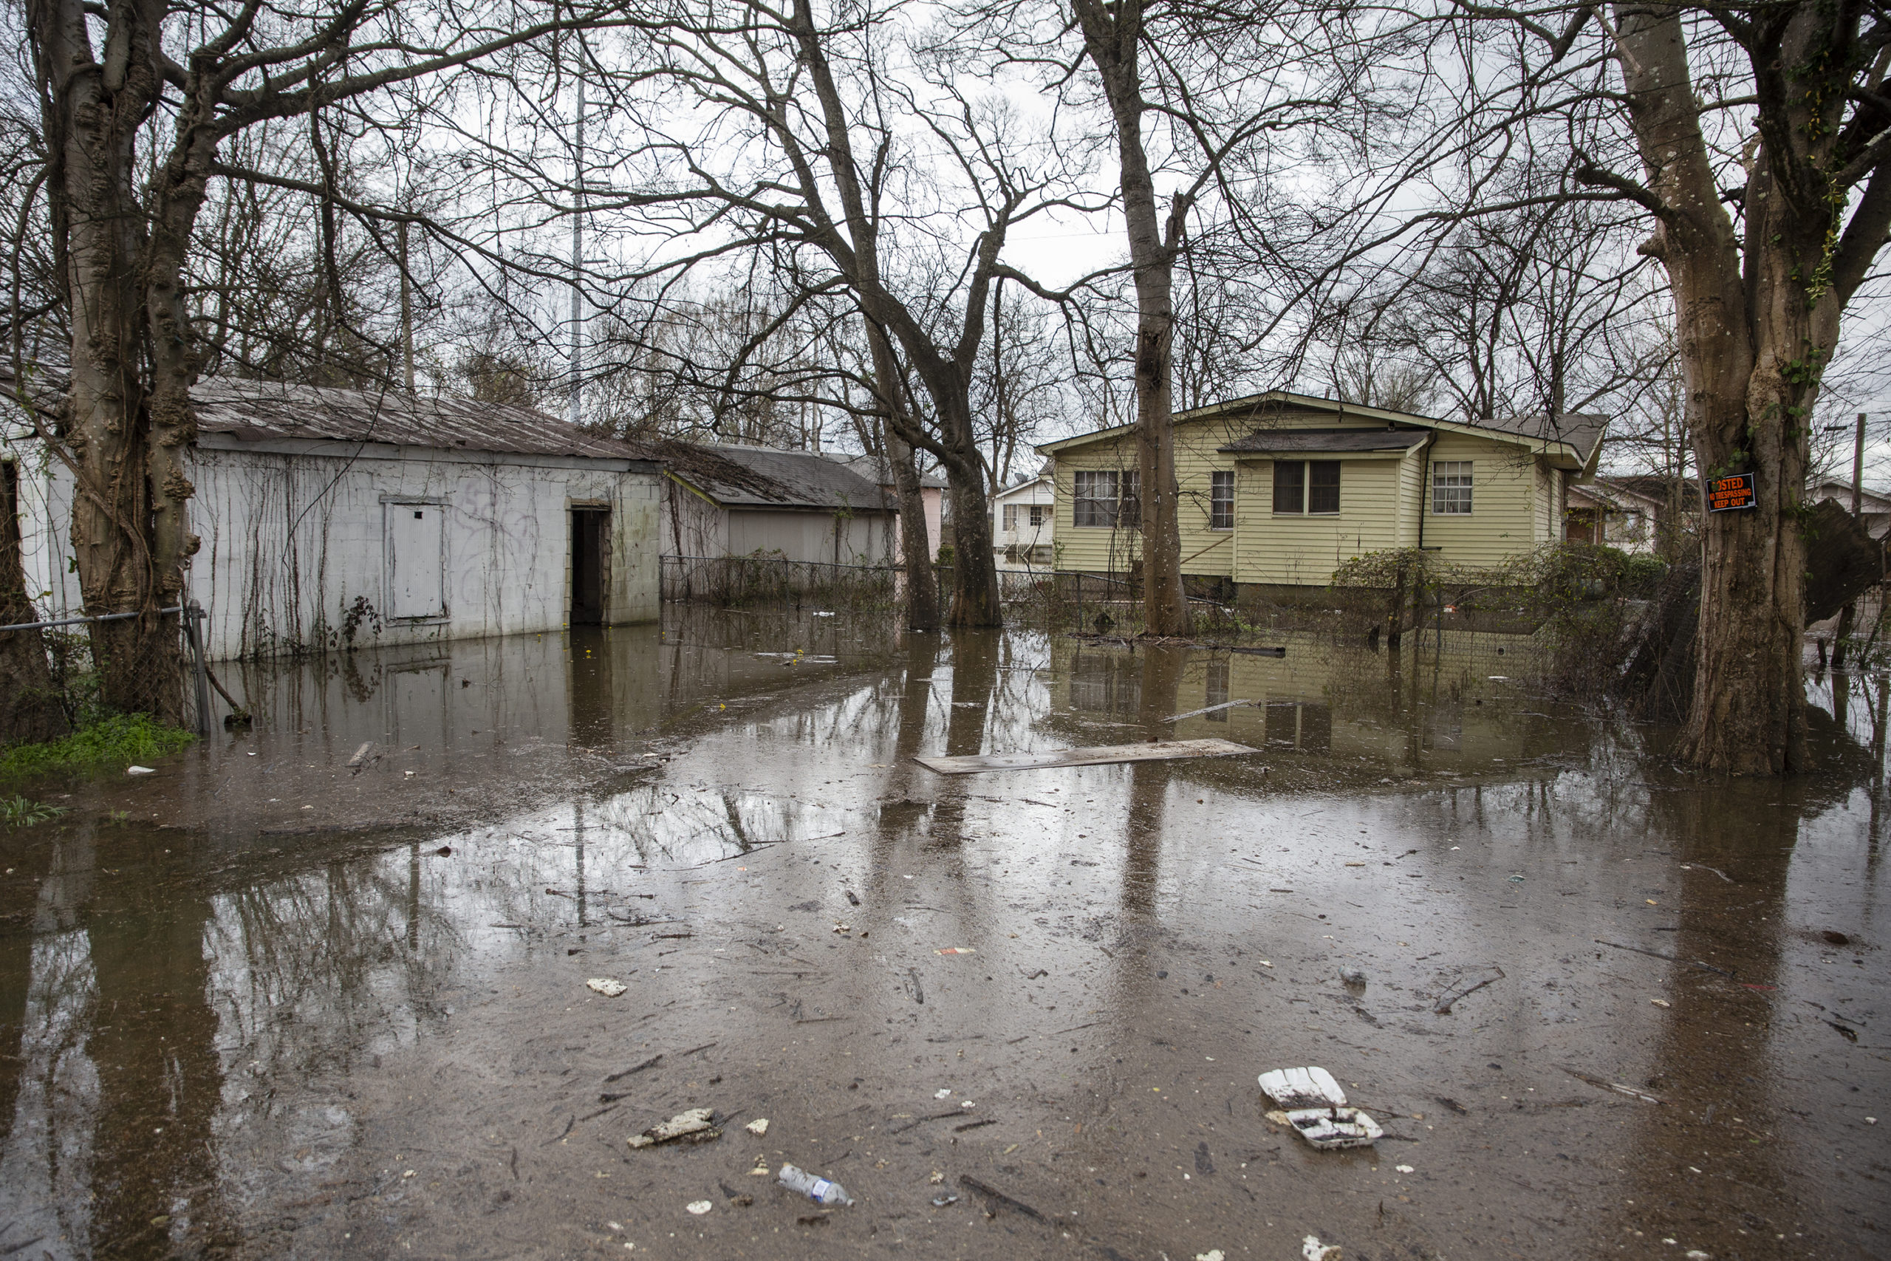
Problem Statement
Background
What Are Floods?
Where Do Floods Occur?
Globally 70 million people are exposed to flood risk each year.
Vietnam is one of the most disaster-prone countries in the world.
Approximately 70% of the Vietnamese population is exposed to the risk of flooding.
Central Vietnam has endured approximately 70% of flood damage over the past 20 years.
An overflow of water that submerges land that is usually dry.
Common causes: heavy rainfall, accelerated snowmelt, tsunamis (in coastal areas), storm surges from tropical cyclones.
The most frequent type of natural disasters.
The most widespread of all weather-related natural disasters.
Areas prone to flooding: coastal areas and river flood plains.
May occur in other areas due to unusual heavy rainfall for long periods of time.
Types of Floods
Coastal
River
Storm surges
Inland flooding
Flash floods
Causes of Floods?
Most floods are caused by excessive rainfall, overflowing rivers, storm surges, tsunamis, broken dams, channels with steep banks, snow/ice melt, insufficient vegetation.
General Impact of Floods
Loss of life
Property damage
Economic impacts
Psychosocial impacts

Slide 5
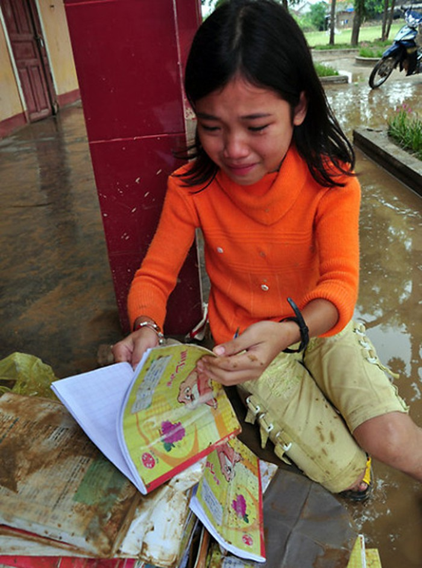
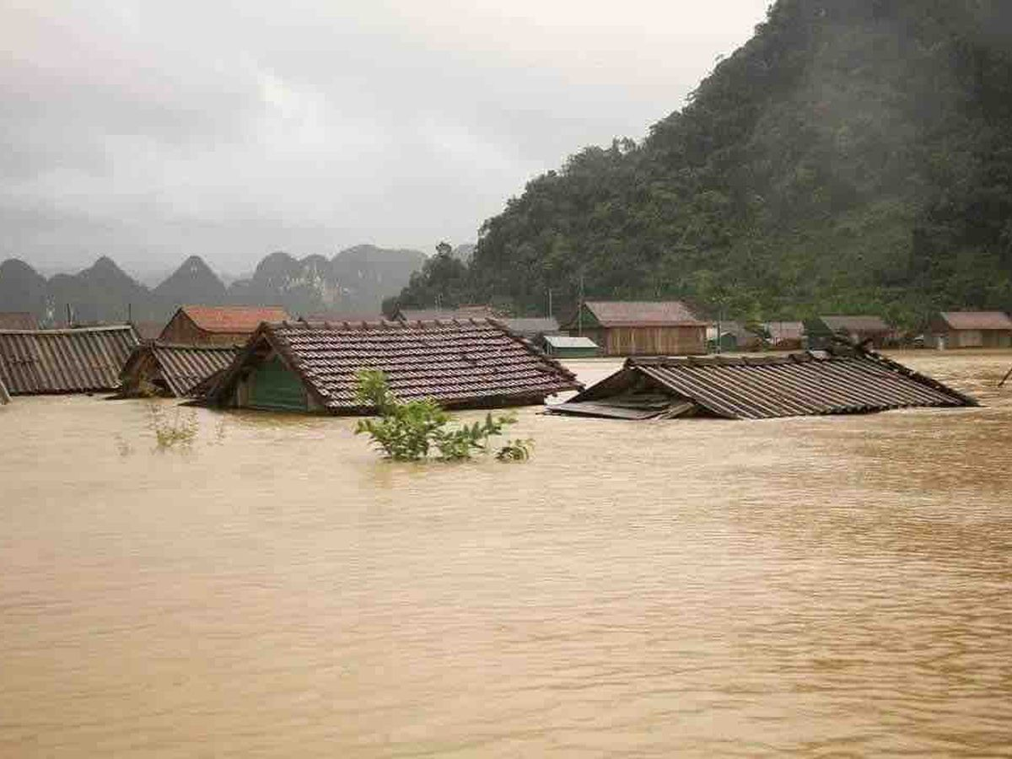
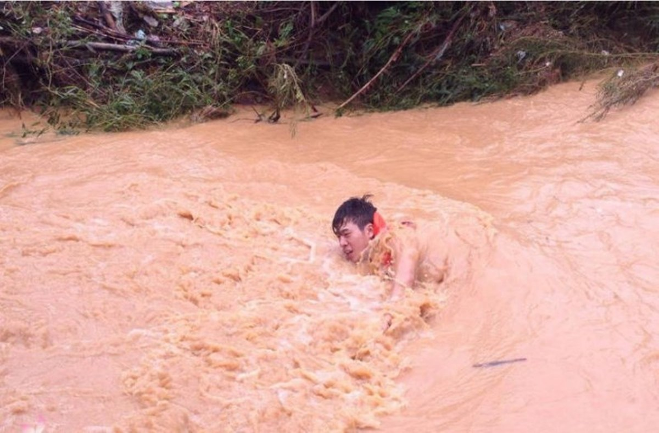
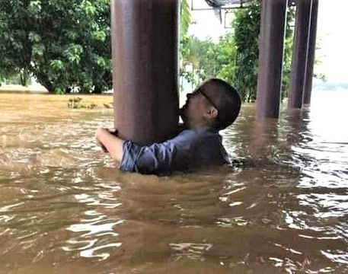
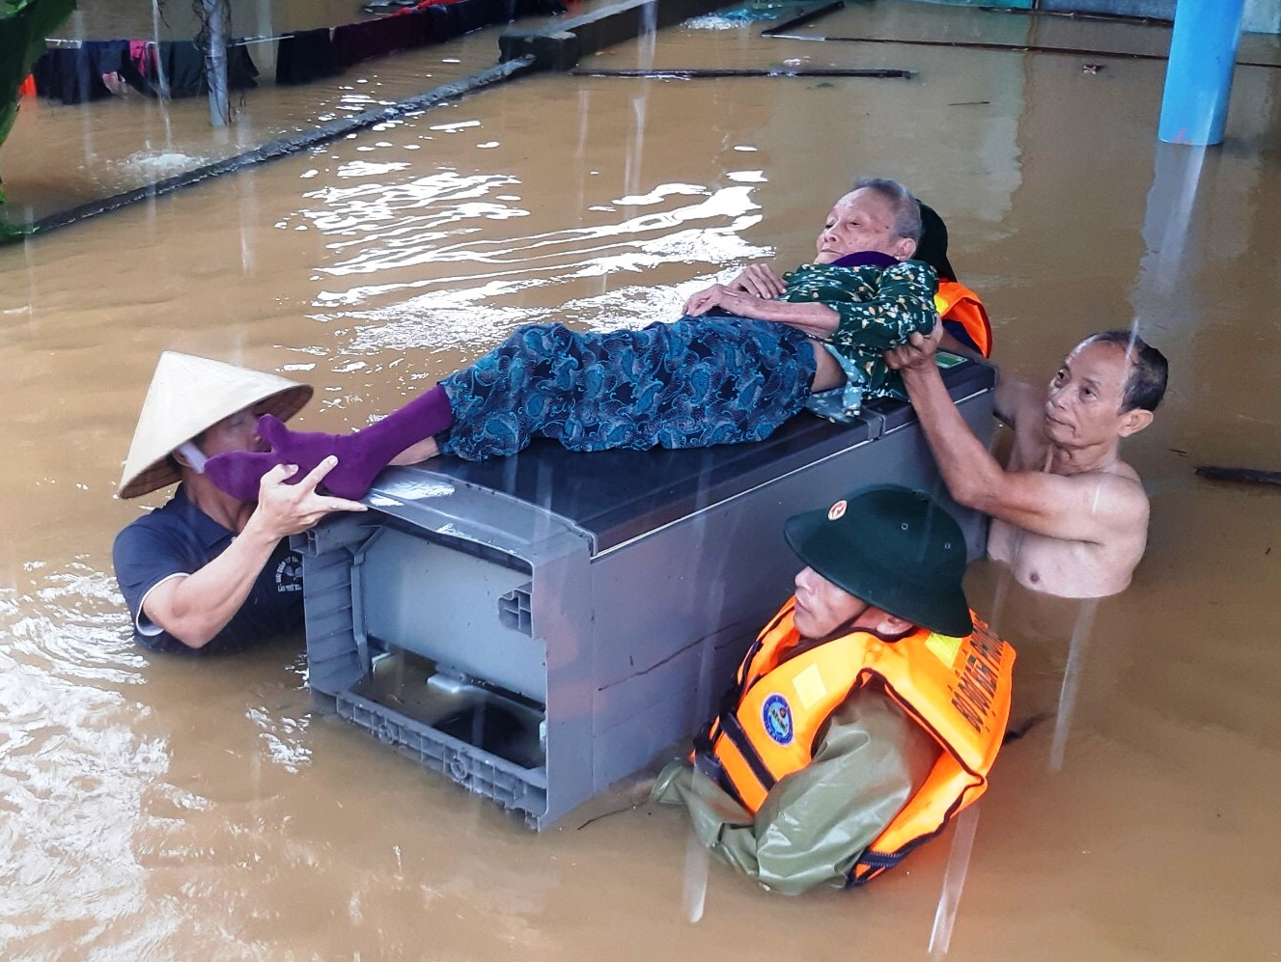
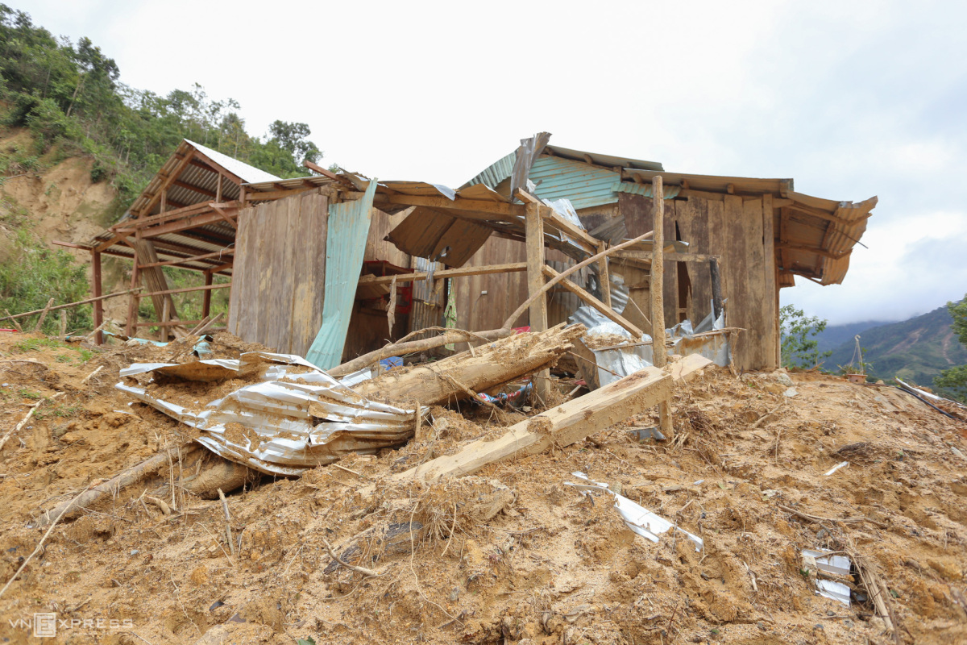
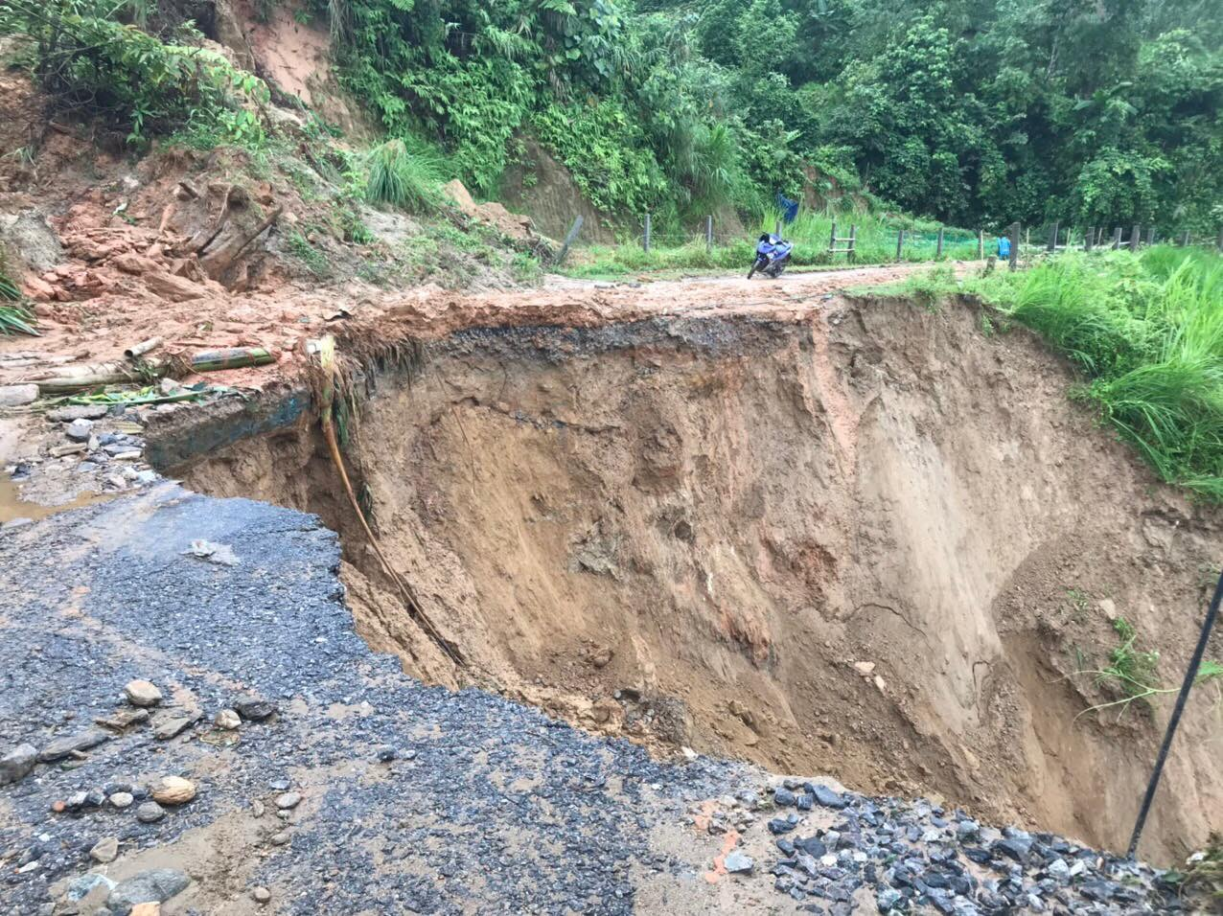
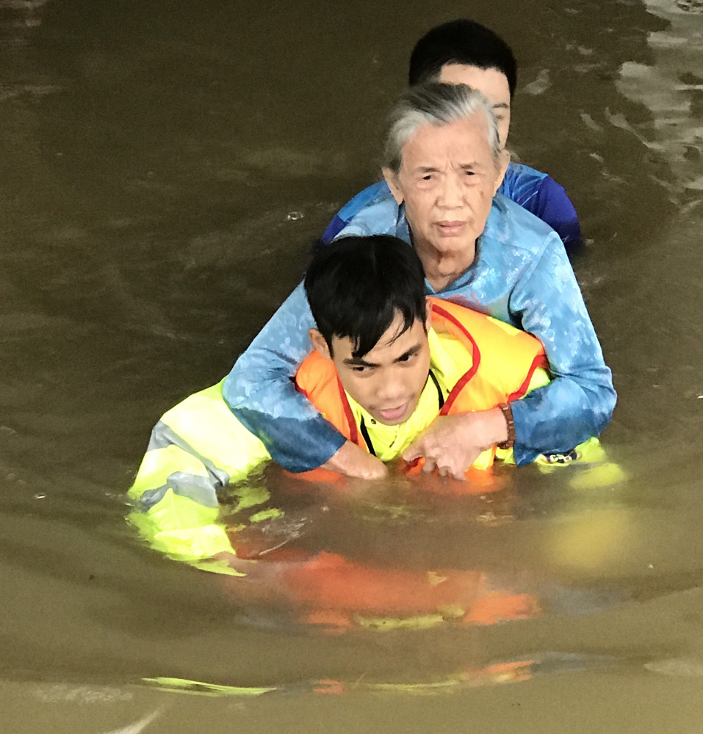
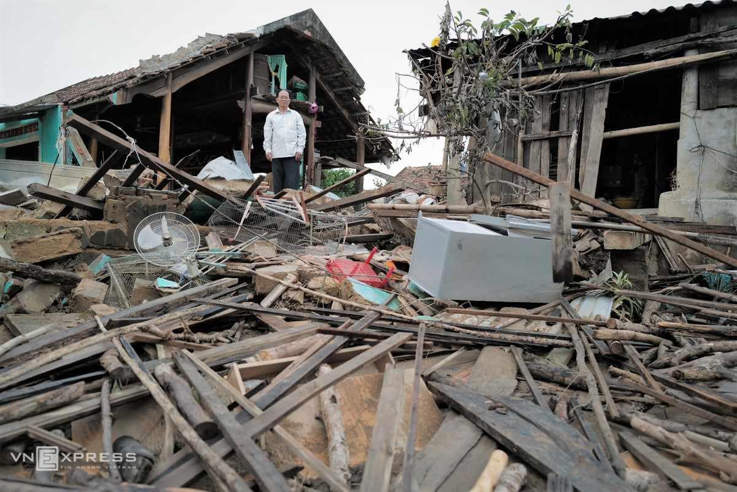
Impacts of Floods in Vietnam
A vulnerable area which is highly exposed to all types of floods, not once but three to four times a year.
Economic Loss
Damage of Infrastructure
Human & Psychosocial Impact
Some Flood Statistics in Vietnam:
2020: heavy rains caused severe flooding in 8 provinces. 511,172 houses submerged; 3,429 collapsed houses; 333,084 damages houses/roofs blown away; 291 fatalities; 66 missing people.
2017: Typhoon Damrey caused catastrophic floods causing damage of US$630,5 million; more than 100 fatalities.
2016: severe floods due to heavy rains 5 provinces. Affected 500,000 people; damaged 100,000 houses.
Notes:
Economic losses: destruction of crops, loss of livestock, displaced homes, food/water supplies, disrupted health systems
Damage of infrastructures: damage and disruption to roads, bridges, schools, community buildings
Human loss: 75% of deaths in flooding are due to drowning and fires caused by flooding
Psychosocial impacts: Emotional distress, physical health illness from waterborne diseases such as cholera and typhoid

Slide 6
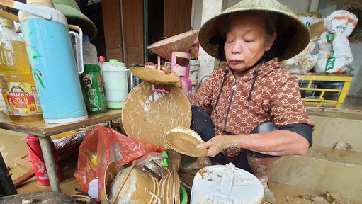
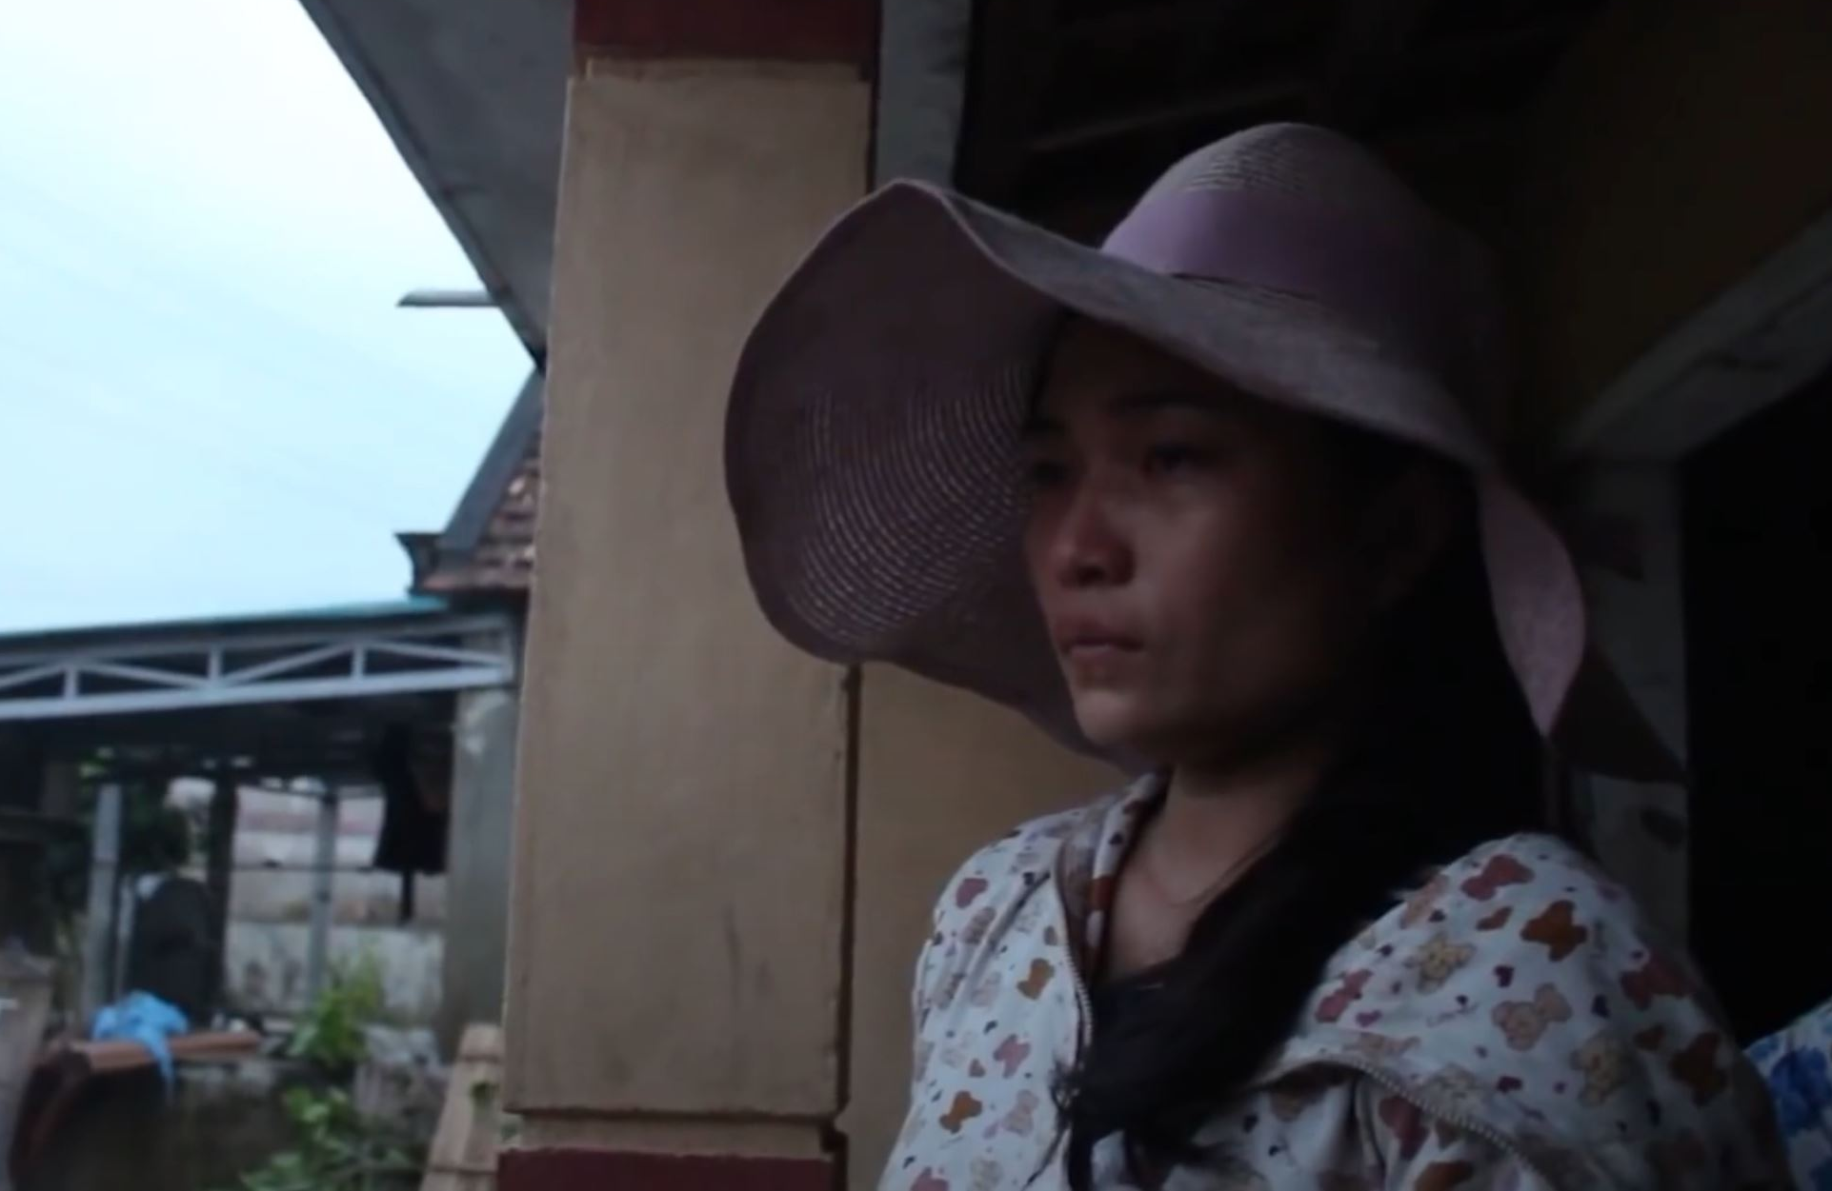
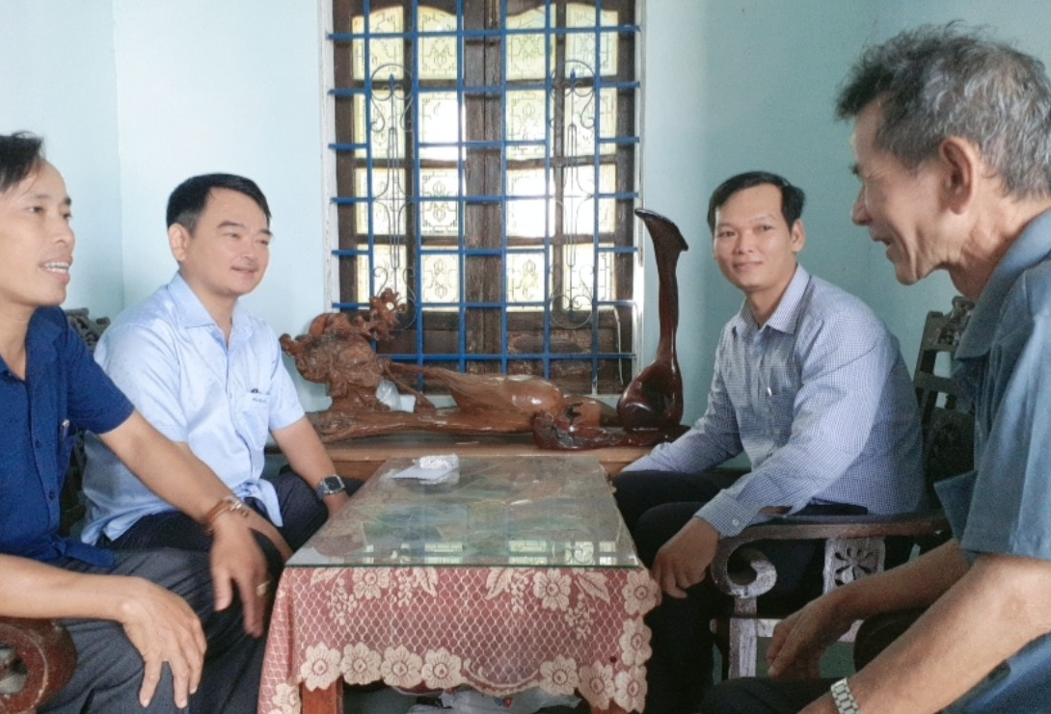
Proof of Research
Mrs. Thi Ngo Hoang – 67-year-old citizen from Nghe An city
"The water level rose 1 meter in only half an hour. I did not have time to bring anything with me to get to a higher ground. Now, I've lost everything."
Ms. Ly Nguyen – Ba Don town, Quang Binh Province
“The Flood water has broken the front wall of my house and swept away all of my house facilities. When the water approached, I called my relatives to inform them of my possible death. I am still scared because it was horrible."
Mr. Quoc Thang Tran – President of the People Committee of Quang Dien province
"The most urgent priority now is to ensure food and water for innocent people and also to help them re-structure their damaged houses, and provide financial support for post-disaster recovery."

Slide 7
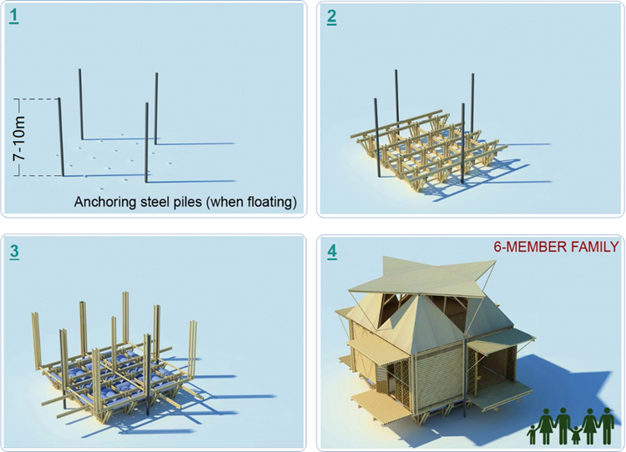
This disaster-proof shelter is attached to four anchoring steel piles which fix the whole structure into one place. These anchoring steel piles can be seven- to ten-metre long depending on the locations.
Solution Development
The Floating House
1
2
Next, the base of the house will be built, and this creates the ground floor.
The floor dimension is 5mx6m which will cover a total space of 30 square metres.
3
4
The walls and the roof are constructed using galvanised metal sheets. Like the recycled barrels, this type of construction material is available everywhere and inexpensive in Vietnam.
Multiple empty plastic barrels will be tied up underneath the ground floor. These recycled tanks are easily accessible and cost-effective

Slide 8
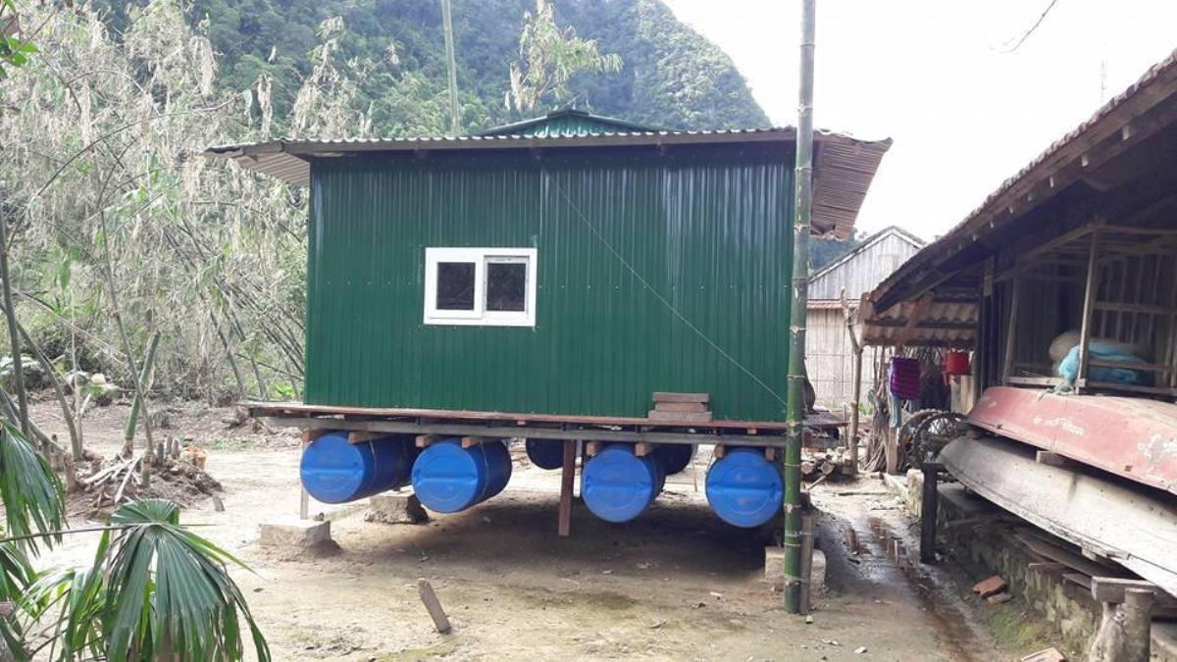
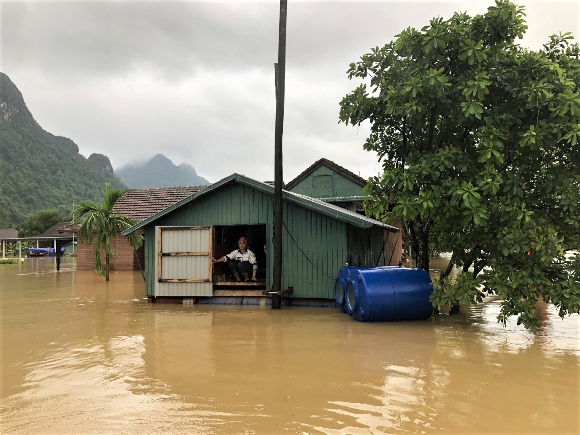
Feasibility Study
Economic aspect
Cost: US$1300 – US$1500, including material cost and labour cost
Building time estimation: 3-5 working days with 3 skilled workers
Design: Straightforward, easy to follow and manageable for experienced workers, no architect required
Sustainability aspect
Environmentally friendly​
Long lasting lifespan: for up to 25 years​
Applicable worldwide, especially in developing countries​
Low-cost and simple-design
Resilience aspect
A solid disaster-proof shelter during hazardous weathers
Pre-stocked humanitarian essentials (water, foods, medicines, sanitation products)
Enhance disaster resilience at a family-level community

Slide 9
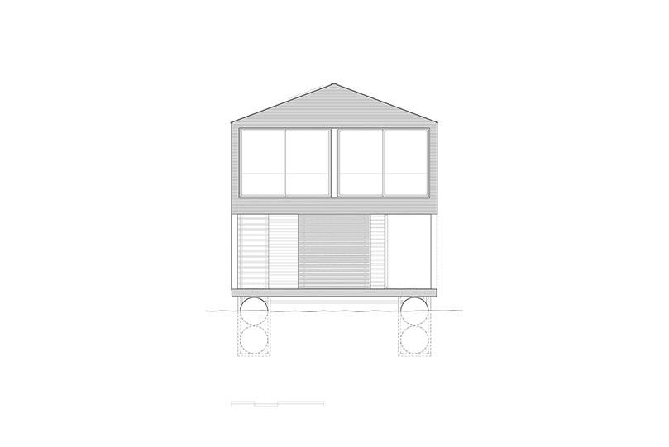
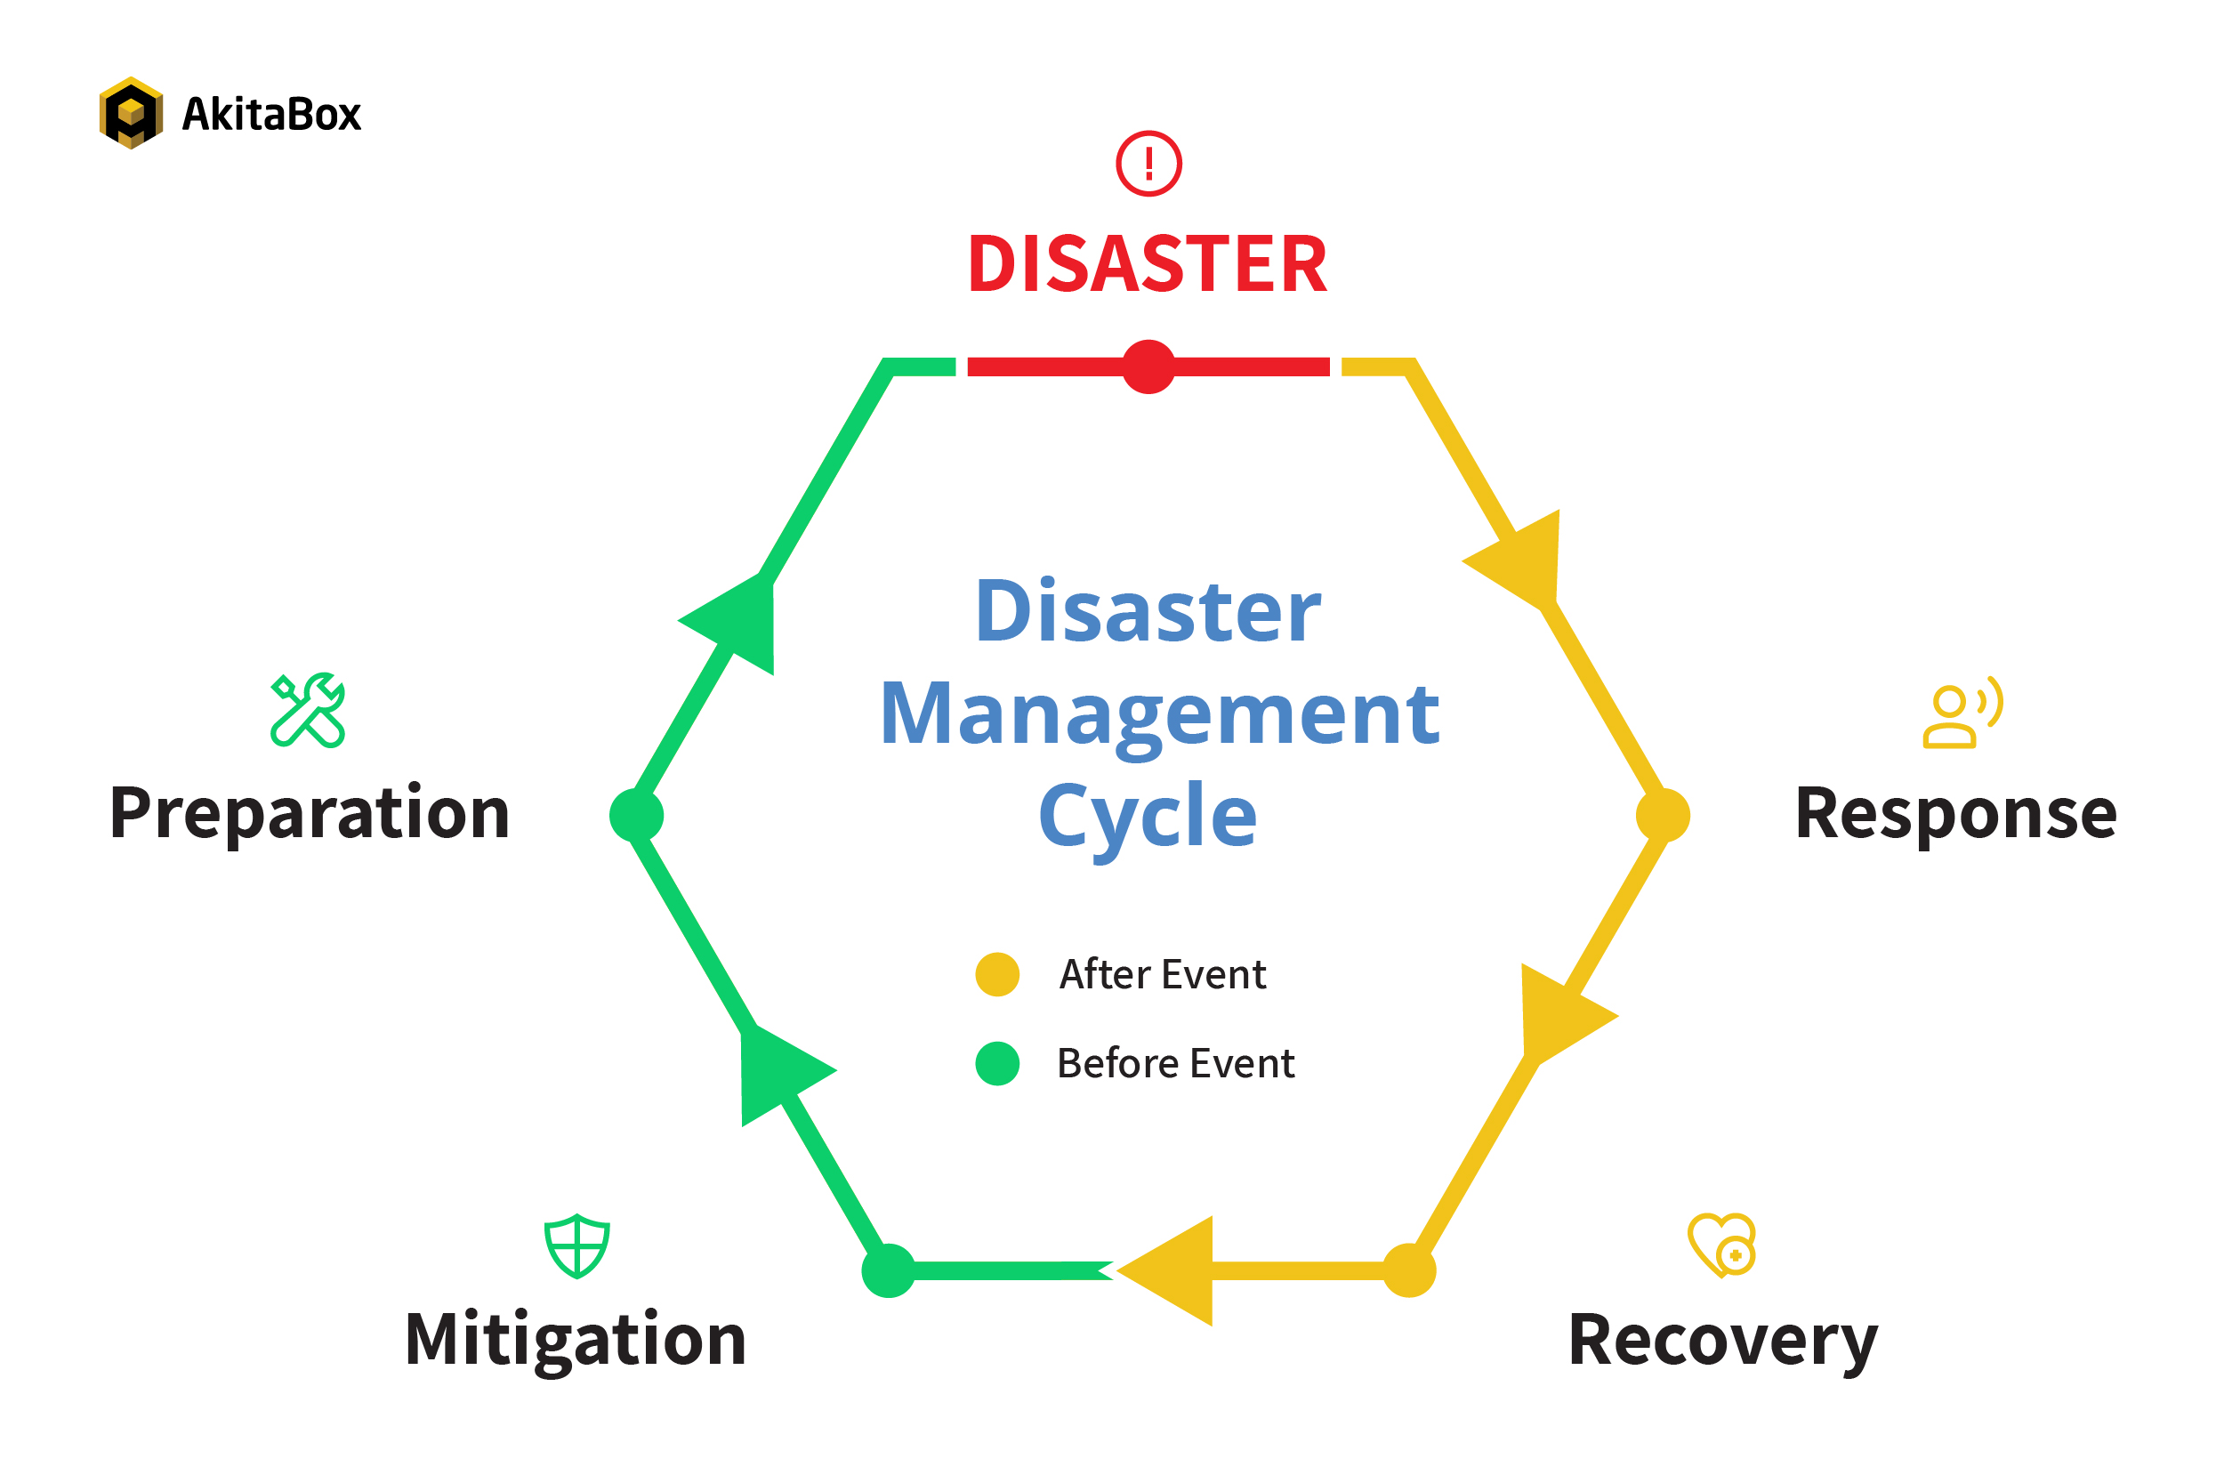
Implementation
 | 30 sqm house | 50 sqm house
Cost (US$)* | 1500 | 2200
Number of people | 6 | 10
Lifespan (years) | 25 | 25
Building time (days) | 3-5 | 5-7
*Costs are subjected to 20 percent off if mass production takes place
This floating houses
strategy falls under
the preparedness stage within
the disaster management cycle.

Slide 10
THANK YOU
"A house is made of bricks and beams. A home is made of hopes and dreams."
Duc
Pauline
Jesse
Oluwadamilola

Slide 11
REFERENCES
Asian Disaster Reduction Centre. Coping with century flood disasters in central Vietnam. https://www.adrc.asia/management/VNM/vietnam_response_to_disaster.html?Frame=yes
Australian Institute for Disaster Resilience. (2021). Flood. https://knowledge.aidr.org.au/resources/flood/
Davies, R. (2021). Vietnam. https://floodlist.com/tag/vietnam
Earth Networks. (2021). Flooding 101. https://www.earthnetworks.com/flooding/#flood-type
International Federation of Red Cross and Red Crescent Societies. (2021). Vietnam: Floods - revised appeal n° MDRVN020. (). https://reliefweb.int/report/viet-nam/vietnam-floods-revised-appeal-n-mdrvn020
Natural Disasters Association. (2017). Natural hazards. https://www.n-d-a.org/flooding.php
Nguyen, M. T., Sebesvari, Z., Souvignet, M., Bachofer, F., Braun, A., Garschagen, M., Schinkel, U., Yang, L. E., Nguyen, L. H. K., Hochschild, V., Assmann, A., & Hagenlocher, M. (2021). Understanding and assessing flood risk in Vietnam: Current status, persisting gaps, and future directions. Journal of Flood Risk Management, 14(2), e12689. https://doi.org/https://doi.org/10.1111/jfr3.12689
Nunez, C. (2015). Floods, explained. https://www.nationalgeographic.com/environment/article/floods
The National Severe Storms Laboratory. (2021). Severe weather. https://www.nssl.noaa.gov/education/svrwx101/floods/
WHO. (2021a). Disaster in Viet Nam. https://www.who.int/vietnam/health-topics/disasters
WHO. (2021b). Floods. https://www.who.int/vietnam/health-topics/disasters
The World Bank Group. (2020). GDP per capita (current US$) - Vietnam. https://data.worldbank.org/indicator/NY.GDP.PCAP.CD?locations=VN

