Slide 1
ILO-GBSN-UniGE: Teaching Resources
Fair recruitment of migrant workers. Teaching labour and human rights in business schools #2.
Last updated: July 2024
The International Labour Organization (ILO), the Global Business School Network (GBSN) and the University of Geneva (UNIGE) joined forces in 2022 to include human and labour rights in business school education. The teaching resources are developed in expert workshops and consist of a standard slide deck and teaching notes. The resources can be adapted to regional contexts and are available open-source.
For more information, see: https://gbsn.org/ilo-gbsn-unige-teaching-resources/
Notes:
Today is a bit of a different format.

Slide 2
About this teaching resource
https://www.fairrecruitmenthub.org/news/ilo-gbsn-unige-hosts-business-school-educators-technical-workshop-fair-recruitment-migrant
Notes:
Picture of the expert workshop.
More info on the development of the ILO-GBSN-UNIGE teaching resources: https://gbsn.org/ilo-gbsn-unige-teaching-resources/

Slide 3
Fair recruitment of migrant workers
Business and Human Rights
Based on a workshop organized at the Geneva School of Economics and Management, June 2024
Source of the picture: Evaluating the risk of labour exploitation among migrant workers in the UK during Covid-19 | Vision | University of Nottingham
Notes:
Why are we talking about migrant labor?
Migrant labor is a key concern for companies in our neighborhood.
Many migrant workers work in agriculture (26% of registered cases of migrant-labor related complaints acc. to BHRRC, 2022-24).
Why do we talk about recruitment?
Data from an online post on “world day for decent work” (source: Randstad, placement agency, https://www.randstad.ch/workforce-insights/hr-trends/world-day-decent-work/):
In 2020, 58 million individuals worldwide found job opportunities through private employment services.
ILO analysis of key labor market issues: 61% of the global workforce are employed informally, without any assurances of job security.

Slide 4
Learning objectives
Grasp labour migration trends and dimensions, and systemic human rights risks for migrant workers
Understand the characteristics of recruitment and the relevance of fair recruitment to businesses
Identify ways how businesses can participate in ensuring fair recruitment of migrant workers

Slide 5
Agenda
Unit 1 – Setting the stage
Unit 2 – Labour migration and forced labour at a glance
Unit 3 – Understanding fair recruitment and the ILO approach
Unit 4 – Business decisions to ensure fair recruitment

Slide 6
What does labour migration mean to you?
© ILO Global Estimates on International Migrant Workers – Results and Methodology, ILO, 2021
Notes:
What does migration mean to you? Does anyone here consider themselves a migrant?
A person who moves from one place to another, especially in order to find work or better living conditions.
Cross-border migration and internal migration
Educational migration (in search of better / high quality / more well-suited educational opportunities)
Ancestral migration
What is labour migration?
Movement of persons from one state to another, or within their own country of residence, for the purpose of employment.
Due to globalised economy > workers are increasingly looking for job opportunities beyond their home country > in search of decent work > and better livelihoods
Many workers migrate internally in search of decent work
Low-paid (Unskilled labor is a workforce segment associated with a limited skill set or minimal economic value for the work performed) VS high-skilled workers (highly trained, educated, or experienced segments of the workforce that can complete more complex mental or physical tasks on the job gained through education / training)

Slide 7
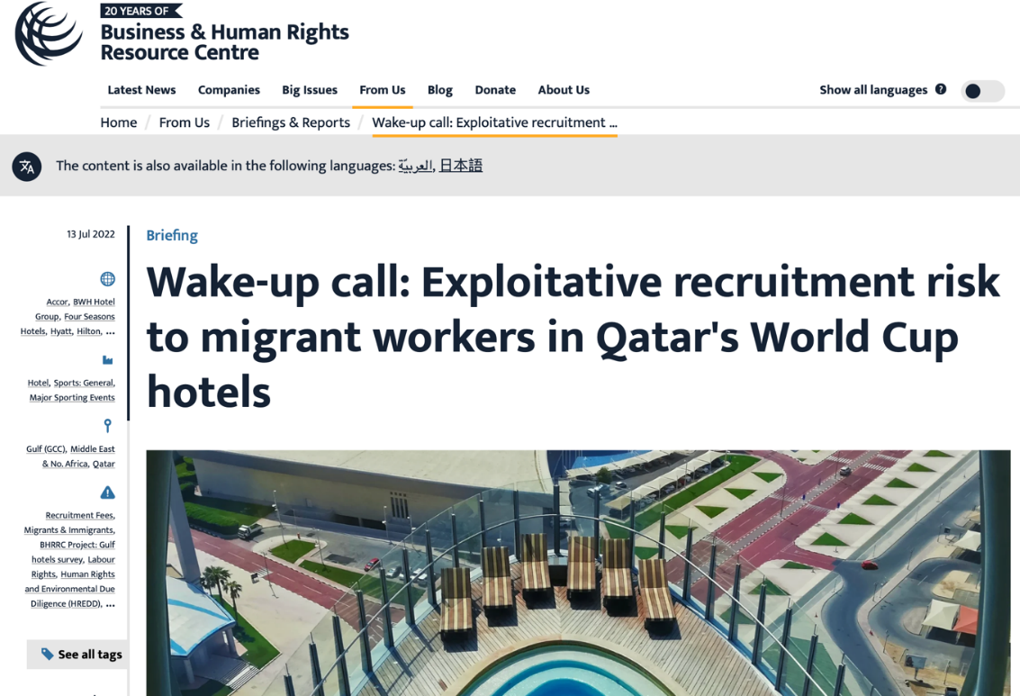
Why do we talk about migrant labour?
Notes:
How labour migration, recruitment and business operations connect
Why is unfair recruitment and the impact it has on migrant workers important for business students to understand?
Migrant workers as a particularly vulnerable group. Informal recruiters put migrants at a heightened risk for severe human rights violations such as forced labor.
Thus: the topic is within the interest of companies – socially and legally – to contribute to addressing the drivers in their supply chain.
Example – On the picture: 2022 Football World Cup in Qatar.
Background: Qatar’s migrant population > making up approximately 95% of its labour force (mostly from South-Asia)
Preparations for the World Cup:
Qatari government: reportedly spent $300 billion transforming its capital city Doha with state-of-the-art stadiums, facilities, and hotels
For 12 years: nearly millions of migrant workers in construction etc.
Human rights accusations
Government: widespread mistreatment of migrant workers, downplaying work-related deaths
Human / labor rights violations: long hours, dangerous environments, prolonged heat exposure, housed in appaling conditions, denied medical care, malnutrition
Recruitment fees: workers then have to maintain their positions (even in cases of abusive employers) to avoid debt / having to buy themselves out of their contract
Kafala system (sponsorship system, elements of modern slavery, workers’ employment and visa linked to their employers
International attention on Qatar due to the World Cup did trigger policy changes in the last several years, but new labor laws don’t do enough to protect workers and their families.
----------------------------
Further info about Qatari migrant landscape:
Gulf countries strive to diversify and modernize their economies, the reliance on migrant labor has increased.
Migrant workers are attracted to work in the Gulf – higher wages on average than their home countries, ability to send remittances to family members back home.
The kafala system caused a significant demographic shift: foreigners outnumber native-born citizens in all Gulf countries except Saudi Arabia.
Many Gulf countries have since reformed their kafala systems, but the legacy of the system and its many malpractices remains intact.
Qatar: migrant workers can now change jobs freely without permission from their employer, a standard minimum wage now exists, and penalties for employers who withhold wages have increased.
Despite policy changes at the government level, implementation of these new protections depends on the actions of companies and employers.
Legislative reforms: not followed up with enforcement / monitoring, companies not held accountable for abuses against the migrant workforce
Source: https://www.boundless.com/blog/qatar-world-cup-migrant-workers/

Slide 8
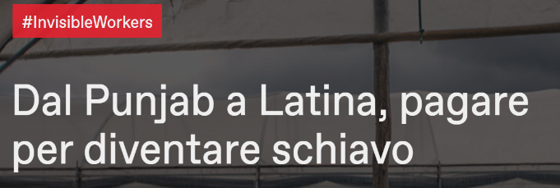
Why is this a business and human rights issue?
Notes:
If you look through the news, you will notice that exploitation of migrant workers is quite wide-spread.
In this class, you will learn why migrant workers are more at risk, what the drivers of these risks are, and approaches what can be done about this – with a particular focus on the role of companies.

Slide 9
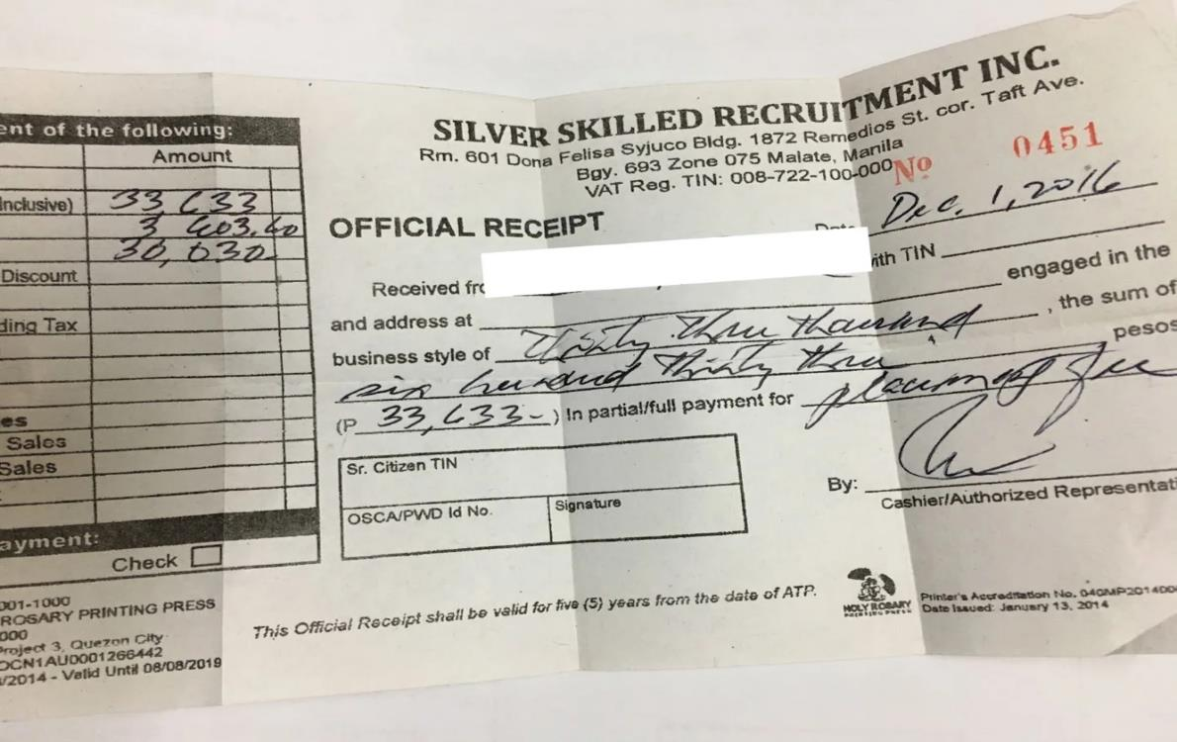
Fair recruitment – fees and costs
© Rappler
Notes:
DQ: What do you see in this picture? What do you think it is?
Answer: Receipt for migrant related recruitment fees (for the worker “Rodel”, an electrician)
Recruitment agency certifying that the worker paid P39,000 (Philippine pesos) (590 CHF).
“Cost” of securing a job in Qatar that would pay a monthly salary of P14,000 (210 CHF), working as an electrician
The workers also took out a loan for P60,000 (900 CHF) to cover the recruitment fees plus a little extra to tide over his family until he got his first salary.
Calculations show that Rodel would pay P95,565 for a P60,000 loan > an astounding annual interest rate of 104.27% was applied.
Source: investigation by Ana Santos and Sofia Tomacruz on debt bondage across the Philippines-Qatar corridor, https://www.rappler.com/newsbreak/in-depth/185211-migrant-life-qatar-ofw-debt-trap/.
Moving on, keep in mind: Migrant workers are asked to pay recruitment fees. They borrow money from intermediaries at interest rates that can be greater than 100%.

Slide 10
Agenda
Unit 1 – Setting the stage
Unit 2 – Labour migration and forced labour at a glance
Unit 3 – Understanding fair recruitment and the ILO approach
Unit 4 – Business decisions to ensure fair recruitment

Slide 11
Global overview on labour migration
Labour migration
The movement of persons from one geographical location to another in order to find gainful employment. Labour migration may be internal, for example rural to urban, or international, across borders.
Migrant worker / labour migrant
The term refers to people who migrate specifically for the purpose of employment – often to states of which he/ she is not a national.
Recruitment fees and related costs
Any fees or costs incurred in the recruitment process for workers to secure employment or placement.
Forced labour
Situations in which persons are coerced to work through violence or intimidation, or more subtle means such as accumulated debt, retention of identity papers or threats of denunciation to authorities.
D E F I N I T I O N S
Notes:
In case the definitions are not clear by now:
Forced labor: we’ll get there.
Expats: temporary work assignment, connotation of being more privileged and more educated
Migrant worker: moving to other places in search for work more permanently

Slide 12
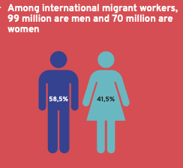
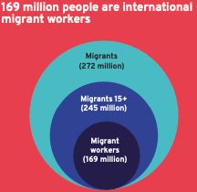
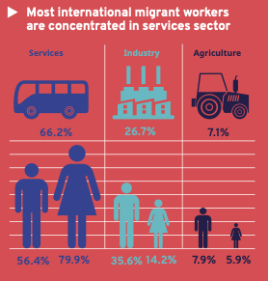
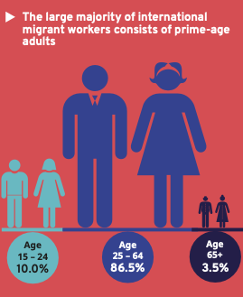
Global overview on labour migration
G L O B A L F I G U R E S
© ILO Global Estimates on International Migrant Workers – Results and Methodology, ILO, 2021
Notes:
On the next slides: facts & figures on who migrant workers are, by gender/age, geography and industry
The distribution of migrant workers varies from region to region.
In Europe, there are more female migrant workers than male.
Internationally, the lower representation of women is likely also due to lower labour force participation.
Gender: also depends on the industry

Slide 13
Global overview on labour migration
G L O B A L F I G U R E S
© ILO Global Estimates on International Migrant Workers – Results and Methodology, ILO, 2021
Notes:
Most migrants are labor migrants.
2019: within the 272 million international migrants:
169 million international migrant workers – this number has been increasing steadily 150 million in 2013)
62% of all migrants = labor migrants (69% of the 245 million migrants at working age)

Slide 14
Global overview on labour migration
G L O B A L F I G U R E S
© ILO Global Estimates on International Migrant Workers – Results and Methodology, ILO, 2021

Slide 15
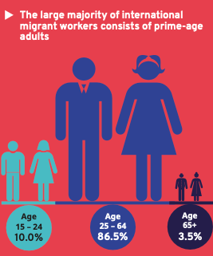
Global overview on labour migration
G L O B A L F I G U R E S
© ILO Global Estimates on International Migrant Workers – Results and Methodology, ILO, 2021

Slide 16
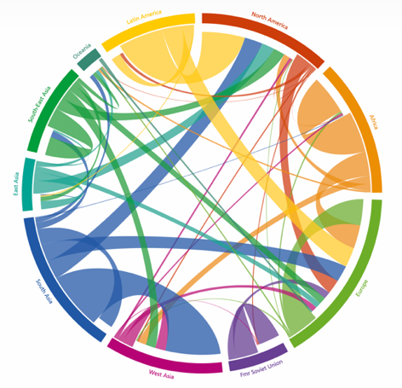
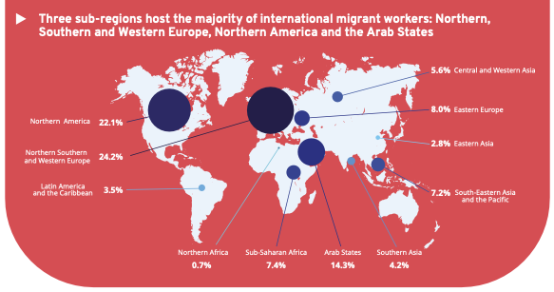
Global overview on labour migration
G E O G R A P H I C A L
D I S T R I B U T I O N
Circular plot of migration flows between and within world regions, 2005-10
© ILO Global Estimates on International Migrant Workers – Results and Methodology, ILO, 2021
© Guy J. Abel and Nikola Sander. 2014 Circular plot of migration flows between and within world regions in 2005-10
Notes:
~169 million international migrant workers: 67.4 % (113.9 million) in high-income countries and 19.5 % (33 million) in upper-middle-income countries
Main regions of destination: include Northern, Southern, and Western Europe (24,2 %), Northern America (22,1%) and Arab States (14,3%) Main regions of origin: Asia-Pacific (1/3 of international migrants), Europe and Central Asia, and the Americas

Slide 17
Global overview on labour migration
G E O G R A P H I C A L
D I S T R I B U T I O N
Circular plot of migration flows between and within world regions, 2005-10
© ILO Global Estimates on International Migrant Workers – Results and Methodology, ILO, 2021
© Guy J. Abel and Nikola Sander. 2014 Circular plot of migration flows between and within world regions in 2005-10
Notes:
Migration is a complex phenomenon that affects every country and region of the world.
Significant movement of workers are taking place along South-South and North- South migration corridors.

Slide 18
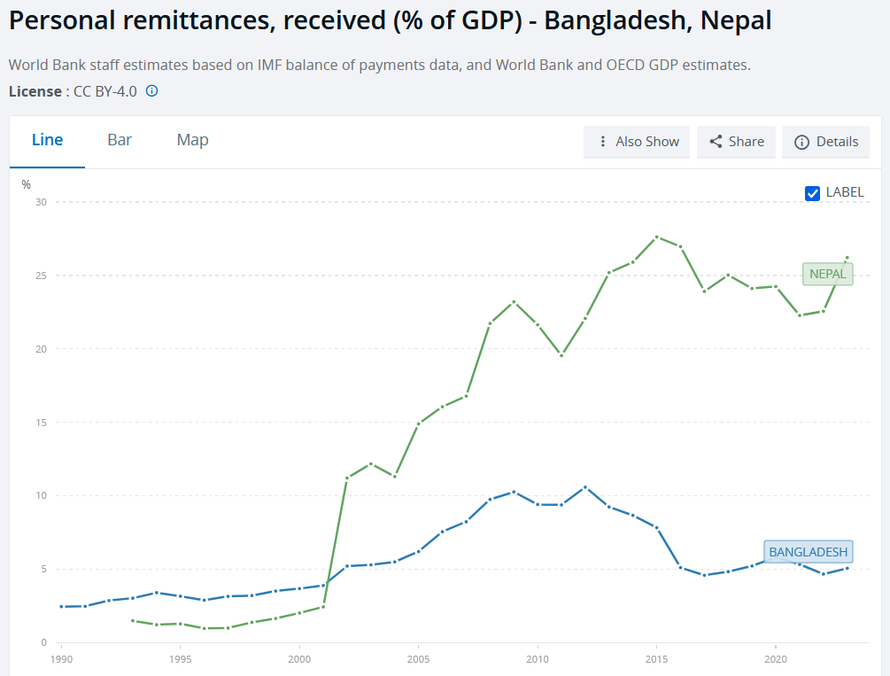
Why is labour migration a key economic factor?
For sending countries: e.g., remittances can significantly contribute to the GDP
Remittance = “money or goods that migrants send back to families and friends in origin countries … most direct and well-known link between migration and development. Remittances exceed official development aid but are private funds.”
For receiving countries: e.g., in Qatar, migrants are 95% of the workforce
30%
20%
10%
0%
1995
2000
2005
2010
2015
2020
https://www.migrationdataportal.org/themes/remittances; https://data.worldbank.org/indicator/BX.TRF.PWKR.DT.GD.ZS?end=2023&locations=BD-NP&name_desc=true&start=1990&view=chart, https://www.boundless.com/blog/qatar-world-cup-migrant-workers/
Notes:
EXAMPLE NEPAL: Remittances play a core role in the Nepalese economy, corresponding to one quarter of total GDP
(= 3 times total exports of goods and services, and ten times official foreign aid).
EXAMPLE SADIO MANÉ: significant investment in his home community in Senegal – US$ 693’000 for the construction of the first hospital in his town (Senegalese footballer playing in the Saudi Arabian Pro League).

Slide 19
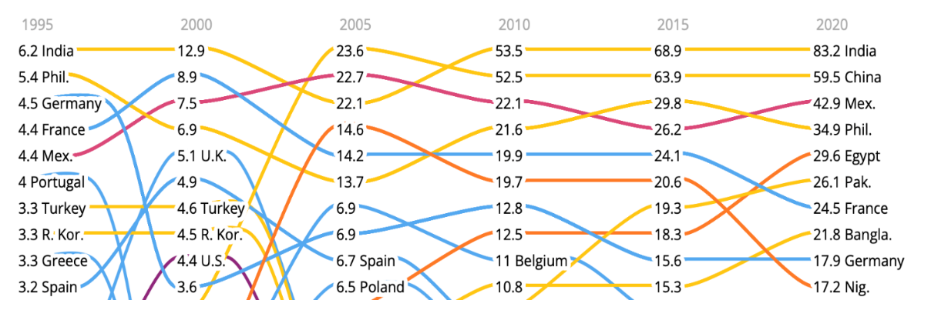
Global overview on labour migration
2020 – 2022: International remittances increased by 650% (US$128 billion – US$831 billion)
Migrant remittances surpass foreign direct investment, boosting the GDP of developing nations
For context: There are 281 million international migrants globally. The number of those displaced hit a record high by the end of 2022 at 117 million.
E C O N O M I C S O F
L A B O U R M I G R A T I O N
Top ten remittance-receiving countries
© World Bank in IOM World Migration Report 2022
Notes:
Excursus – Learning for interpreting statistics:
Ask for the data source and factors influencing the interpretation, e.g.:
What causes the changes in the top ten?
Do the migration flow patterns change?
Is there an increase because there are more migrant workers – or because they remit more?
For which countries are remittances more important than the GDP?
…
Trends in remittance flows are a good indicator of the evolution of general labour migration dynamics.
→ Need to ensure that international migrant workers have appropriate financial education and access to fair financial services.

Slide 20
Drivers of labour migration
Reasons for Migration
Migrant workers seek better opportunities due to lack of economic prospects, decent work, or crises like climate disasters in countries of origin.
Employer Preferences
Employers hire migrants for skill shortages in receiving countries, and their tendency to accept lower wages, poorer conditions, or weaker labour protections.
© 2021 Global Estimates of Modern Slavery: Forced Labour and Forced Marriage
Notes:
Motivation on an individual level – “supply” of migrant workers
Why does migration happen – “demand” for migrant workers

Slide 21
Factors driving labour migration
Discrimination and xenophobia
Political and social unrest
Shirking civic space for dialogue
Labour market dynamics
Economic downturns
S O C I O – POLITICAL AND
E C O N O M I C
D I S P A R I T I E S
Notes:
Reasons why migrants at working age leave their country

Slide 22
Additional factors driving labour migration
Covid-19 Pandemic
The COVID-19 pandemic disproportionately affected migrant workers due to weaker labour protections, isolation, and limited support networks. It has highlighted their significant contributions as essential workers and exposed structural deficiencies in labour migration governance and protection systems, leading to increased vulnerabilities.
Climate change
The linkages between the two have only recently become object of increased attention and concern. Well-governed labour migration can have a beneficial effect for communities suffering from climate-related impacts. Responses which have already been initiated in regions like the Pacific or the Horn of Africa can point to good practices that may be replicated elsewhere in the future.
Conflicts
Recent conflicts leading to large-scale forced displacement of Syrian, Venezuelan, or Ukrainian refugees, are shedding additional light on the importance of appropriate labour migration governance, including the respect of refugees’ rights at work in the context of war. In this context, policymakers highlight the importance of issues such as labour market access, formalization, and the protection of labour rights.
G L O B A L I S S U E S
Notes:
Labor migration needs good governance – policies, and management.
What you’ve heard until now:
Labour migration is in principle a good thing. Curbing labour migration does not help economies.

Slide 23
Vulnerabilities of migrant workers
Human rights issues and vulnerabilities of migrant workers are often systemic and relate to legal and policy frameworks in the context of work:
Workers might lose their resident permit if they lose their employment, so they have no interest in complaining against abuse
Workers do not know about their rights and face legal barrier to joining unions
In some countries, the minimum wage for migrants is lower than that for nationals, and they have limited access to social security
Most migrant workers do not have the option to bring their families. If they do, their families face barriers, too, for example in accessing the education system in a foreign country with a foreign language.
Notes:
But: Migrant workers face a higher risk for human rights issues than non-migrant workers.
Personal characteristics, such as language barriers, amplify workers’ vulnerabilities but are not the root cause.

Slide 24
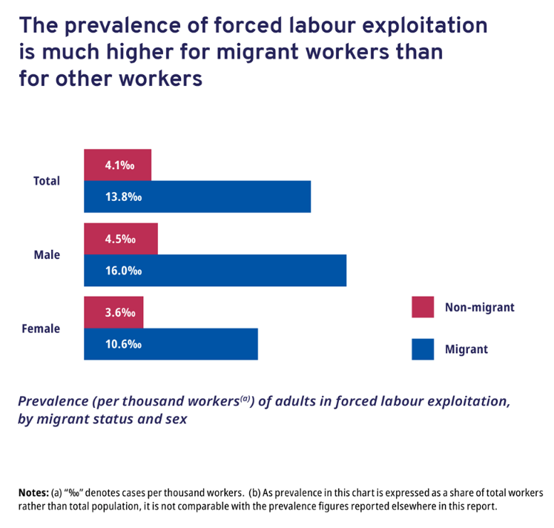
Forced labour & labour exploitation in the context of migration
14 out of every 1000 migrant workers are in forced labour in the private economy
Migrant workers are 3x as likely to be in forced labour as non-migrant workers
US$1.4 billion are attributed to illegal recruitment fees
Fair recruitment and decent work are connected. Lack of decent work > more labour intermediation > poor recruitment outcomes
Source: 2021 Global Estimates of Modern Slavery: Forced Labour and Forced Marriage
Notes:
DQ: What do you think do “forced labour” and “labour exploitation” mean?
(remember the definition from the beginning)
Answer: ILO definition = Forced labour is work that is performed involuntarily and under the menace of any penalty.
It refers to situations in which persons are coerced to work through the use of violence or intimidation, or by more subtle means such as manipulated debt, retention of identity papers or threats of denunciation to immigration authorities.

Slide 25
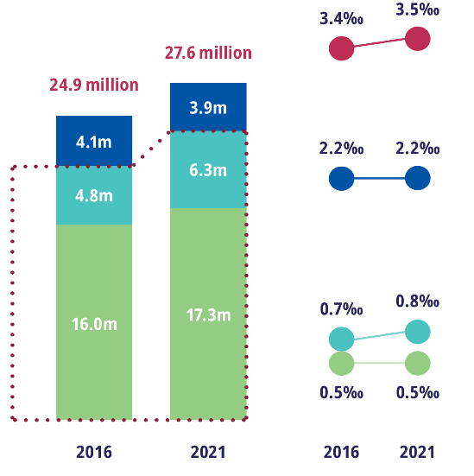
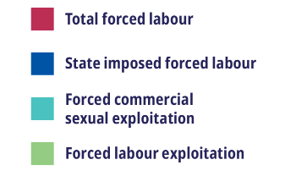
Recruiting migrant workers
Risks and Exploitation
Migrant workers face higher risks of exploitation. Of all workers in forced labour, 15% are migrants.
Recruitment Abuses
Abuses in recruitment include illegal fees, deception, contract substitution, passport retention, wage deductions, and threats.
© ILO & IOM 2021 Global Estimates of Modern Slavery: Forced Labour and Forced Marriage
Notes:
Note that the increase in forced labour is due to the private sector – the green part – and not the state.
Examples: private sector (green) = construction in Qatar, state-imposed (blue) = cotton picking in Uzbekistan

Slide 26
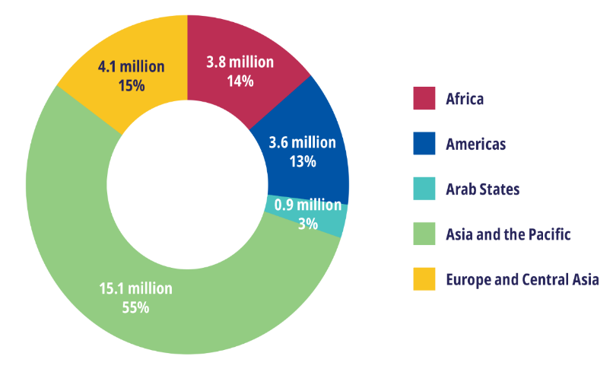
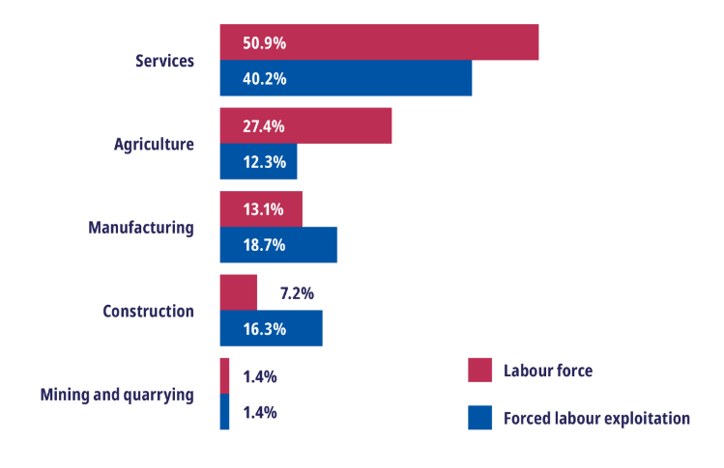
Link between forced labour, migration and fair recruitment
G L O B A L T R E N D S
Forced labour by region: percentage distribution
Distribution of adults in the global labour force and adults in forced labour exploitation, by sector
© 2021 Global Estimates of Modern Slavery: Forced Labour and Forced Marriage
Notes:
Especially on the graph on the right, you see that the proportion of forced labour is alarming.
What is the services sector?
= providing people with intangible products or services
Examples: hospitality sector (restaurants and hotels), maintenance and repair, cleanliness and sanitation

Slide 27
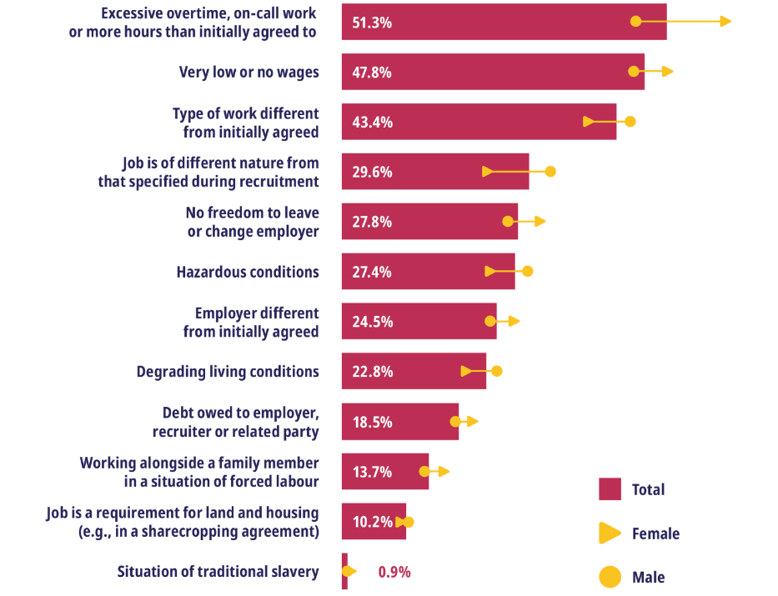
Link between forced labour, migration and fair recruitment
D E S A G R E G A T E D D A T A
% of adults in forced labour / exploitation (experiencing conditions leading to involuntariness)
© 2021 Global Estimates of Modern Slavery: Forced Labour and Forced Marriage
Notes:
Let’s take a look at what labour exploitation actually means.
Many of the factors of labour exploitation are linked to recruitment, such as excessive overtime and low wages.

Slide 28
Agenda
Unit 1 – Setting the stage
Unit 2 – Labour migration and forced labour at a glance
Unit 3 – Understanding fair recruitment and the ILO approach
Unit 4 – Business decisions to ensure fair recruitment
Notes:
Fair recruitment addresses many of the root causes of migrants’ vulnerabilities.
Second half of the course: focus on understanding and addressing vulnerabilities –
What regulations are in place to protect migrants (e.g., ILO approach, company approaches, VINCI case study)

Slide 29
ILO approach to labour migration
ILO mandate: promote employment and protect workers
ILO does not promote or discourage migration – migration as a fact of labour markets worldwide
Most migration is directly or indirectly related to the world of work
Migration is often the result of decent work deficits in the countries of origin; migration should be a choice, not a necessity
Interest in migrants as workers – applying labour migration tools to improve governance + protection
There is a disconnect between labour market realities and labour migration policy
Promote protection of migrant workers via equality principles + recognize unique vulnerabilities
Include refugees and forcibly displaced people: Focus on access to the labour market; include migrant workers in an irregular situation

Slide 30
International framework and initiatives on recruitment
ILO Fundamental Conventions (C87, C98, C29, C105, C138, C182, C100, C111)
ILO Employment Instruments (C88, C181)
ILO Migration for Employment Instruments (C143 and C97)
ILO Sectoral Instruments (MLC, C188, C189)
Tripartite negotiated guidance
General Principles and Operational Guidelines for Fair Recruitment
Definition of Recruitment Fees and Related costs
Operationalisation Strategies and tools:
ILO’s Fair Recruitment Initiative
IOM IRIS (and Montreal Recommendations)
ITUC Migrant Recruitment Advisor
Multi-stakeholder initiatives – Employer Pays Principle, ILO Business Network on Forced Labour, …

Slide 31
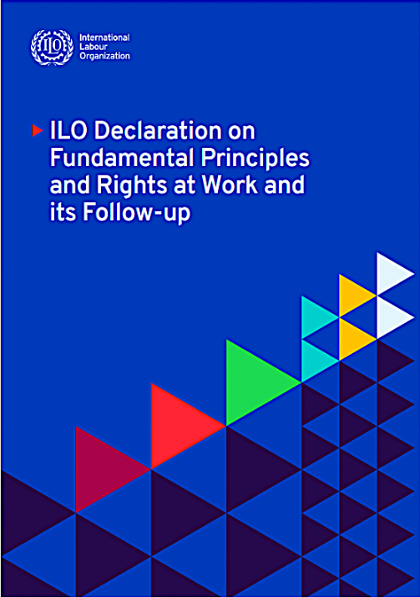
International legal framework
Fundamental principles and rights at work
Freedom of association and the effective recognition of the right to collective bargaining
Elimination of all forms of forced or compulsory labour
Effective abolition of child labour
Elimination of discrimination in respect of employment and occupation
Safe and healthy working environment
© 2021 Global Estimates of Modern Slavery: Forced Labour and Forced Marriage
Notes:
Relevant everywhere (indep of ratification)
The legal and normative framework for fair recruitment supports member states to guarantee the protection of migrant workers and promote fair recruitment processes.
International migrant workers are protected by different international legal instruments which have varying degrees of ratification and focus on the human and labour rights of migrant workers.
Fundamental principles and rights at work
Of most general application is the ILO’s Declaration on Fundamental Principles and Rights at Work. The ILO’s Declaration on Fundamental Principles and Rights at Work is applicable to migrant workers, independently of their legal status. The 4 fundamental principles include:
a) Freedom of association and the effective recognition of the right to collective bargaining;
b) The elimination of all forms of forced or compulsory labour;
c) The effective abolition of child labour; and
d) The elimination of discrimination in respect of employment and occupation.
Conventions on the rights of migrant workers: The 2014 Protocol to the Forced Labour Convention provides guidance in the area of forced labour, which is still prevalent in the 21st century and can result from fraudulent and abusive practices that have take place in the recruitment phase of migration.
What are the core legal instruments related to Fair Recruitment?
Fair recruitment is covered in multiple International Labour Standards, inc ILO’s 8 Fundamental Conventions
Fair recruitment provisions also feature in a number of specific legal instruments. Including those covering forced labour, employment, migration, and instruments addressing specific sectors
Fair recruitment rights are also protected for under conventions that are relevant due to the thematic or sectoral focus:
International labour standards and international instruments with specific focus on migrant workers:
No.97 – Migration for Employment Convention (Revised), 1949 (No. 97) stipulates that each Member State must ensure adequate services to assist migrants for employment
No. 143 Migrant Workers (Supplementary Provisions) Convention, 1975 (No. 143) – intended to combat migration in abusive conditions and to promote equality of opportunity and treatment for migrant workers (including those in irregular migration situation)
International Convention on the Protection of the Rights of All Migrant Workers and Members of Their Families, 1990
Other international labour standards of particular relevance - ILO employment instruments:
Employment Service Convention 1948 (No. 88)
Private Employment Agencies Convention 1997 (no. 181)
These recognise the role of private employment agencies and the need to protect workers
ILO sectoral instruments relevant to the recruitment landscape as well
Maritime Labour Convention 2006
ILO Work in Fishing Convention 2007
ILO Domestic Workers Convention 2011

Slide 32
International legal framework
International labour standards
Thematic instruments
Sectoral instruments
Other instruments
ILO Migration for Employment Instruments, 1949 (No. 97)
Maritime Labour Convention 2006
Employment Service Convention 1948 (No. 88)
Migrant Workers (Supplementary Provisions) Convention, 1975 (No. 143)
ILO Work in Fishing Convention 2007
Private Employment Agencies Convention 1997 (No. 181)
International Convention on the Protection of the Rights of All Migrant Workers and Members of Their Families, 1990
ILO Domestic Workers Convention 2011
Notes:
The legal and normative framework for fair recruitment supports member states to guarantee the protection of migrant workers and promote fair recruitment processes.
International migrant workers are protected by different international legal instruments which have varying degrees of ratification and focus on the human and labour rights of migrant workers.
Fundamental principles and rights at work
Of most general application is the ILO’s Declaration on Fundamental Principles and Rights at Work. The ILO’s Declaration on Fundamental Principles and Rights at Work is applicable to migrant workers, independently of their legal status. The 4 fundamental principles include:
a) Freedom of association and the effective recognition of the right to collective bargaining;
b) The elimination of all forms of forced or compulsory labour;
c) The effective abolition of child labour; and
d) The elimination of discrimination in respect of employment and occupation.
Conventions on the rights of migrant workers: The 2014 Protocol to the Forced Labour Convention provides guidance in the area of forced labour, which is still prevalent in the 21st century and can result from fraudulent and abusive practices that have take place in the recruitment phase of migration.
What are the core legal instruments related to Fair Recruitment?
Fair recruitment is covered in multiple International Labour Standards, inc ILO’s 8 Fundamental Conventions
Fair recruitment provisions also feature in a number of specific legal instruments. Including those covering forced labour, employment, migration, and instruments addressing specific sectors
Fair recruitment rights are also protected for under conventions that are relevant due to the thematic or sectoral focus:
International labour standards and international instruments with specific focus on migrant workers:
No.97 – Migration for Employment Convention (Revised), 1949 (No. 97) stipulates that each Member State must ensure adequate services to assist migrants for employment
No. 143 Migrant Workers (Supplementary Provisions) Convention, 1975 (No. 143) – intended to combat migration in abusive conditions and to promote equality of opportunity and treatment for migrant workers (including those in irregular migration situation)
International Convention on the Protection of the Rights of All Migrant Workers and Members of Their Families, 1990
Other international labour standards of particular relevance - ILO employment instruments:
Employment Service Convention 1948 (No. 88)
Private Employment Agencies Convention 1997 (no. 181)
These recognise the role of private employment agencies and the need to protect workers
ILO sectoral instruments relevant to the recruitment landscape as well
Maritime Labour Convention 2006
ILO Work in Fishing Convention 2007
ILO Domestic Workers Convention 2011

Slide 33
Labour migration cycle
Job opportunity
Return to country of origin
Selection
At each stage, there might be recruitment fees extracted from workers
Placement
Pre-departure
Notes:
According to the ILO, the term “recruitment” includes the advertising, information dissemination, selection, transport, placement into employment and – for migrant workers – return to the country of origin where applicable. This applies to both jobseekers and those in an employment relationship.
It involves different steps and possible unfair practices (including the charging of fees) in each phase of the process.
Job opportunities: recruitment starts when information on the existence of a job opportunity is shared. Unfair practices such as deception can happen at that moment, for example through the publication of false promises or information about the terms and conditions of employment.
Selection, pre-departure and placement into employment: Recruitment processes can be complex and involve different private or public actors. The more intermediaries there are between the employer and the worker, the more risks there are of unfair practices.
Return to the country of origin: For international migrant workers, recruitment does not end with the termination of the contract in the country of destination. The safe return to the country of origin is an integral part of the recruitment process.

Slide 34
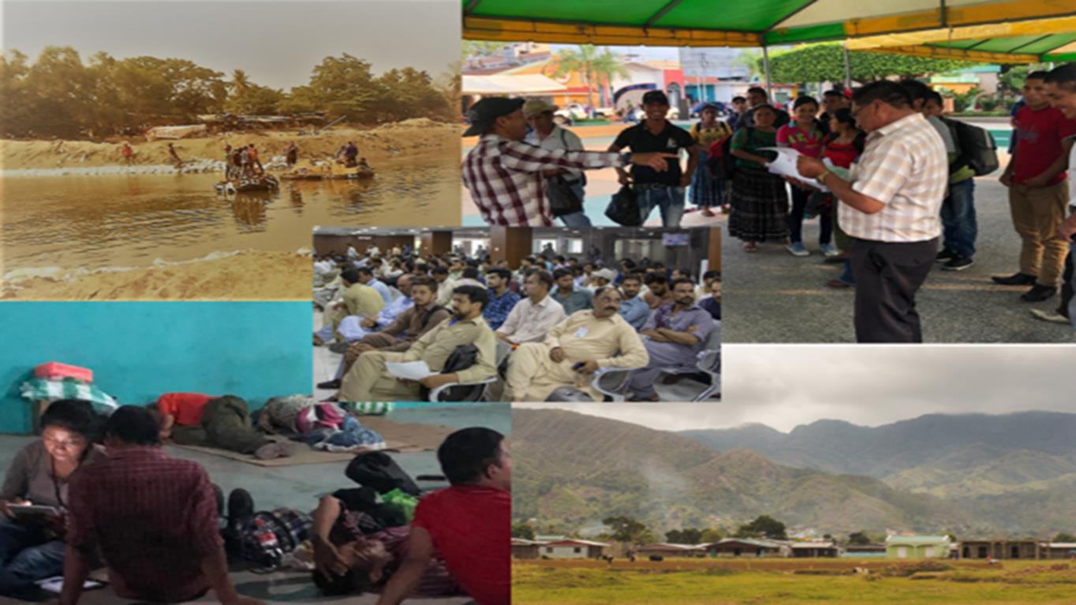
What does recruitment look like in practice?

Slide 35
Recruitment in the context of labour migration
What is an unfair recruitment in the context of labour migration ?
Notes:
Recruitment:
Recruitment includes advertising, information dissemination, selection, transport, placement into employment and – for migrant workers – return to the country of origin where applicable – applies to both jobseekers and those in an employment relationship
Recruiters are middlemen/intermediaries between job seekers and organisations looking to fill positions. Labour recruiters refer to both public employment services and to private employment agencies and all other intermediaries or subagents that offer labour recruitment and placement services. Labour recruiters can take many forms, whether for profit or non-profit, or outside legal and regulatory frameworks.
Can operate within a country’s borders or across borders.
Recruitment landscape is complicated and involves a wide range of actors > regulated and unregulated
When appropriately regulated, public and private employment agencies play an important role in the efficient and equitable functioning of labour markets
They match available jobs with suitability qualified workers
HOWEVER: concerns have been raised about unscrupulous employment agencies and informal labour intermediaries and other operators acting outside the legal & regulatory framework
Unregulated recruiters carry out UNFAIR recruitment practises
Unfair recruiters TARGET especially LOW-SKILLED workers
Placing them at risk of HT and FL
National and migrant workers at risk of facing abuse during recruitment phase

Slide 36
Recruitment in the context of labour migration
Potential forms of abusive recruitment practices
Pre-departure
Illegal recruitment fees and related costs, and corruption
Debts and high interest rates
Deception and fraud
In destination
Contract substitution
Retention of passports or travel documents
Non-payment and deduction of wages/ wage theft
Debt bondage linked to repaying recruitment fees and costs
Threats if workers want to leave their employers, fears of subsequent arrest, expulsion or deportation from the country of employment
Workers are tied to the employers through their work permits and restrictions on employer changes

Slide 37
Recruitment in the context of labour migration
What can be a recruitment cost ?

Slide 38
Recruitment cost indicator (RCI)
# of work months it would take for a migrant worker to cover recruitment costs for their job abroad
Disclaimer: These figures indicate how much recruitment costs can vary in different countries of origin. The data is not comparable data across countries:
Cost can vary widely within a country and differ depending on the country of destination, the economic sector or the demand for a particular skill set or occupation.
All data was collected through sample surveys. Pilots are not necessarily nationally representative. The graph should be interpreted as illustrative of differences in scale rather than giving national estimates per country.
Lao PDR
Ghana
0.33
0.32
2.1
2.0
Average 0.33
Average 2.1
Vietnam
ILO,2019
Bangladesh
ILO,2019
Maldives
7.6
7.2
7.8
15.1
3.9
8.3
Average 7.4
Average 11.45
Average
8.2
ILO, 2022
LFS Bangladesh, 2022
Maldives Bureau of Statistics, 2019
Notes:
A key indicator that measures the recruitment cost of migrants is the Recruitment Cost Indicator (RCI), which is defined as the number of months it would take for a migrant worker to offset the recruitment cost incurred as a result of migrating to another country to work.
Lao PDR : 0.33 work months for female is equal to about 6.6. work days and the male is 6.4 work days. Thus, the average is about 6.6 work days Mexico: is basically not up to 1 day ***** In the Maldives, recruitment costs as a proportion of monthly earnings were lowest for those with no education (2.3 months), followed by certificate or diploma holders (3.5 months), while migrants with primary, secondary, or higher secondary education levels faced costs exceeding the national average (8.2 months), with those having higher secondary education requiring almost one and a half years to recover the recruitment expenses."

Slide 39
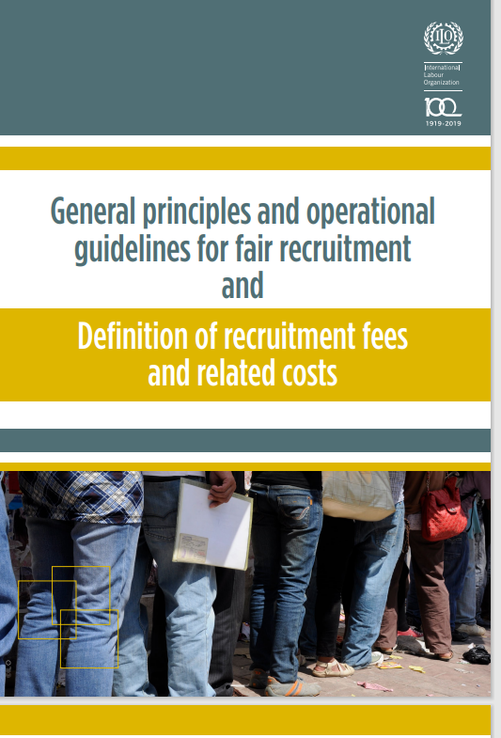
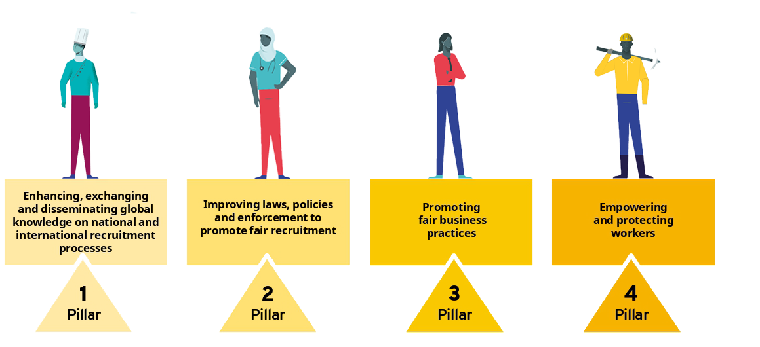
Fair recruitment initiative
© International Labour Organization, 2021, Fair Recruitment Initiative Strategy 2021-2025

Slide 40
Fair recruitment initiative
Aims:
Help prevent human trafficking and forced labour,
Protect the rights of workers, including migrant workers, from abusive and fraudulent practices during the recruitment process, and
Reduce the cost of labour migration and enhance development outcomes for migrant workers and their families, as well as for countries of origin and destination
Notes:
The Fair Recruitment Initiative (FRI) was launched in 2014 by the ILO within a broader call for a Fair Migration Agenda.
The FRI aims to
(i) help prevent human trafficking and forced labour,
(ii) protect the rights of workers, including migrant workers, from abusive and fraudulent practices during the recruitment process, and
(iii) reduce the cost of labour migration and enhance development outcomes for migrant workers and their families, as well as for countries of origin and destination
After a first phase (2014-2019), the initiative is implementing its second phase for the 2021-2025 period.
The work is currently structured around 4 interconnected pillars with the aim of creating an environment where the recruitment of workers – and notably international migrant workers – is safe and respectful of their fundamental rights:
Pillar 1 – Enhancing, exchanging and disseminating global knowledge on national and international recruitment processes
Pillar 2 – Improving laws, policies and enforcement to promote fair recruitment
The ILO has produced standard guidance and definition to inform the work on fair recruitment of governments, international organizations, and other stakeholders
General principles and operational guidelines for fair recruitment and Definition of recruitment fees and related costs (see following slide)
Pillar 3 – Promoting fair business practices
The ILO is working with governments, organizations, and local businesses to promote fairer and safer recruitment practice by the private sector. This work has led to the development of several resources by the ILO or its partners
Pillar 4 – Empowering and protecting workers
The ILO has worked globally to help develop new resources and increase the capacity of partners to improve their outreach in order to empower and protect workers’ rights. A noteworthy example is the Recruitment Advisor, a global recruitment and employment review platform that gives potential workers easy access to information about recruitment agencies and workers’ rights when they begin looking for jobs abroad. The platform was developed collaboratively by governments, migrant workers associations and unions to evaluate agencies practices and build trust amongst the working communities. https://www.recruitmentadvisor.org

Slide 41
Fair recruitment initiative
Benefits of fair recruitment
For employers and recruitment agencies
Better job-skill matching Efficiency
Productivity gains and staff retention
Regulatory and cost transparency
Professionalization of the industry
For workers
Access to decent work
Transparency
No recruitment debt
Understanding of employment contract and working conditions
Access to services
Less vulnerable
For governments
Enabling labour market functioning
Policy and regulatory clarity
Protection of workers
Development contributions made by migrant workers

Slide 42
Agenda
Unit 1 – Setting the stage
Unit 2 – Labour migration and forced labour at a glance
Unit 3 – Understanding fair recruitment and the ILO approach
Unit 4 – Business decisions to ensure fair recruitment

Slide 43
Why fair recruitment matters for businesses
Reduce employee turnover rate
Ensure the resilience of global supply chains
Preserve companies’ reputation whilst attracting talents, consumers and investors
Drive positive change and elevate industry standards
Avoid sanctions targeting products of forced labour (ex. US tariff Act)
The risks associated with non-compliance with international labour standards, national laws and regulations, including potential legal liabilities, are substantial.
© https://www.accessnow.org/revised-draft-u-n-treaty-on-business-and-human-rights-a-few-steps-forward-a-few-unanswered-questions/

Slide 44
Trends: FRI in supply chains
Two major themes:
Labour and skills shortages
Forced labour
Current company responses:
Increased focus on due diligence
Repayment of recruitment fees and related costs (remediation efforts)
Varying progress in different sectors
Advancing social justice, promoting decent work

Slide 45
What can a company do to ensure fair recruitment and reduce the risks associated to unfair recruitment?
General principles
At the company level
Implement a fair recruitment policy aligned with ILO guidelines, ensuring zero recruitment fees
Build a transparent overview of all actors involved in the recruitment of workers
Increase direct involvement and closely monitor every step of the recruitment process
Provide clear communication to workers
Maintain involvement with workers after recruitment
ILO Toolbox “How do fair recruitment practices help prevent the risk of forced labour”
Notes:
Possible actions (1/3):
Adopt a fair recruitment policy which is aligned to the ILO General Principles and Operational Guidelines for Fair Recruitment, including a policy on zero recruitment fees and related costs.
Build a transparent overview of all actors involved in the recruitment of workers.
Carry out comprehensive human rights due diligence assessments of business partners who provide recruitment services.
Support company, labour recruiter and sub-agent capacity-building.
Increase direct involvement and closely monitor every step of the recruitment process.
Develop third-party independent and human-rights based monitoring of recruitment within communities of origin.
Require disclosure of recruitment partners and key practices.

Slide 46
What can a company do to ensure fair recruitment and reduce the risks associated to unfair recruitment?
General principles
With workers
Interview workers on arrival and post-arrival
Provide access to a third-party helpline to all candidates during their recruitment journey (within 3-6 months) in a safe and confidential environment
Raise migrant workers’ awareness of their right to fair recruitment through community engagement, mandatory orientation programs
Reimburse recruitment fees and related costs to all affected workers
ILO Toolbox “How do fair recruitment practices help prevent the risk of forced labour”
Notes:
Possible actions (2/3):
Interview workers on arrival and post-arrival (within 3-6 months) in a safe and confidential environment, to provide them the opportunity to disclose details around any recruitment fees and costs paid, and/or any intimidation faced.
Suppliers may contract directly with source-country labour recruiters where possible.
Establish service-level agreements with suppliers, labour recruiters and subagents which clearly communicate that the costs of recruitment are covered by the company and that workers should not pay fees as part of the recruitment process.
Engage with labour recruiters and/or sub-agents to understand their costs and profit margin in detail and pay agents sufficient service fees (administration and/or profit margins) to reduce risk of fee-charging to workers.
Pay service fees to labour recruiters up front to reduce risk of fee charging to workers – as all costs are borne by the recruitment agency prior to the candidates starting work.

Slide 47
What can a company do to ensure fair recruitment and reduce the risks associated to unfair recruitment?
General principles
Concerning outsourced activities
Develop third-party independent human-rights based monitoring of recruitment within communities of origin
Require disclosure of recruitment partners and key practices
Suppliers may contact directly with source-country labour recruiters where possible
Establish service-level agreements with suppliers, labour recruiters and subagents which clearly communicate that the costs of recruitment are covered by the company
Engage with labour recruiters and/or sub-agents to understand their costs and profit margin in detail and pay agents sufficient service fees
Pay service fees to labour recruiters up front to reduce risk of fee charging to
ILO Toolbox “How do fair recruitment practices help prevent the risk of forced labour”
Notes:
Possible actions (3/3):
Raise migrant workers’ awareness of their right to fair recruitment through community engagement.
Raise migrant workers’ awareness of their rights and how to seek support both pre- and post-arrival by introducing mandatory orientation programmes.
Provide clear communication to workers – both verbally and in writing in a language they understand– regarding recruitment and employment.
Maintain involvement with workers after recruitment is completed, to provide them with opportunities to disclose the payment of fees, if applicable.
Provide access to a third-party helpline to all candidates during their recruitment journey and ensure that they know to report any fee payment requests or other forms of recruitment-related exploitation to the helpline.
Reimburse recruitment fees and related costs to all affected workers.

Slide 48
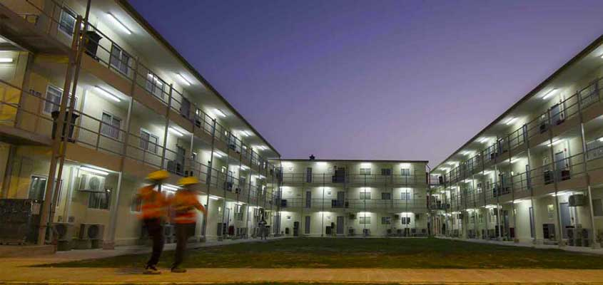
Case study: VINCI in Qatar
Seeking to respect human rights in a challenging operating context
Discuss:
what aspects of the project or process were successful,
what challenges were encountered,
what areas require ongoing monitoring and improvement.
Develop recommendations that could be provided to VINCI and other companies.
©VINCI denies the accusations made about working conditions on its work sites in Qatar, and will continue to cooperate with the courts (07/11/2022) - Press releases - Media [VINCI]
Notes:
Any questions about the video and website you prepared for class?
------------------------------
Last week’s homework in preparation for today’s class:
Think about these question:
What are elements of fair recruitment at VINCI?
What does VINCI do differently?
Critical discussion:
What are limitations of VINCI’s approach?
Why don’t more companies do this?

Slide 49
Context: VINCI pre-pilot action against forced labor risks in Qatar
QDVC, a joint venture between VINCI and Qatari Diar, specializing in designing and building of large-scale infrastructure projects for Qatar’s domestic market
Who?
“Employer Pays policy”
since 2007
Strengthening of due diligence since 2015
…including in the supply chain
Recruitment of migrant workers
Contracts with agencies mandating no fees to be charged to workers.
Paying recruitment agencies the equivalent of one month’s salary per worker.
Direct recruitment drive in 2015-16: 1,133 workers from India, Bangladesh, Philippines
Per worker recruitment service charge covering recruitment agencies' costs and profit margin.
Recruitment process monitored at every step.
Audits of temporary work agencies and subcontractors
Recruitment policies reviewed
Supply chain workers interviewed
Improved employment practices, working and living conditions.
What?
YET debt bondage observed for migrant workers.
Risks reduced for the majority of direct workers (91% did not pay fees).
YET difficulty to change recruitment practices in the supply chain.
Notes:
Speaker : H.McCool (VINCI)
2015: 177 workers interviewed (after between 1 and 8 years of employment)
2017: 538 workers interviewed (2 years after recruitment)

Slide 50
Construction supply chain and actors involved in the pilot project
A wide range of stakeholders participated in the pilot project:
Qatar Ministry of Administrative Development, Labour and Social Affairs (ADLSA)
ILO Qatar Project Office
General contractor (VINCI/QDVC)
Manpower agency of QDVC in Qatar (STS)
Recruitment agency in Bangladesh (Bonanza)
+ Full in-depth audit by Verité
+ Moderation by the Fair Hiring Initiative
Notes:
Speaker: Niyama Rai (ILO)

Slide 51
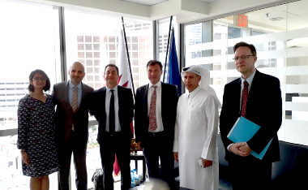
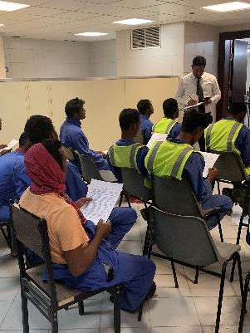
Fair recruitment pilot project building blocks
Impact assessment
Thorough research conducted by Tufts University to assess impact on workers and employer
Recruitment of workers
Recruitment of 142 workers carried out from Bangladesh using action plan and tools developed through the capacity building
Signature of a Public-Private Partnership between QDVC and the ILO Project Office in Qatar, 2018
Capacity building
Tailored training sessions and regular feedback provided based on audit findings
Independent audit
Qatar sub-contractor and Bangladesh private employment agency
Workers’ interview for the impact assessment, Doha, Qatar, 2019
Capacity-building workshop in Doha, Qatar, 2018

Slide 52
Impact on fees and costs paid by workers
 | Before | After
Average recruitment fees and related costs | USD 3,408 | USD 300
Let’s look deeper!
Service fee to recruitment agency | USD 158 | USD 0
Service fee to sub-agent | USD 828 | USD 46
Travel and lodging | USD 101 | USD 69
Who did workers pay to get the job?
Family member | 6% | < 1%
Friend | 6% | 2%
Local community | 66% | 14%
Sub-agent | 16% | 6%
Private employment agency | 26% | 0%

Slide 53
Looking beyond fees and costs
 | Before | After
Debt upon arrival in Qatar | 55%¹ | 7%²
Unaware of working hours and pay | 10% | 0%
Contract changed | 35% | 8%
Notes:
Footnotes:
¹ After 2 years of working in Qatar
² After 1 ½ years of working in Qatar
³ Within the first 18 months of arrival

Slide 54
Impact achieved and multiple tools developed
Tools shared by QDVC
or developed during the pilot
Concrete impact
Increased supply of fairly recruited workers manpower and recruitment agencies following ILO Fair Recruitment principles who changed their business model.
Placement agencies that VINCI and the industry in Qatar can trust, equipped to assess and reduce risks early in the process.
Improved visibility over recruitment practices in the sector.
Cost Distribution Matrix.
Service agreement template between the contractor/placement agency and the recruitment agency.
Cartography of the recruitment process and associated risks.
Draft incentive scheme for agents and sub-agents.
Pre-departure orientation sessions and videos for workers.
Grievance & remediation mechanisms.
Notes:
Speaker: Henriette McCool (VINCI)

Slide 55
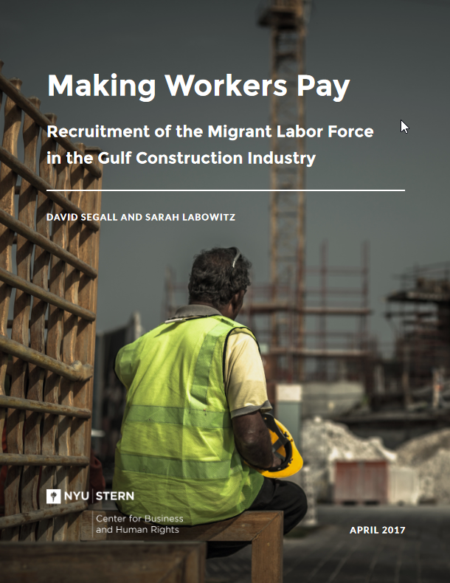
Insights from the Gulf construction industry
Despite legislative reforms and commitments to eliminate recruitment fees for workers, worker-paid fees remain common. Reasons include:
Culture of permissiveness for illegal visa selling practices by firms
Lack of transparency and number of transactions around recruitment – mark-ups at every stage lead to inflated costs for recruitment
Many layers of formal and informal recruitment – Subagents are essential for recruiting migrant workers, yet there is often no paper trail documenting migrants’ transactions with subagents
About the report: Based on 18 months of research into the link between corporate practices in the Arabian Gulf’s engineering and construction sector and the recruitment of many of the migrant workers who staff the industry’s projects, including field missions to India, Bangladesh, Qatar, and the UAE.
David Segall and Sarah Labowitz (April 2017), “Making Workers Pay: Recruitment of the Migrant Labor Force in the Gulf Construction Industry”, NYU Stern Center for Business and Human Rights. https://bhr.stern.nyu.edu/wp-content/uploads/2024/03/FINALFINAL-MakingWorkersPay-Report-Print1.pdf
Notes:
NYU Stern report (2017)
GCC = Gulf Cooperation Council (GCC) – Saudi Arabia, the United Arab Emirates (UAE), Qatar, Kuwait, Bahrain, and Oman
Reasons for recruitment cost inflation
- mark-ups at every transaction, incl. for medial screenings, skills testing, document processing etc.
Layers of formal and informal recruitment
Gulf-based agents – agents procure demand letters for laborers for South Asia-based recruiters, operate illegally or legally (e.g., for locating domestic workers)
South Asia-based urban recruiters – companies registered and authorized by their governments to process and facilitate migration (e.g., receive demand letters for workers from GCC-based firms or sometimes Gulf-based agents), coordinate a recruitment process to deliver the required workers.
Subagents in South Asia – mostly unregistered, independently operating individuals based in rural villages and district centers (e.g., with personal connections to pools of prospective migrants), identify and collect the required number of workers on behalf of larger recruitment agencies

Slide 56
Insights from the Gulf construction industry
Recommendations for companies:
Assess the real costs of recruitment for each stage of the recruitment process to support an industry-wide fee-for-service model with appropriate cost controls.
Pay for all recruitment-related services. Project bids to clients should account for all costs of recruiting – these costs amount to only a fraction of the overall project cost.
Audit recruitment hubs in South Asia to spot-check whether workers are being overcharged and penalize non-compliances.
Execute mutually-binding contracts with recruiters and provide complaint mechanisms.
Disrupt the visa-selling system in Gulf states by auditing visa issuance procedures.
David Segall and Sarah Labowitz (April 2017), “Making Workers Pay: Recruitment of the Migrant Labor Force in the Gulf Construction Industry”, NYU Stern Center for Business and Human Rights. https://bhr.stern.nyu.edu/wp-content/uploads/2024/03/FINALFINAL-MakingWorkersPay-Report-Print1.pdf
Notes:
Common counter-argument:
Is it too expensive for companies to pay for recruitment? No! Recruitment fees are only 1% of the total project cost.
Recruitment related costs include, e.g., document processing fees, worker travel, and service fees to subagents. Companies should pay for the recruitment for all workers at all skill levels.
----------------------------
NYU Stern report (2017):
Key findings:
Low-wage workers pay for their own recruitment.
Workers pay significantly in excess of the real cost of recruitment.
Corporate representatives effectively sell visas to recruiters, in violation of GCC laws.
Layers of agents facilitate migration while increasing costs.
While subagents add to recruitment costs, they are essential to recruiting rural workers.
Even small transactions present the opportunity to charge workers.

Slide 57
Insights from the Gulf construction industry
Recommendations for clients:
(Co-)commission a study on the real cost of migration.
Only accept bids which accurately account for the cost of recruitment.
Give preference to contractors that provide proof of payment to recruiters.
Recommendations for governments in Gulf states:
Investigate and prosecute the sale of visas through demand letters.
Reform immigration and labor laws in line with international standards.
Enforce protective laws already on the books.
Recommendations for governments in South Asia:
Abolish or narrowly limit recruitment fees.
Legalize, license, and regulate subagents.
Sign all ILO and UN conventions that protect the rights of migrants.
David Segall and Sarah Labowitz (April 2017), “Making Workers Pay: Recruitment of the Migrant Labor Force in the Gulf Construction Industry”, NYU Stern Center for Business and Human Rights. https://bhr.stern.nyu.edu/wp-content/uploads/2024/03/FINALFINAL-MakingWorkersPay-Report-Print1.pdf
Notes:
GCC = Gulf Cooperation Council (GCC) – Saudi Arabia, the United Arab Emirates (UAE), Qatar, Kuwait, Bahrain, and Oman
----------------------------
NYU Stern report (2017):
Key findings:
Low-wage workers pay for their own recruitment.
Workers pay significantly in excess of the real cost of recruitment.
Corporate representatives effectively sell visas to recruiters, in violation of GCC laws.
Layers of agents facilitate migration while increasing costs.
While subagents add to recruitment costs, they are essential to recruiting rural workers.
Even small transactions present the opportunity to charge workers.

Slide 58
Thank you!

